Slide 1
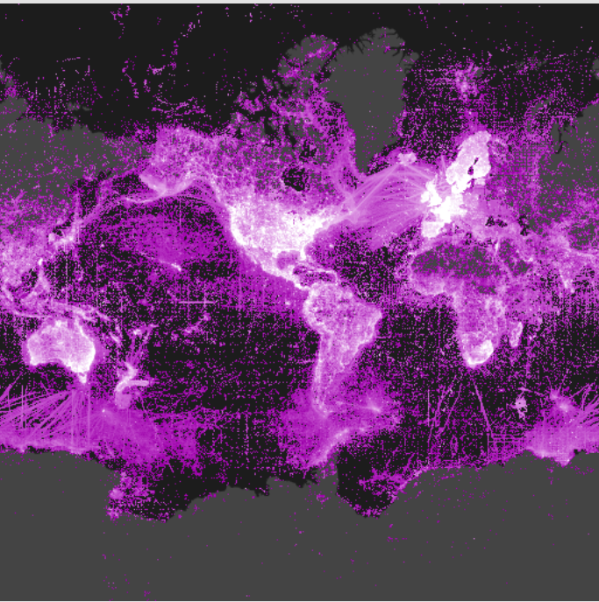

Slide 2
GBIF Initiatives on Data Quality
Dmitry Schigel Programme Officer for Content Analysis and Use GBIF Secretariat
Biodiversity Data Quality Symposium: Developing A Common Framework To Improve Fitness For Use Of Biodiversity Data — FAPESP, São Paulo, BRAZIL. 8 March 2016

Slide 3
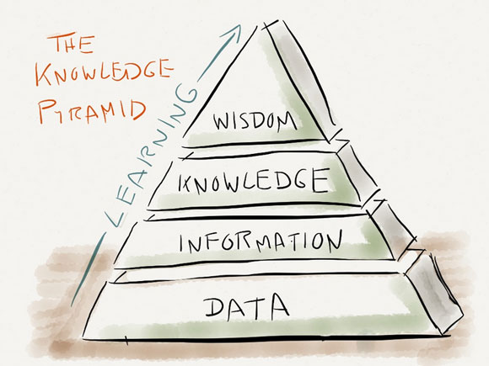
outline
Global biodiversity data
GBIF network
GBIF as a global scientific infrastructure
Brazil and biodiversity data
GBIF: fitness for use and data quality
Future prospects

Slide 4
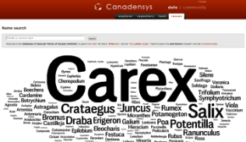
what
DATA SOURCES AND DATA USES
!?
Uses of biodiversity data
Taxonomy, conservation, biosecurity, land-use planning, climate change response, crop development, resource management, materials development, forensics …
!
!
Sources of biodiversity data
Collections, field observations, monitoring activities, genomics, citizen science, remote sensing, expert knowledge, historical literature, ...
www.gbif.org

Slide 5
Global Biodiversity Informatics Outlook
Models
Indicators
EBVs
GEO BON
Portals
Repositories
Curation
GBIF, DataONE,
ALA, EOL, CoL,
IUCN, WCMC,
GenBank, BOLD, ...
Digitisation
Field data
Remote-sensing
Museums
Universities
Govt. Agencies
Citizen Science
Standards
Best practices
Open data
RDA
TDWG
OGC
http://biodiversityinformatics.org/

Slide 6
GBIF network: partnerships and affiliations
http://www.gbif.org/whoweworkwith

Slide 7
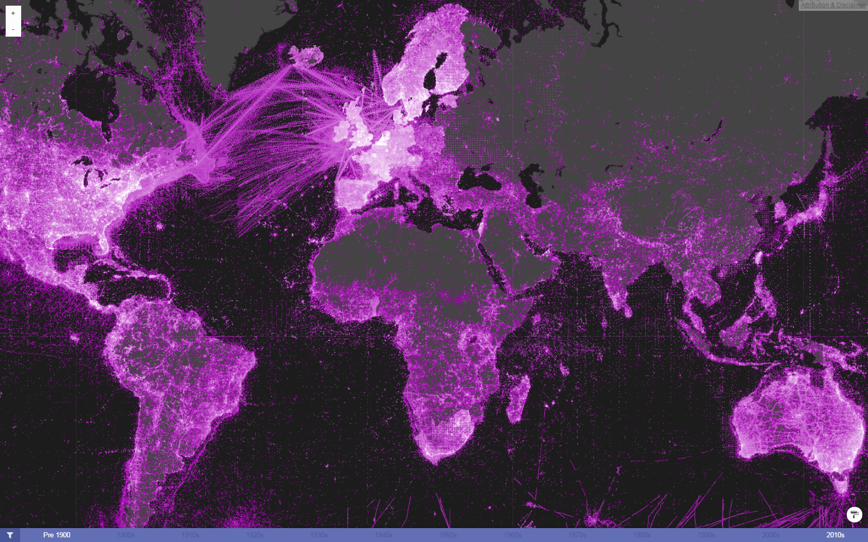
Global Biodiversity Information Facility
Data integration - >656 million records for open access download
Evidence of species occurrence in time and space – any source
Expanding to accommodate sample event / abundance data
Web service interfaces
http://www.gbif.org/

Slide 8
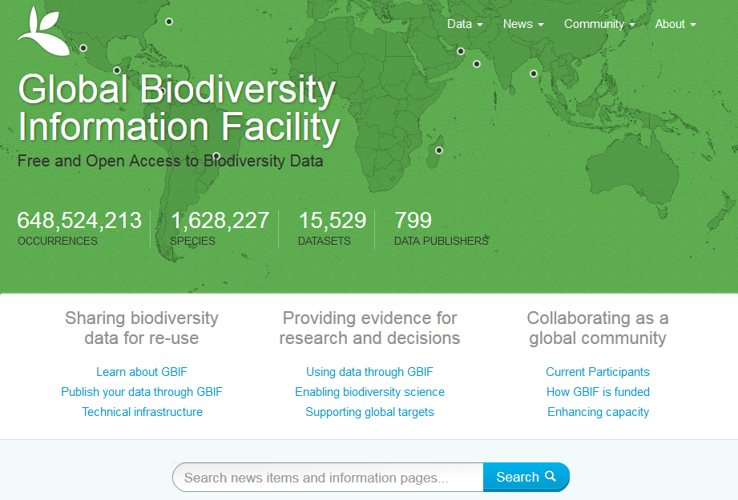
GBIF.org

Slide 9
Data published through GBIf.org
data mobilization
Occurrence records (millions)
http://www.gbif.org | 3 MAR 2016

Slide 10
Data publishers
data mobilization
Number of institutions registered as GBIF data publishers
. http://www.gbif.org | 3 MAR 2016

Slide 11
GBIF BY THE NUMBERS
648,781,852 species occurrence records
15,516 datasets
798 data-publishing institutions
http://www.gbif.org | 03 MAR 2016

Slide 12
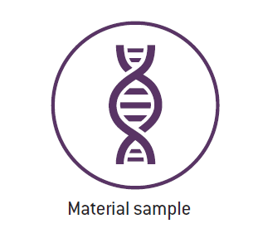
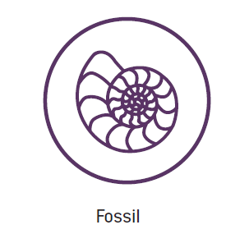
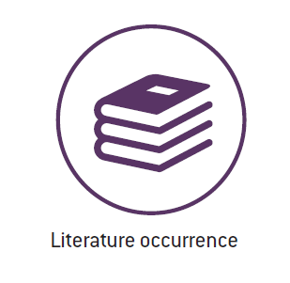
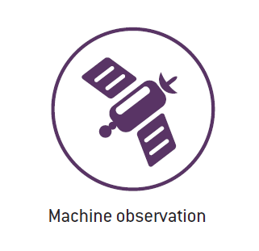
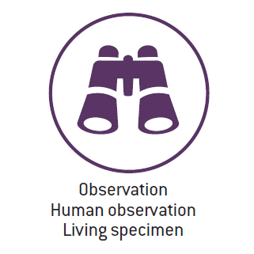
what
TYPES OF DATA SHARED THROUGH GBIF
New uses and new data quality dimensions
sample-based data
http://www.gbif.org/occurrence

Slide 13
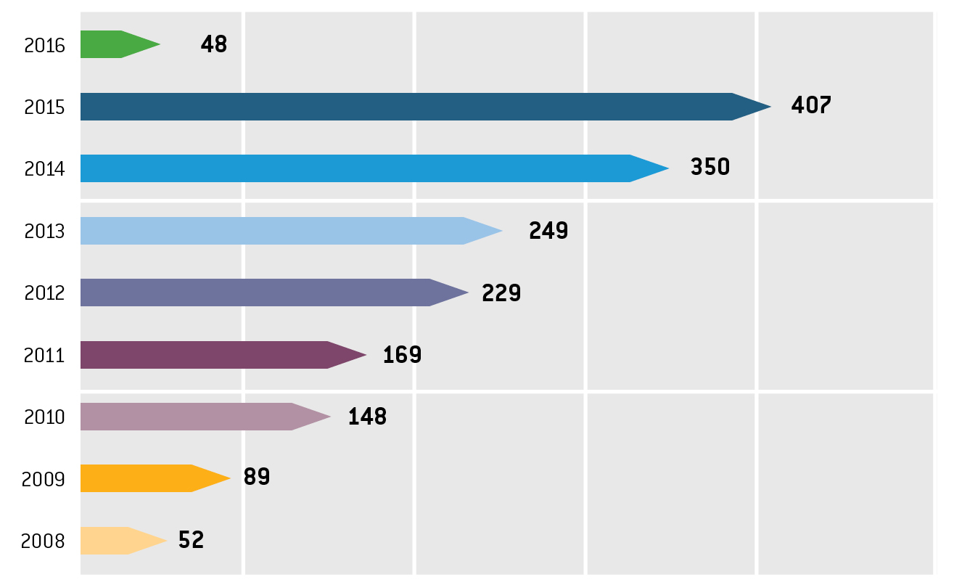
GBIF FOR SCIENCE
> 1 peer-reviewed publications a day
annual number of peer-reviewed publications using GBIF-mediated data
http://www.gbif.org/resources/3427

Slide 14
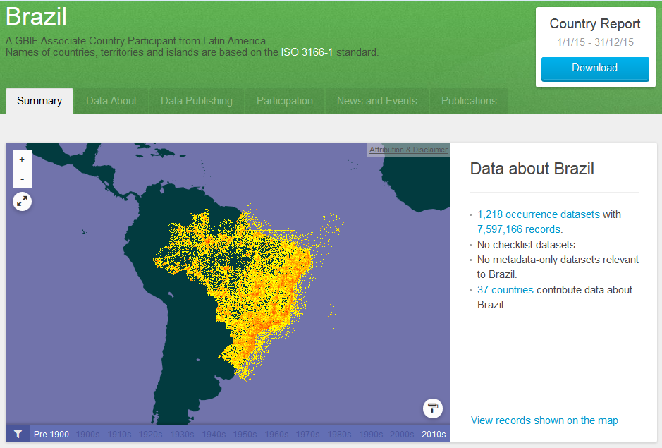
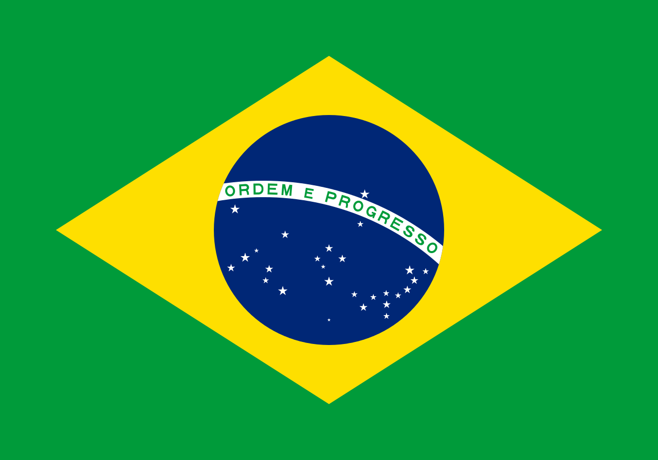
BRAZIL And Global Biodiversity DATA

Slide 15
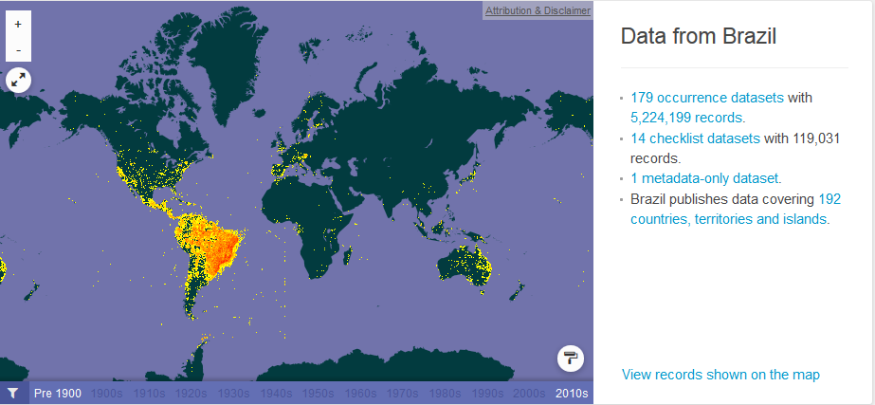
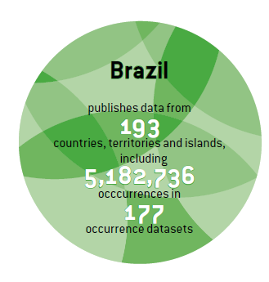
BRAZIL And Global Biodiversity DATA

Slide 16
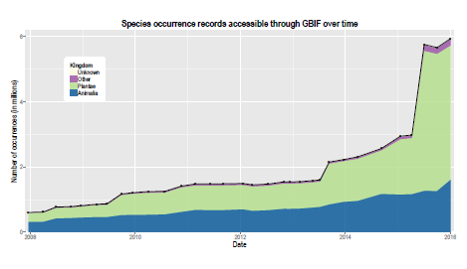
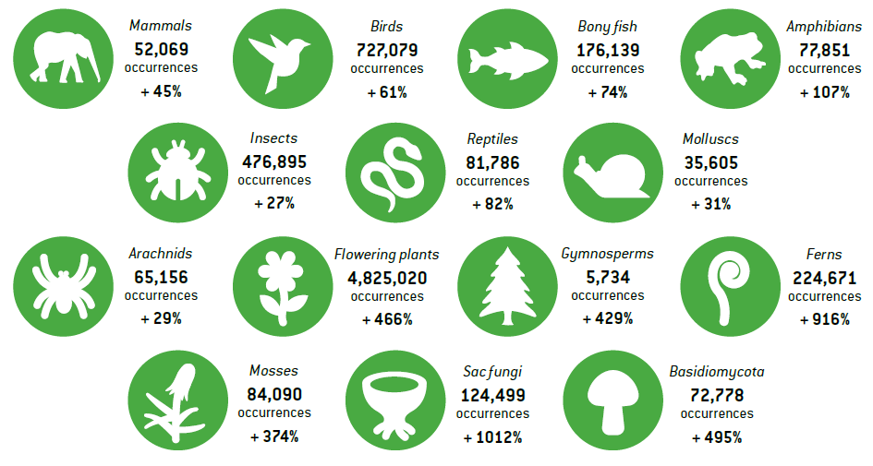
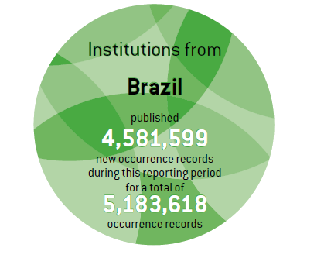
BRAZIL: A SUPERPUBLISHER COUNTRY

Slide 17
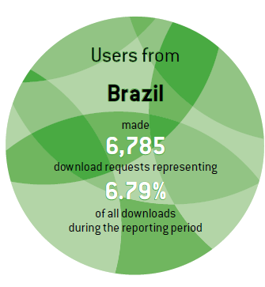
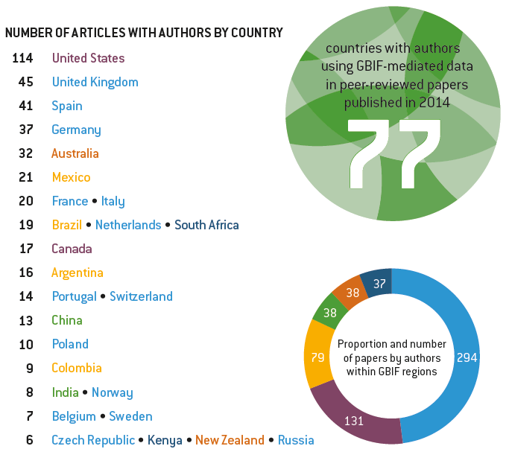
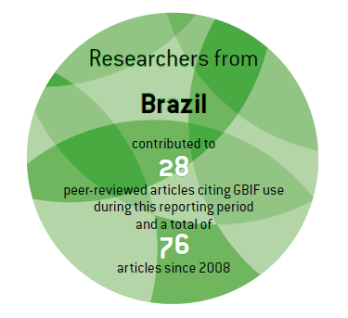
BRAZIL: A SUPERUSER COUNTRY

Slide 18
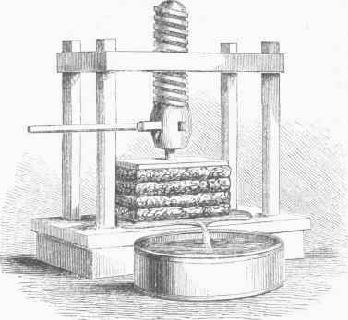
DATA QUALITY, ANALYSIS AND USE
Task groups on fitness for use consulting with pro communities: recommendations, best practices, data demands
Promoting data quality culture: talks, teaching, [publications]
TDWG / GBIF data quality interest group, chairs: Antonio Saraiva & Arthur Chapman
Join the work at the GBIF Community Site!
http://www.gbif.org/using-data

Slide 19
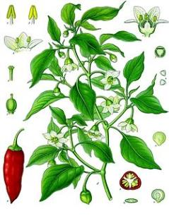
FITNESS FOR USE 2015: AGRO BIODIVERSITY
Agricultural biodiversity and GBIF
Elizabeth Arnaud (Chair), Jean Ganglo Cossi, Nora Patricia Castañeda-Álvarez, Dag Endresen, Ebrahim Jahanshiri, Yves Vigouroux
Survey of community needs
Final report on data needs and best practices ready
50 recommendations, incl. 7 top priorities
Use cases and template to collect more
http://www.gbif.org/resource/82283

Slide 20
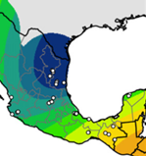
FITNESS FOR USE 2015: DISTRIBUTION MODELLING
Distribution modelling and GBIF
Jorge Soberón (Chair), Robert Anderson, Miguel Araújo, Antoine Guisan, Jorge M. Lobo, Enrique Martinez, Townsend Peterson
sets of recommendations on improving access, flagging, completeness, filtering, bias, feedback, and archival functions.
Report ready online
survey of expert experiences and opinions
public symposium videos: https://vimeo.com/album/3669289 American Museum of Natural History, 4 Nov 2015
http://www.gbif.org/resource/82612

Slide 21
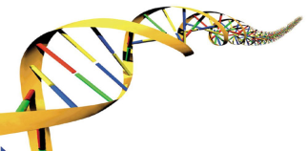
2016: PROFILES, INVASIVES & DNA
2015
Fitness for use 2016 topics
Invasive alien species
DNA evidences for:
names = barcoding
occurrences = e-DNA
Marine biodiversity
Formalization framework
São Paulo, Brazil & Co
Use-specific needs -> data use profiles
Why data profiles?
to save time, to reduce data misuse and to lower data use threshold
2016

Slide 22
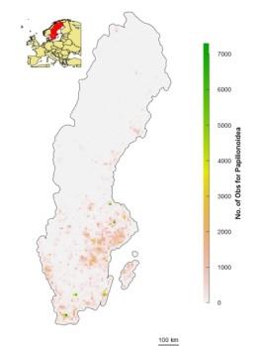
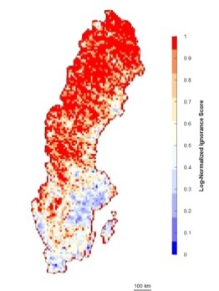
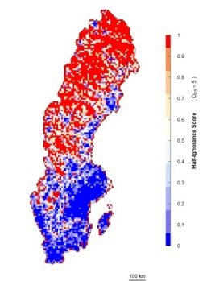
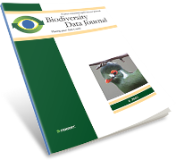
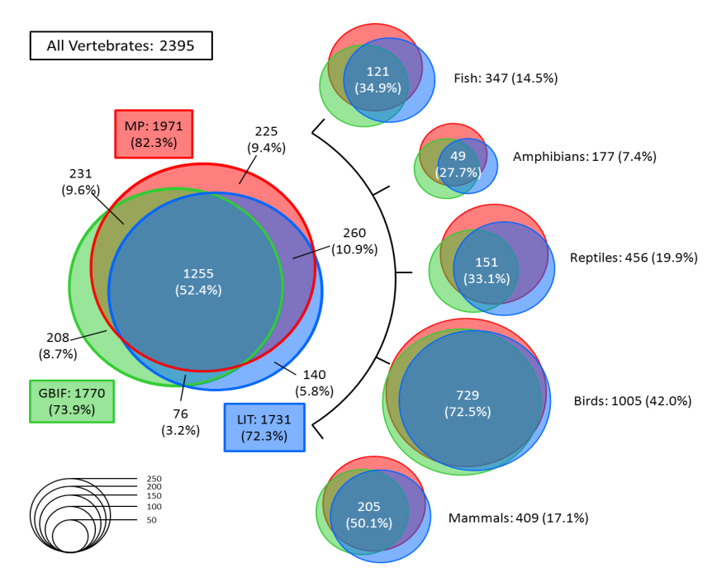
GAP ANALYSIS AND IGNORANCE MAPS
Arturo Ariño & co-authors
GBIF gap analysis guide reviewed
2015: online release for feedback
16 data gap analyses summarized
6 GBIF related cases discussed in detail
Alejandro Ruete & co-authors
Displaying bias in sampling effort of data accessed from biodiversity databases using ignorance maps
to visually explore data quality
To filter out unreliable results
= where do citizen scientists go?
DOI: 10.3897/BDJ.3.e5361

Slide 23
strategic planning
GBIF Strategic Plan 2017-2021
http://www.gbif.org/newsroom/consultations#strategicplan

Slide 24
Muito obrigado

