Slide 1


Dmitry Schigel
Roderic Page
Donald Hobern
Bridging biodiversity evidence
through data standards:
the GBIF perspectives towards molecular data
iBOL7, Kruger, South Africa
NASA/CXC/SAO/JPL-Caltech/STScI
Notes:
Bridging biodiversity evidence through data standards:
the GBIF perspectives towards molecular data
Dmitry D. Schigel,1 Roderic R. Page,2 and Donald D. Hobern1
1Secretariat, Global Biodiversity Information Facility, Denmark.
2Institute of Biodiversity Animal Health and Comparative Medicine, University of Glasgow, United
Kingdom.
Corresponding author: Dmitry D. Schigel (email: dschigel@gbif.org).
Global Biodiversity Information Facility (GBIF) has grown to accommodate
evidence from many sources, including citizen science and
quantitative ecology. A critical requirement is to expand this network
to accommodate evidence from molecular research. GBIF.org aims for
universality in its data discovery services, supporting integration,
search and filtering capabilities, documenting data provenance, and
promoting best practice around data citation. By early 2017, the GBIF
network includes several datasets of molecular origin. These early
efforts require further enhancements around data linkage and attribution,
particularly through making connections between specimen
data and associated molecular information. GBIF’s ambition is to accelerate
processing of all data records to cluster related data records
derived from specimens, sequences, publications, and other sources.
GBIF and Barcode of Life Data System (BOLD) need to establish a continuous
feed for new sequence data to be incorporated within GBIF. As
the barcode of life community continues to expand, growing volumes
of data will flow from field-based monitoring activities that rely on
barcodes to determine the set of taxa recorded. The interpretation of
the growing volumes of sequences will evolve as reference libraries
improve. These data will serve as one of the key streams of evidence
for species distribution. GBIF aims to work closely together with molecular
infrastructures to (i) form cross-linkages between digitized
specimens and associated barcode data, (ii) to accommodate spatiotemporal
data from environmental sequencing projects, and (iii) to
expand the current taxonomic backbone to include operational taxonomic
units based on molecular and other evidence, including BOLD
Barcode Index Numbers (BINs). Further, GBIF could support organisation
and visualisation of data on infraspecific genetic variation as part
of the representation of species distribution data.

Slide 2
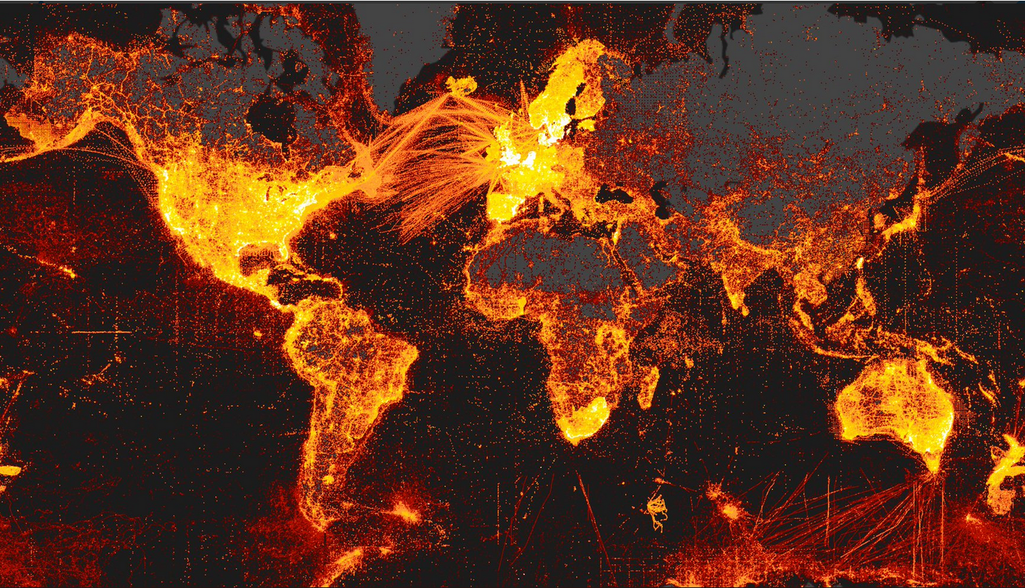

Slide 3
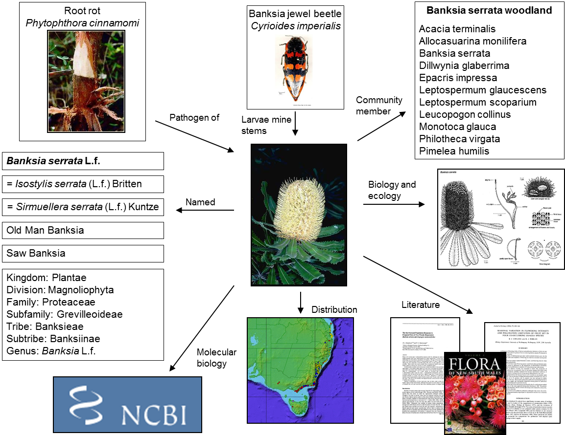

Biodiversity information
Informatics partnerships – Common standards – Stable infrastructure
Notes:
Users need all biodiversity information to work together and for it to be possible to create synthetic complex data sets

Slide 4

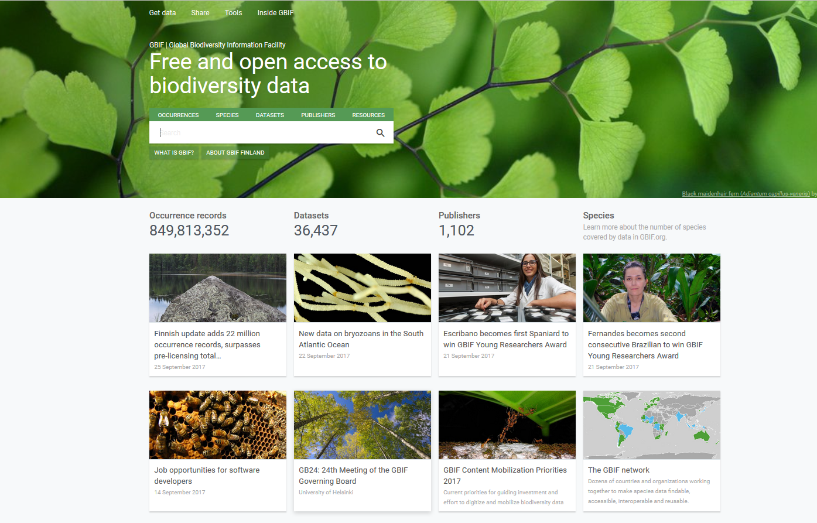
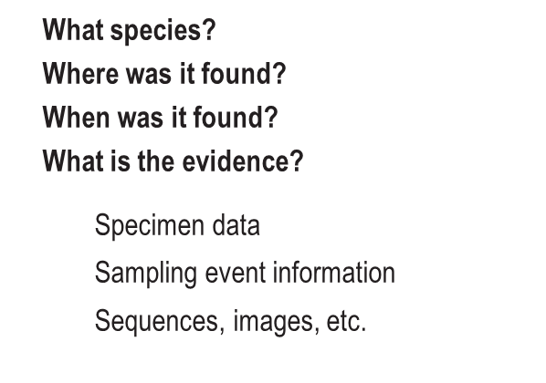
Intergovernmental open data infrastructure
Funded by the governments
of the participant countries
Network for free and open access
to biodiversity data
94 participants:
54 countries and 40 organisations
https://www.gbif.org/the-gbif-network
Notes:
Remove obstacles to collaboration in sharing and use of biodiversity data
Organise evidence of recorded occurrence of any species in time and space
Support development of a global virtual natural history collection

Slide 5

BY THE NUMBERS
21 Nov 2017
Species occurrence records
Datasets
875,244,719
37,209
Publishers
Country Participants
Organizational Participants
1,129
54
40
Records downloaded per month (avg Jan-Aug 2017)
Total page views (Aug)
43.4 billion
97,053
Notes:
Useful to see GBIF in its different modalities:
A window on biodiversity
An informatics infrastructure focused on tools and standards in service to science and society
A global network on bioinformatics

Slide 6
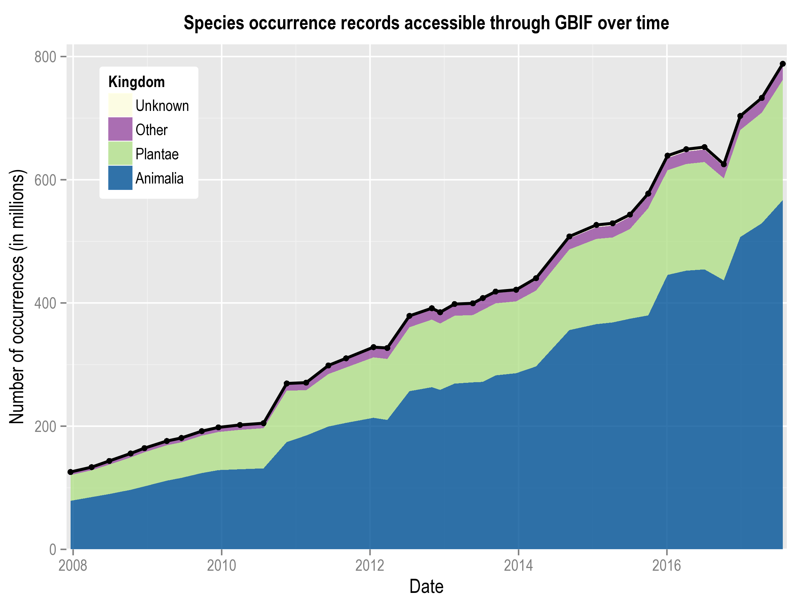
Data published through GBIF.org
data availability
www.gbif.org/analytics/global

Slide 7
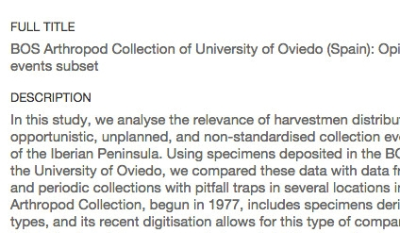
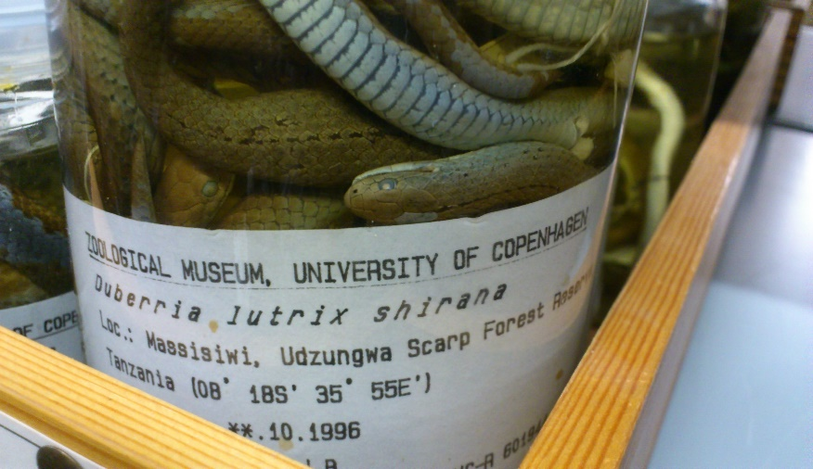
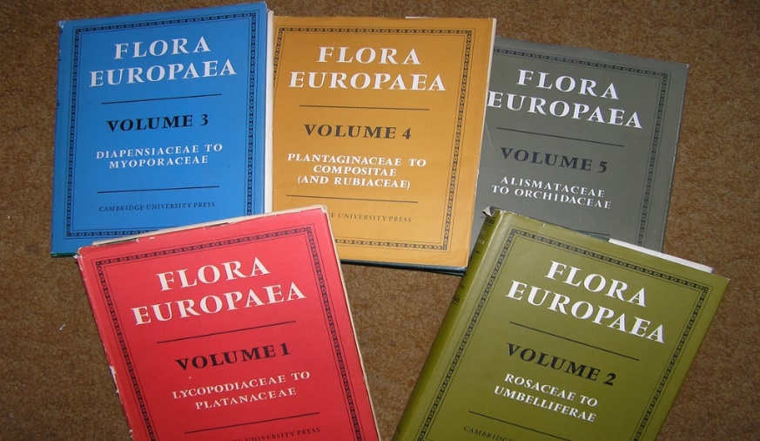
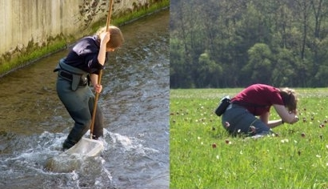
Data richness levels supported by GBIF
1.
Catalogue of collections
3.
Species with dates and coordinates
Collection Metadata
Species Occurrences
2.
Species in countries and areas
4.
Species with dates, coordinates, methods, abundance and absence etc.
Species Checklists
Sampled Organisms
https://www.gbif.org/dataset-classes
Notes:
GBIF now deals with four types of biodiversity data:
Occurrences (observations, specimens etc)
Samples (sets of observations from a single collecting event, including information on sampling protocols and abundance)
Checklists (names)
Metadata (data about data) - http://www.gbif.org/dataset/search?type=METADATA
Occurrences are records that document a 'collection event'—evidence that a particular, named organism was found at a particular time and place. Also known as primary biodiversity data, occurrences document the 'what, where, when, how and by whom' of our exploration of the planet's species. An occurrence record can be based on an observation in the field, vouchered (labeled) specimen in a museum or herbarium, or other evidence.
Sample-based data are records from thousands of different kinds of environmental, ecological, and natural resource monitoring and assessment investigations. These events range from one-off surveys to ongoing monitoring and includes activities like freshwater and marine sampling, plant cover and vegetation plots, and citizen science bird counts, among others.
Checklists are lists of scientific names of organisms grouped into taxonomic hierarchies. They serve two main functions: first, they provide data that help to enrich information about particular species, for example by including them on national checklists, and on lists of invasive or threatened species; and they provide taxonomic 'backbones' around which species information can be organized.
Metadata are structured descriptions of datasets giving essential details such as the geographic and taxonomic scope of the data, methods of collection or observation, contact details and citation requirements. They help to give context to datasets and enable users to assess whether data are fit for use in a particular research project or application.

Slide 8
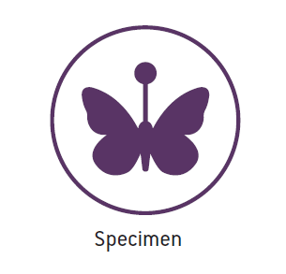
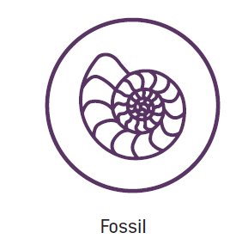
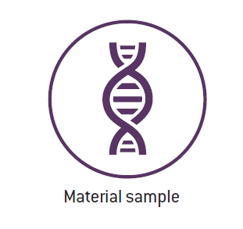
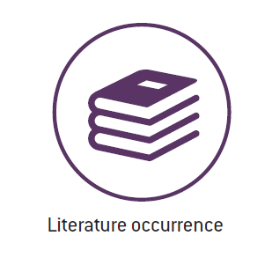
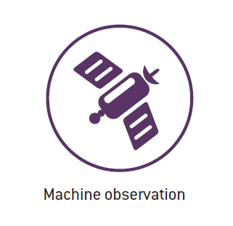
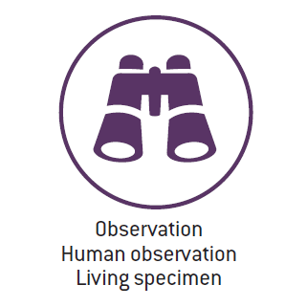
Types of data shared through GBIF
what
Barcoding!
Metagenomics!
eDNA!
sample-based data
https://www.gbif.org/dataset-classes

Slide 9
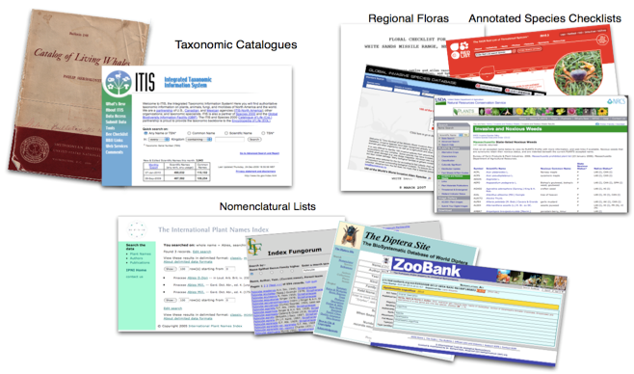
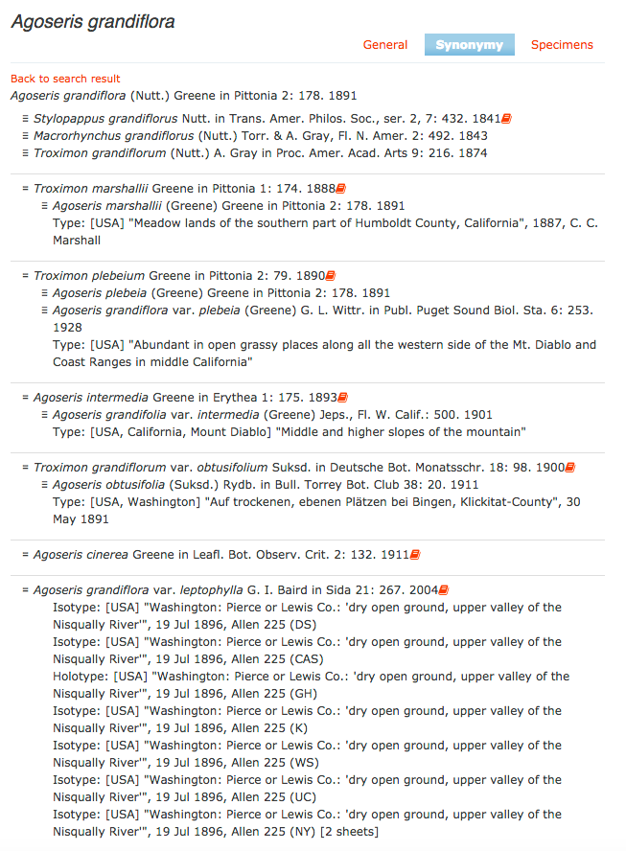
Organizing occurrences
GBIF needs a single, consistent taxonomy
GBIF assembles taxonomic index of checklists
Catalogue of Life – largest single source
Checklist bank: source for GBIF Backbone
Name matching service

Slide 10
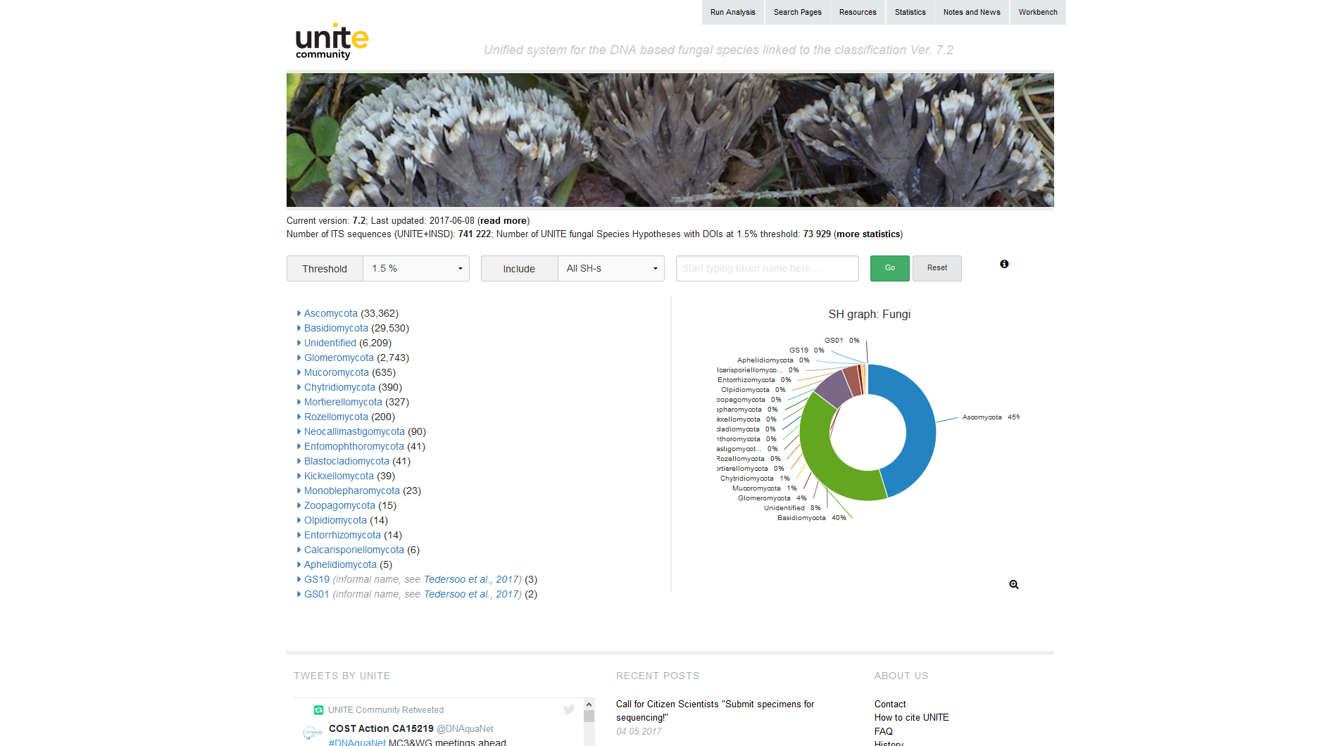
Experiment:
adding molecular non-Linnaean
checklist of fungi from UNITE…
https://unite.ut.ee/

Slide 11
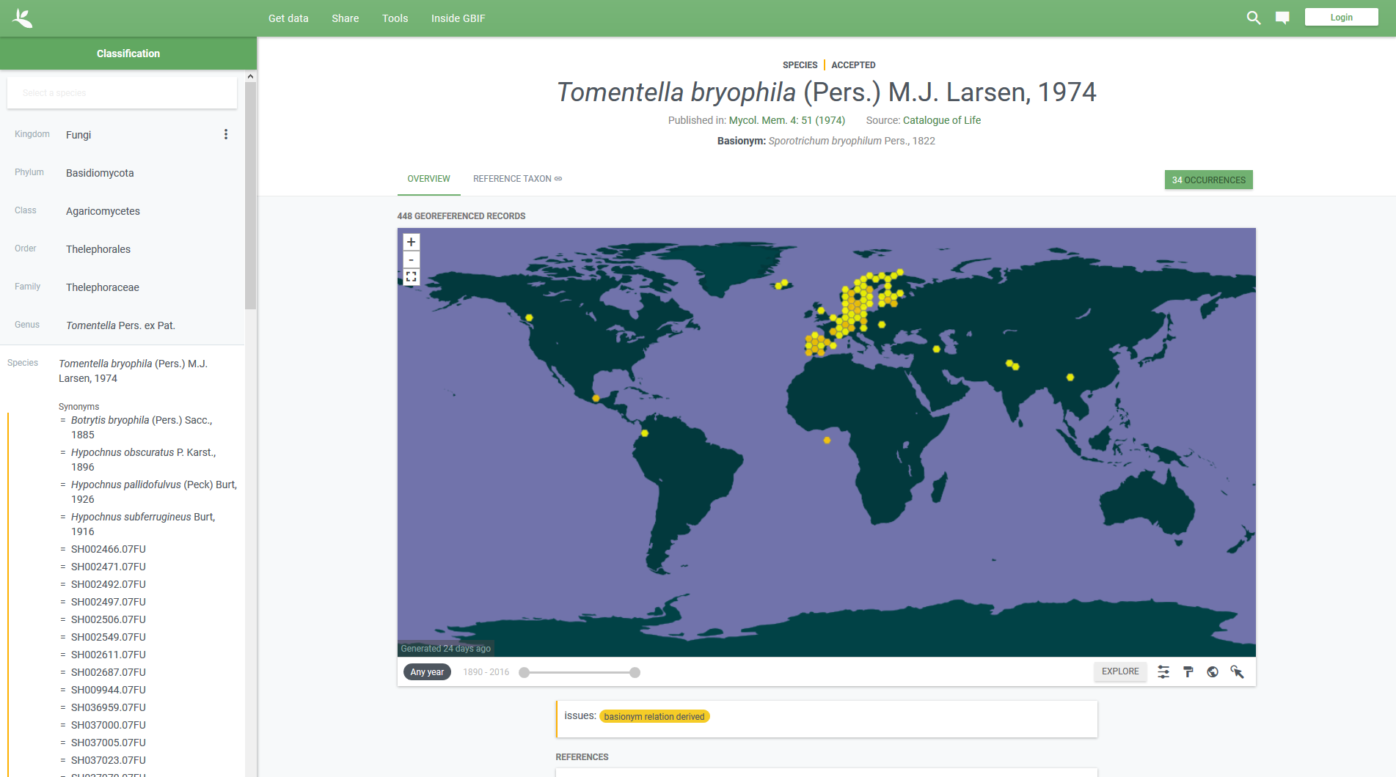
Experiment:
adding molecular non-Linnaean
checklist of fungi from UNITE to GBIF backbone

Slide 12
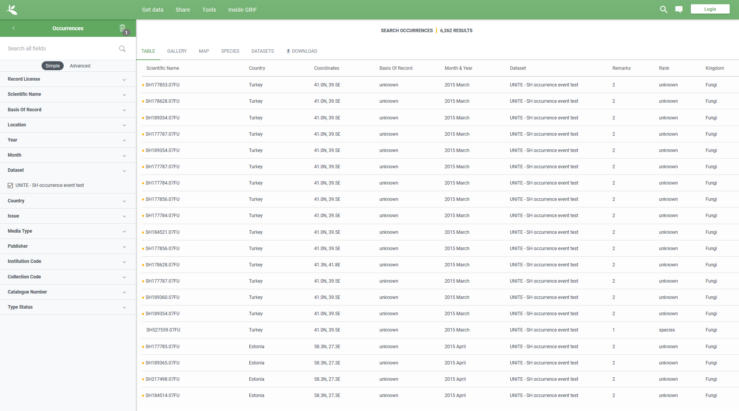
Experiment:
an opportunity to index and list georeferenced sequence data

Slide 13
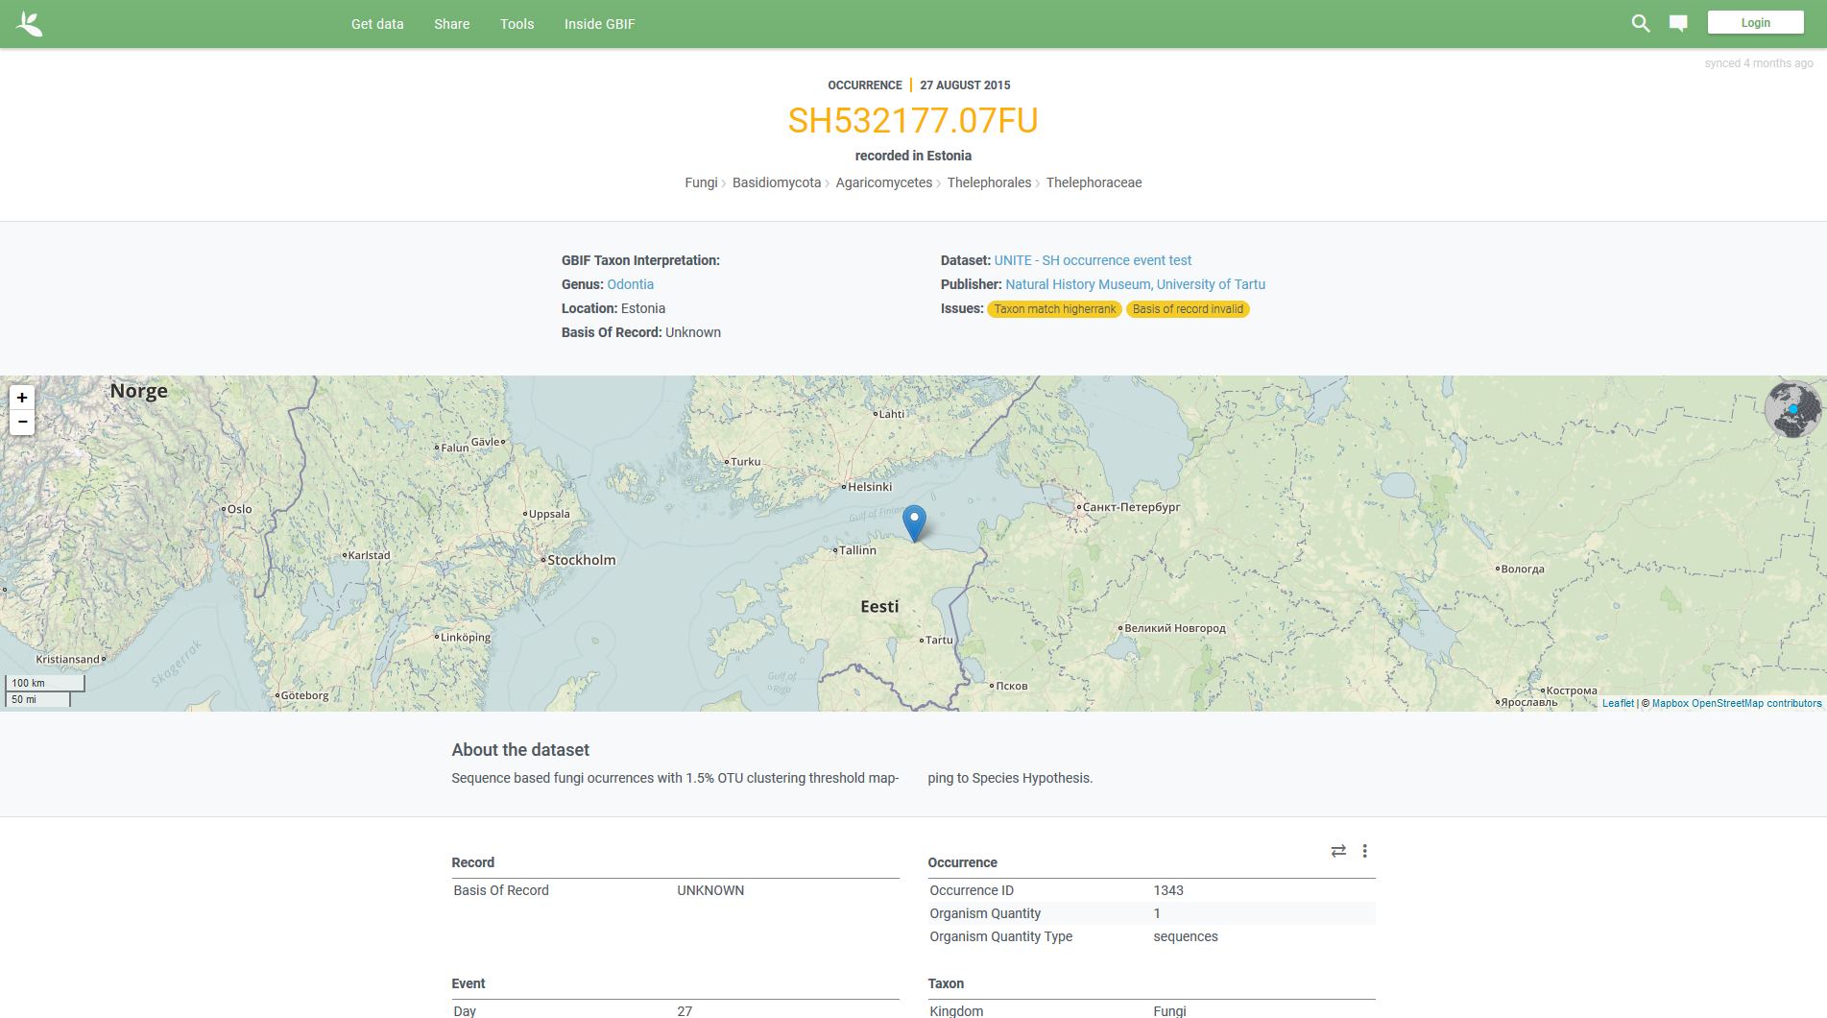
Experiment:
… and to display sequence occurrences just as we do with specimens and citizen science observations

Slide 14
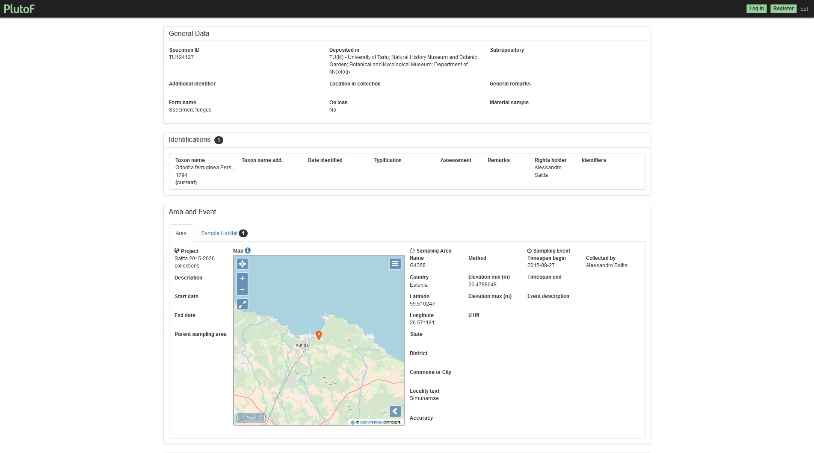
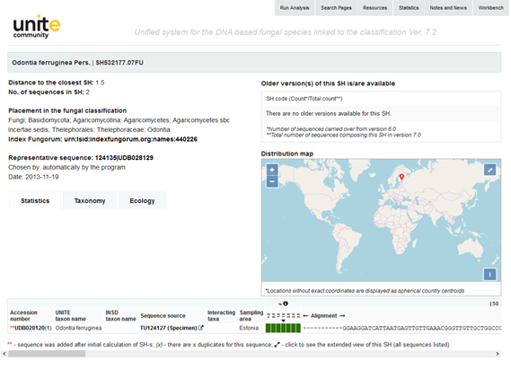
Experiment:
… and to link back to the detailed information at source

Slide 15
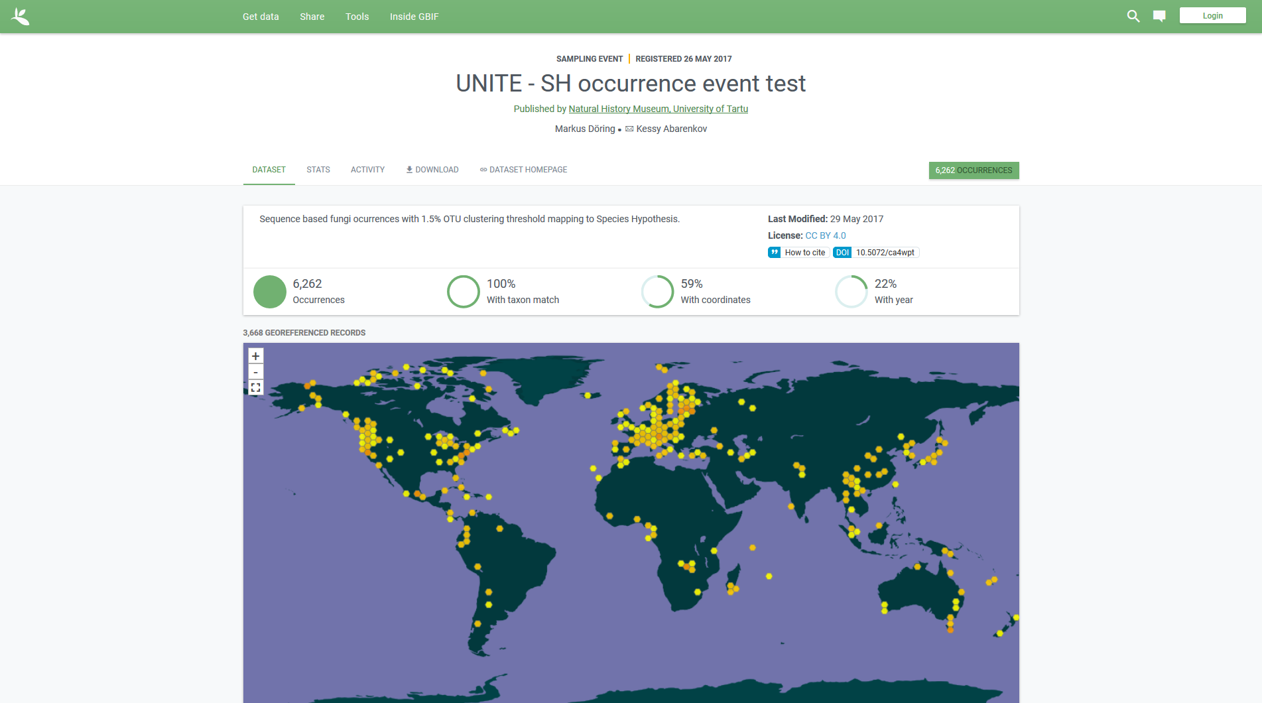
Experiment: adding molecular non-Linnaean checklist of fungi from UNITE to GBIF backbone

Slide 16

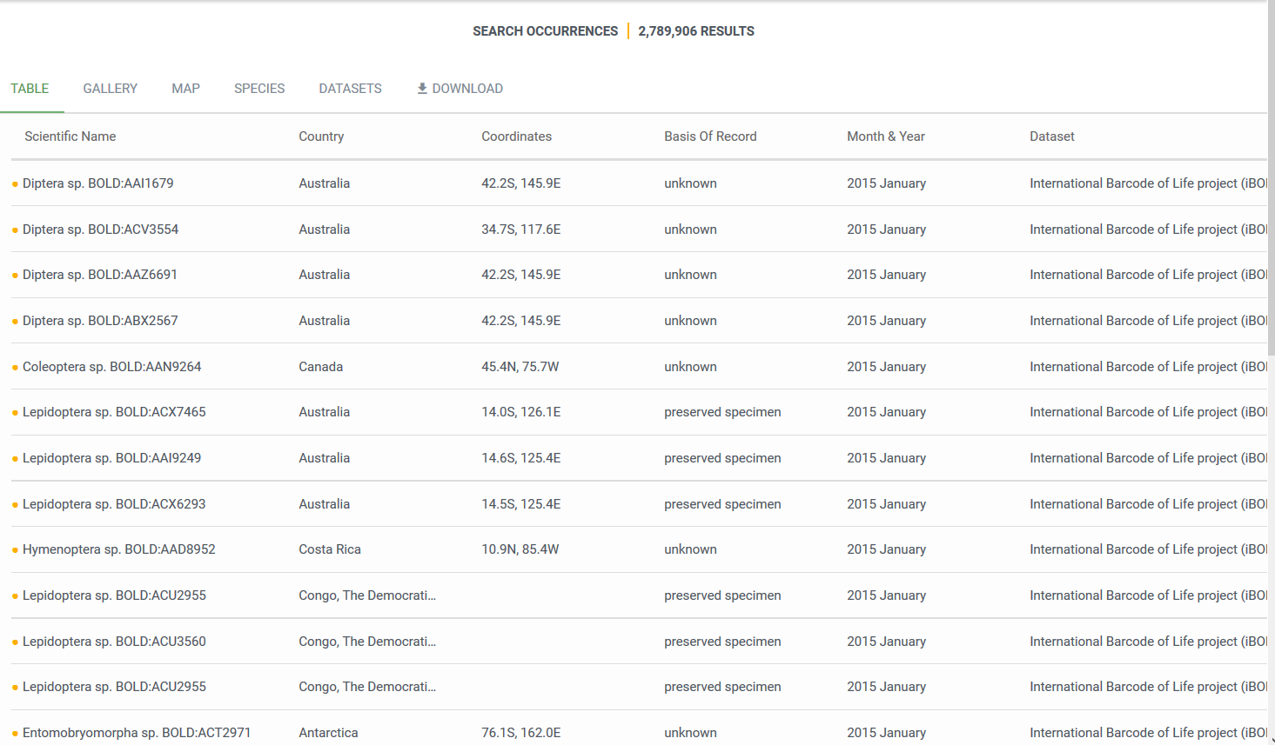
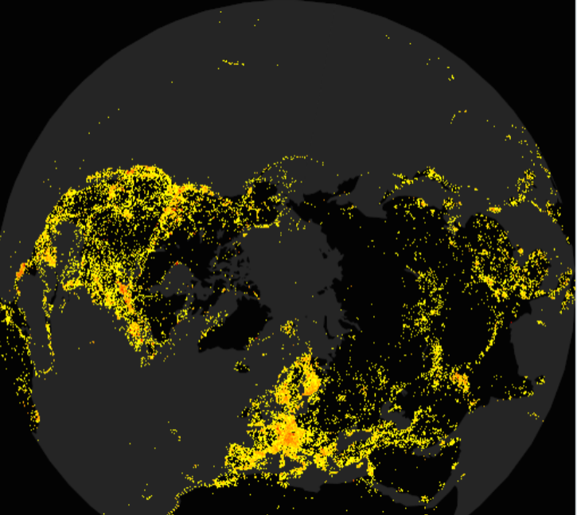
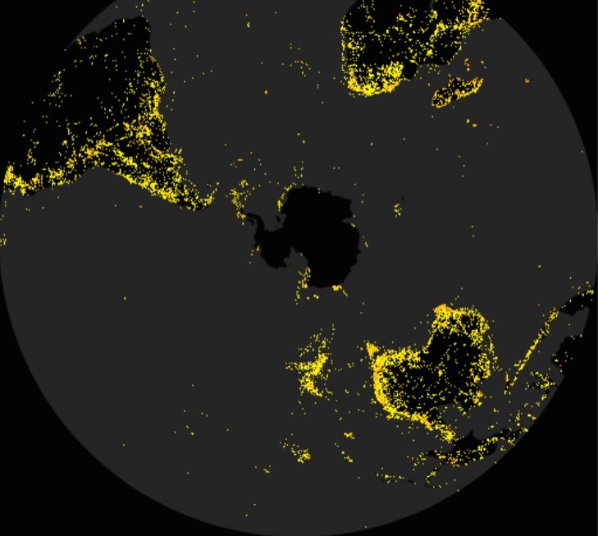
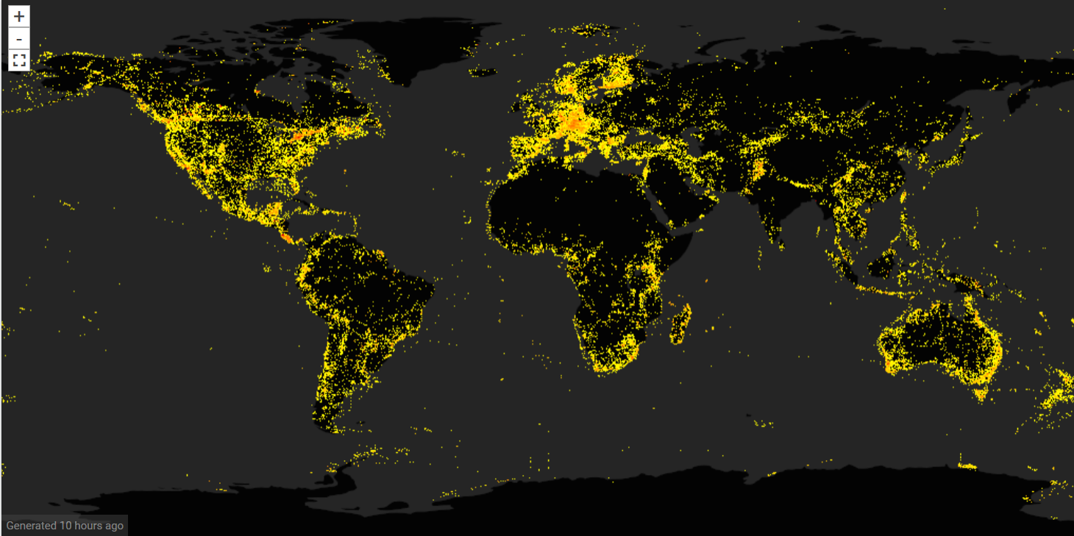
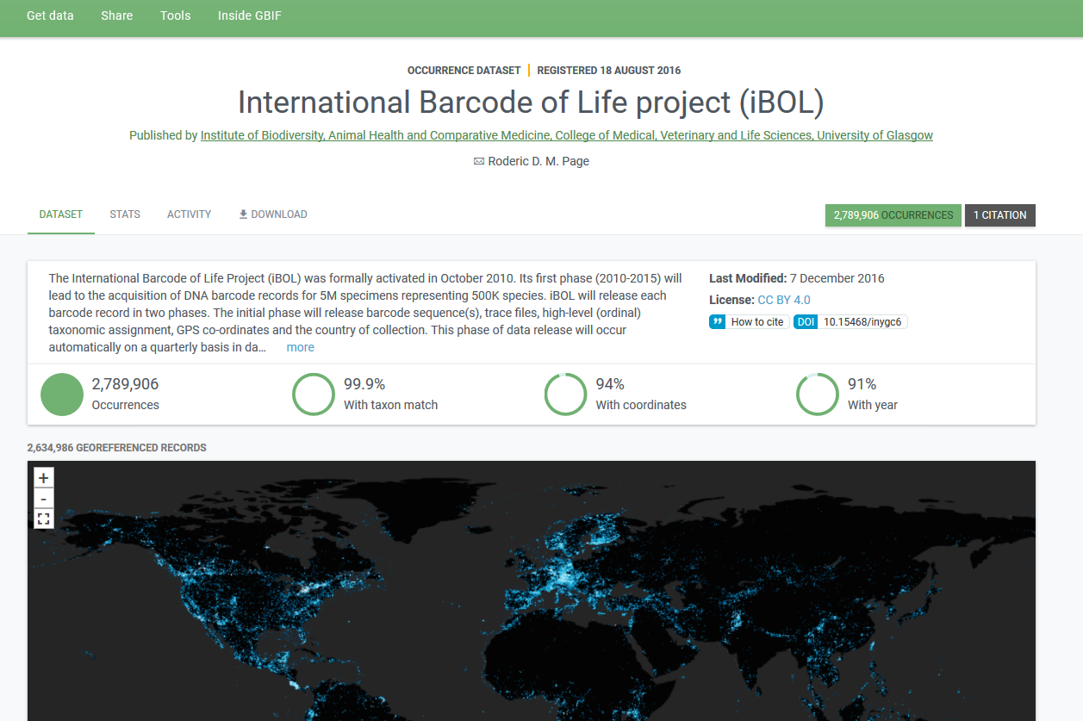
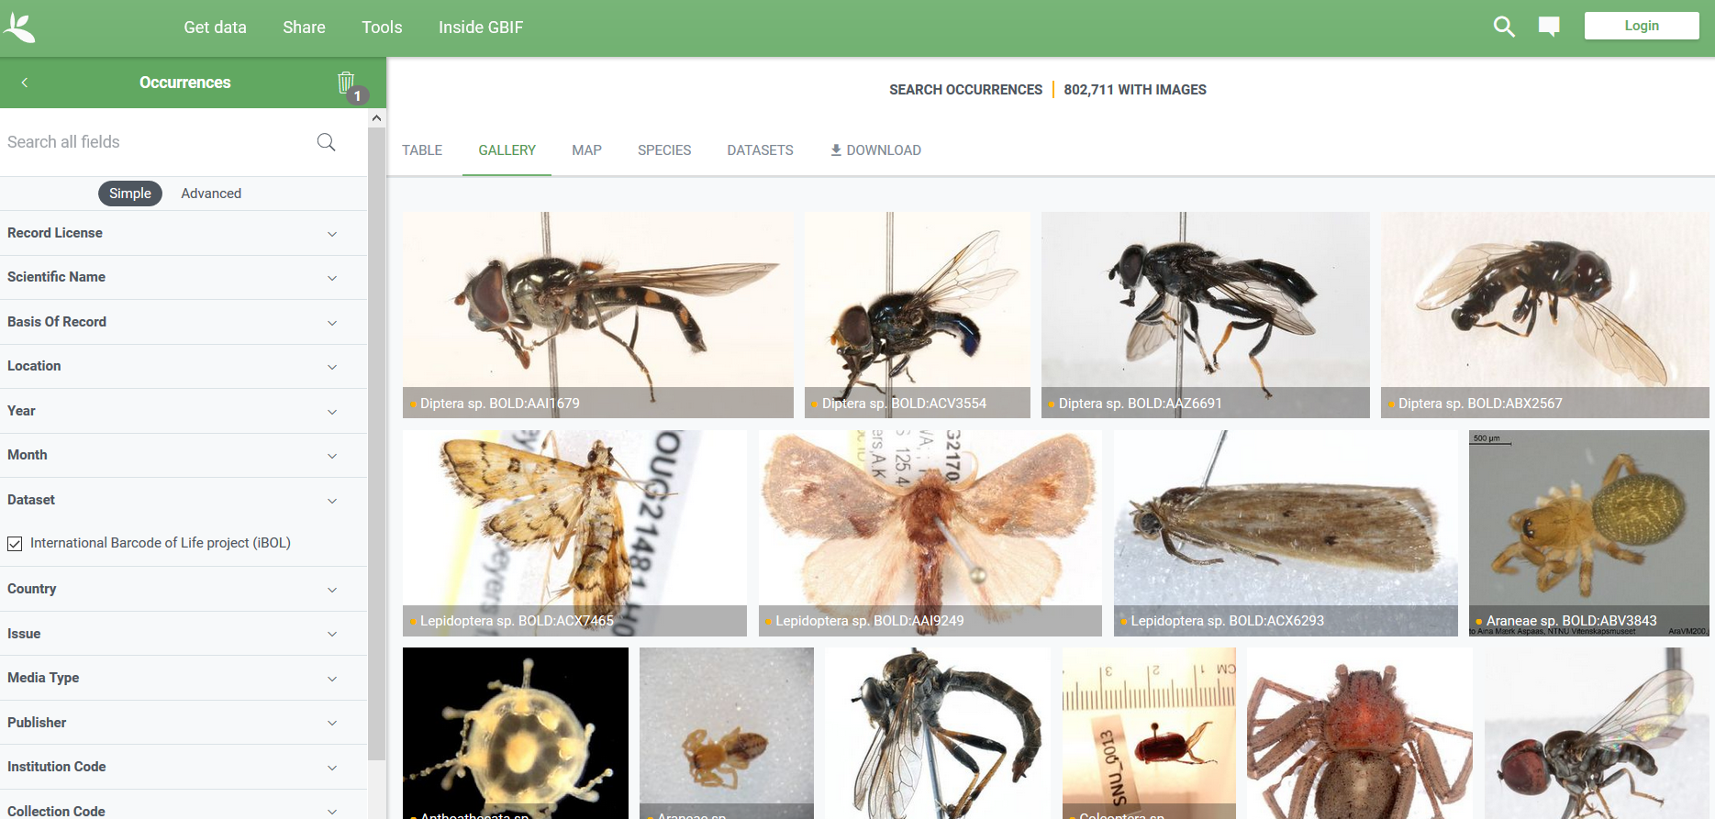
BOLD data in GBIF: Barcodes
10.15468/inygc6i
Notes:
Moving these figures closer

Slide 17
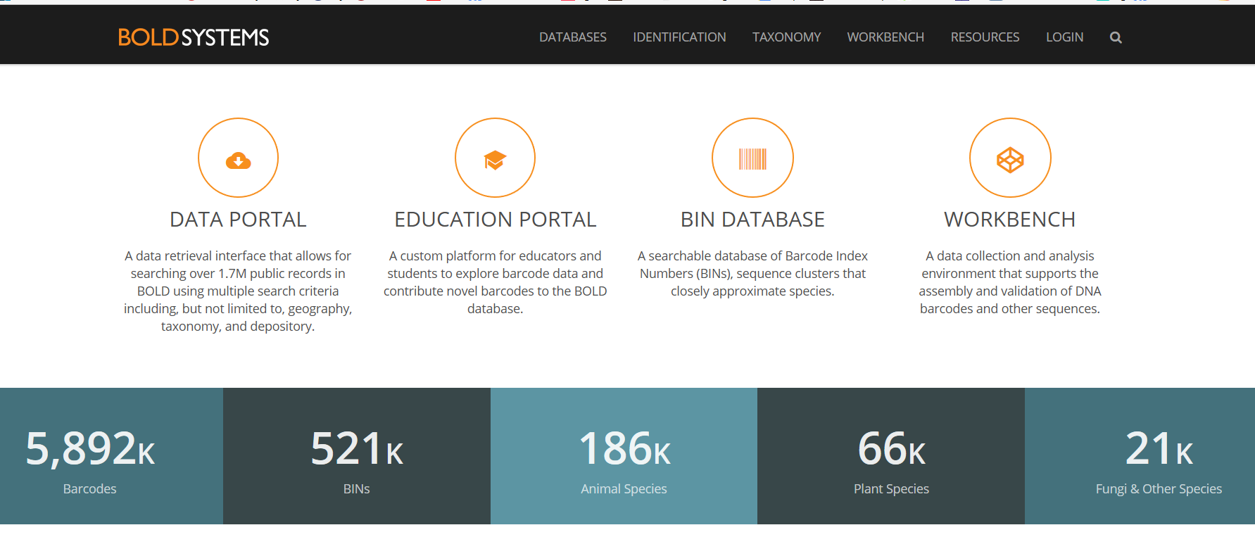
BOLD data in GBIF: Barcodes
10.15468/inygc6i
Notes:
Moving these figures closer

Slide 18
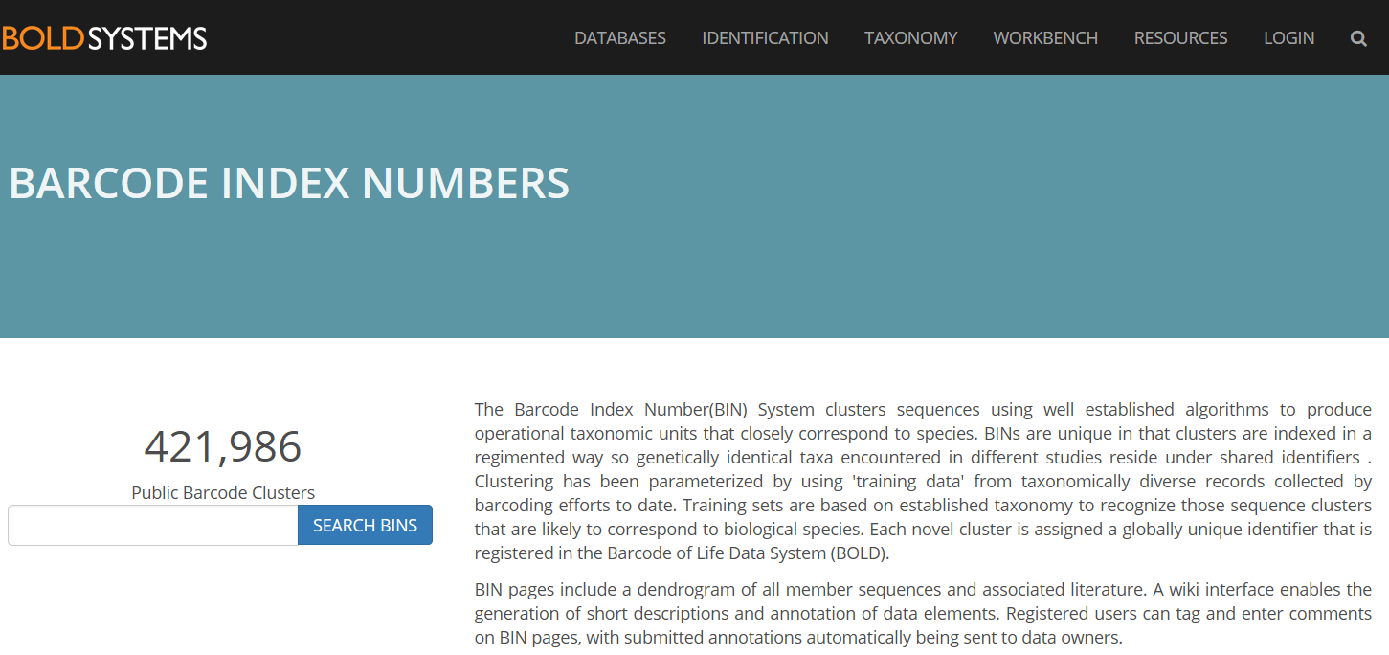
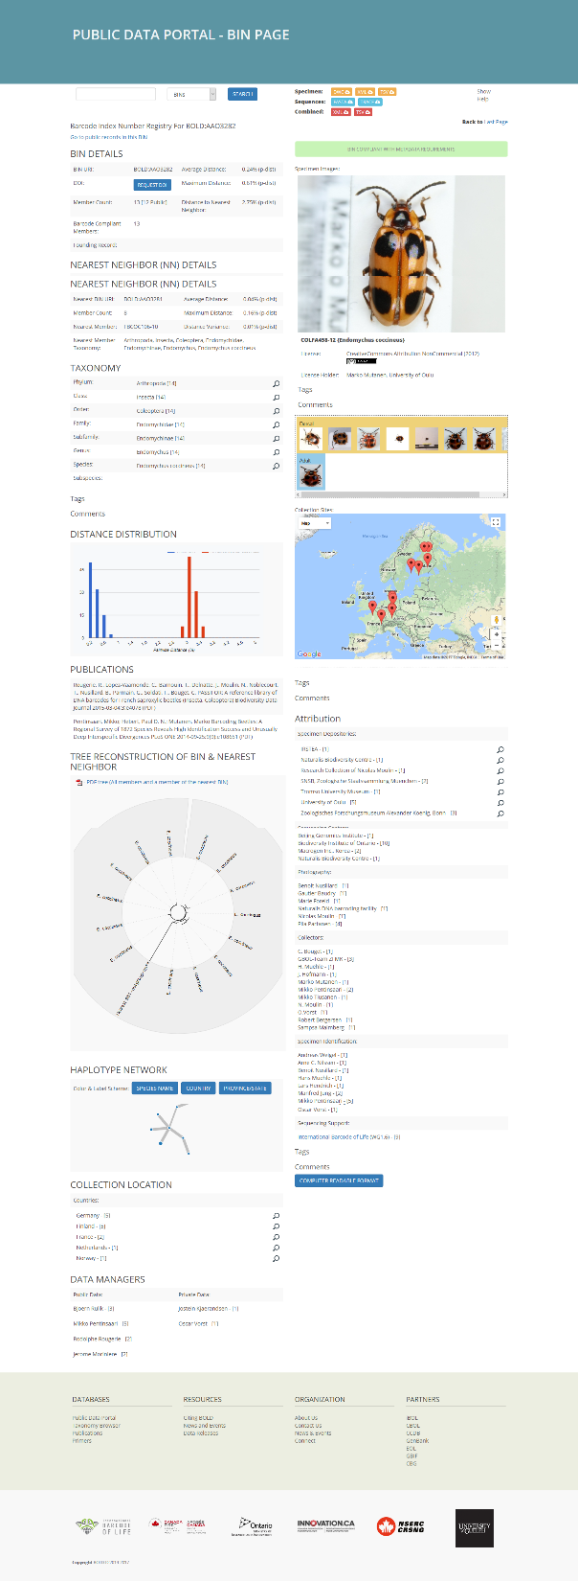
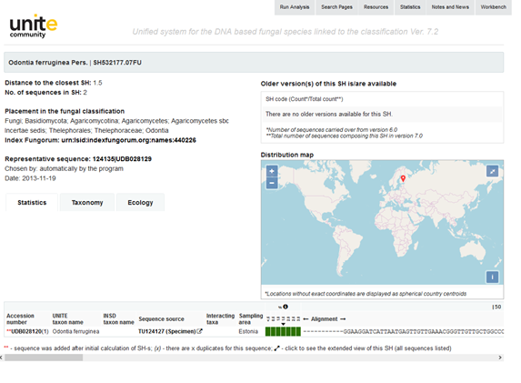
Checklists are the key…
OTU sources
What and where?
Stable, but dynamic
Digitally citable, DOI
Linked to Linnaean taxa

Slide 19
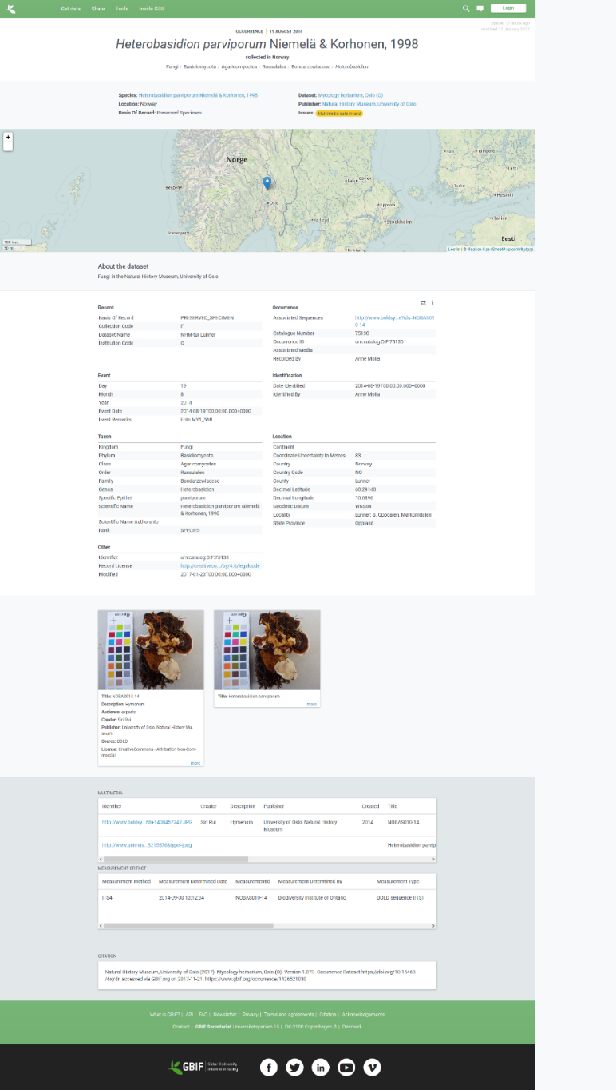
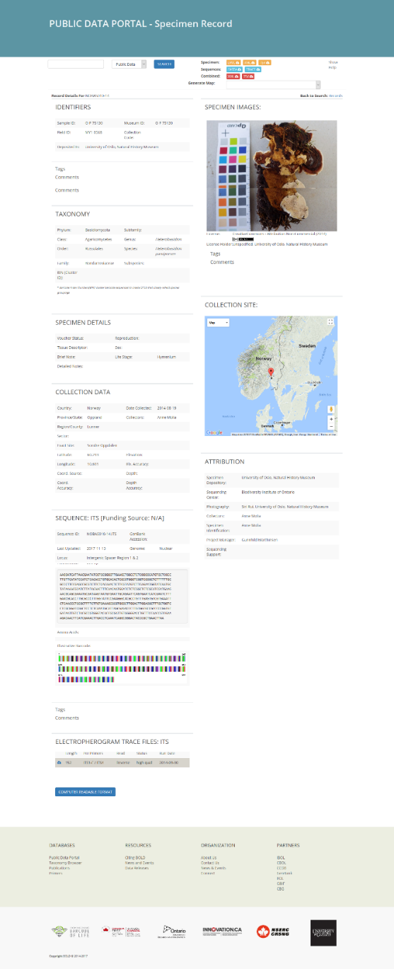


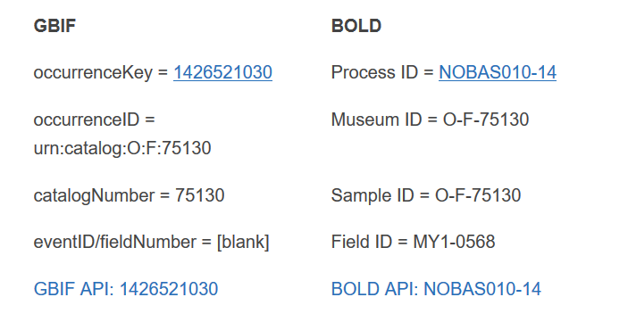


national example
Look at Norway – do like Norway
+
=
http://www.gbif.no/news/2017/bold.html
Notes:
Mendeley, monitoring use

Slide 20

data access and use
Grab your copy here and in the GBIF booth
Peer-reviewed publications using GBIF-mediated data
through 30 September 2017
https://www.gbif.org/science-review

Slide 21
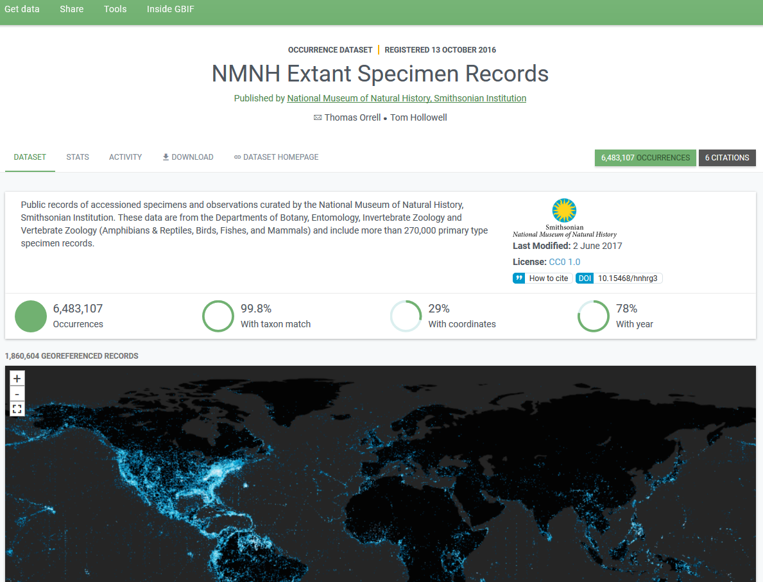
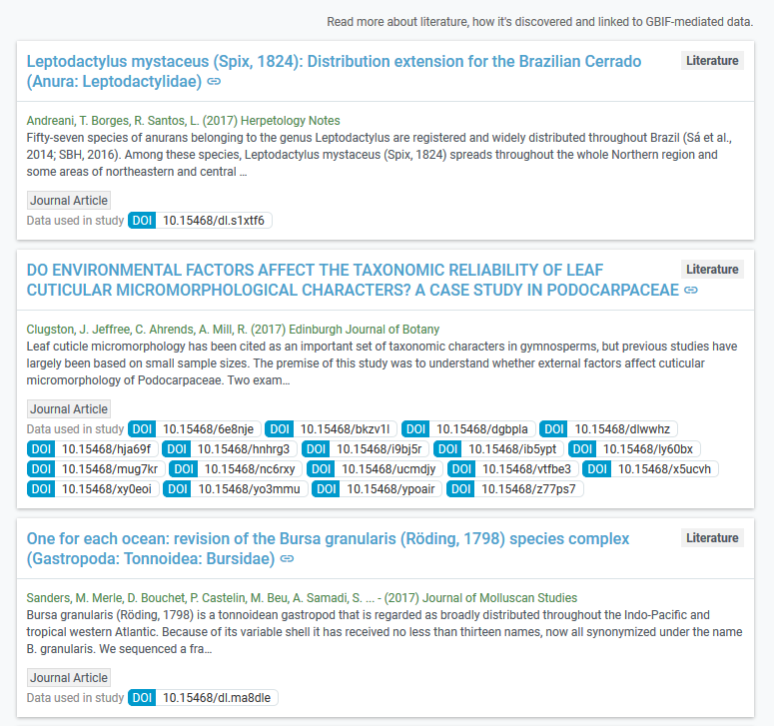
data access and use
Data citation: tracking and display
Notes:
Mendeley, monitoring use

Slide 22
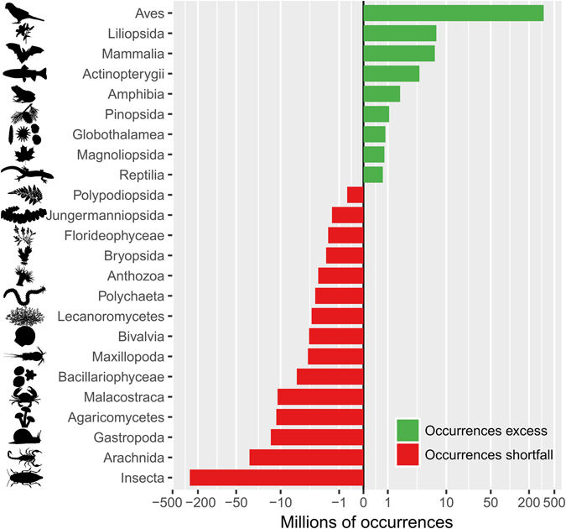
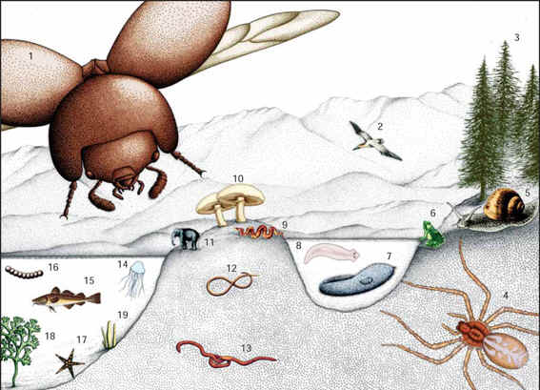
Global biodiversity
Troudet et al. Nature 2017
Notes:
Mendeley, monitoring use

Slide 23
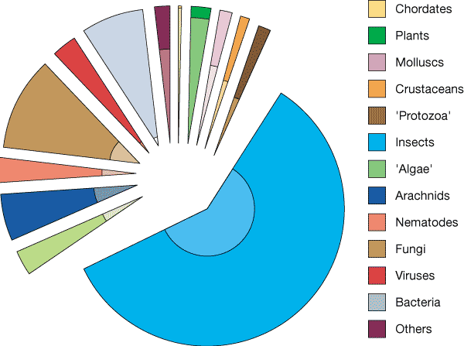
Global biodiversity state of knowledge
Number of species worldwide:
Purvis & Hector 2000 Nature 405
doi:10.1038/35012221
Number of species occurrences
GBIF.org, 9 May 2017
Notes:
Mendeley, monitoring use

Slide 24







SUPPORTING SUSTAINABILITY
Biodiversity
Commitments
Biodiversity
Assessments
Biodiversity
Models
Biodiversity
Data
Engage expert communities – Deliver relevant data products
Notes:
Meeting big national and global needs depends on government commitments (as coordinated through the CBD). IPBES exists to coordinate global and regional assessments to guide and support these commitments. These assessments should be based on the best available models, which in turn depend on the best possible data. Coordinated work on delivering and organising biodiversity data can support this whole process.

Slide 25
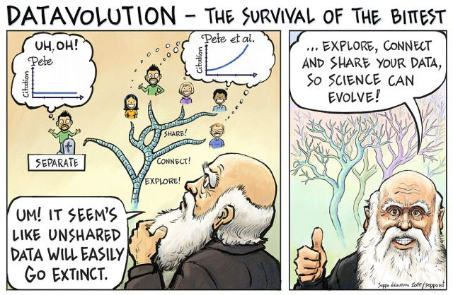
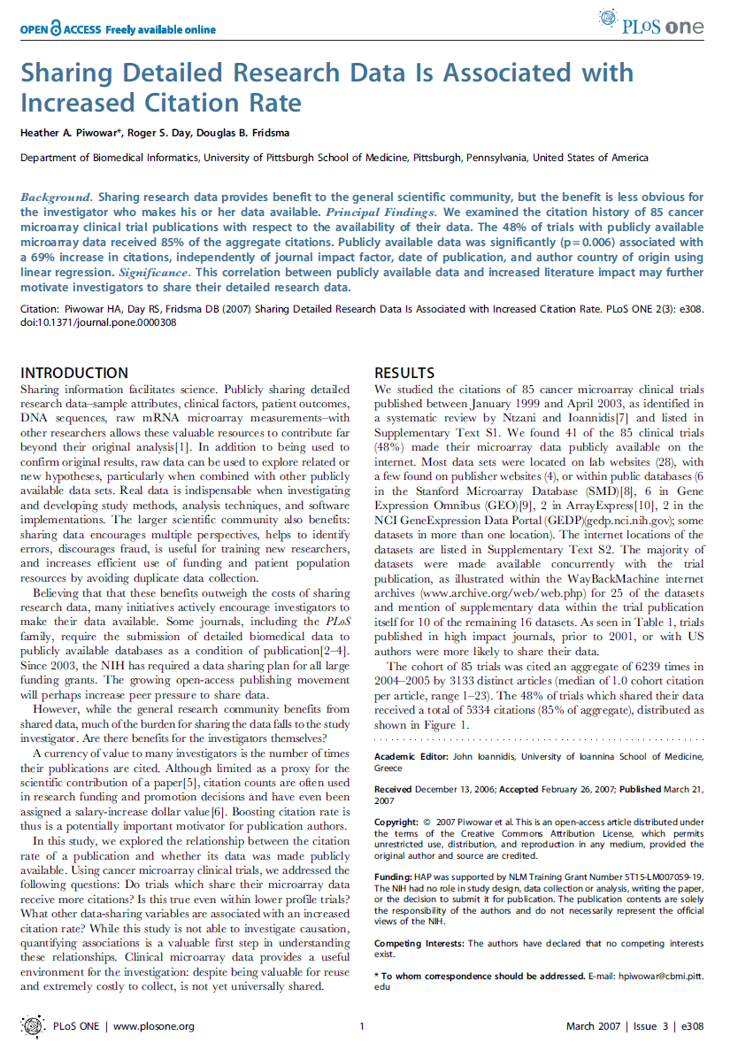
Benefits of openess
Efficiency of research
Scholarly rigor and quality of research
DOIs: tracking data use and citation
Spectrum of academic products, data papers
Visibility and scope for engagement
Researchers to ask new questions
Collaboration and community-building
Economic and social impact of research
International conventions and funding requirements
Cartoon: Seppo Leinonen, www.seppo.net
Piwowar et al. 2007

Slide 26
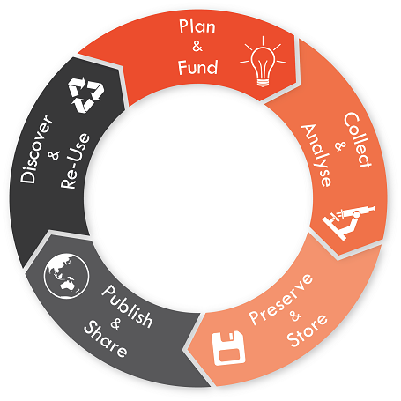

The research data lifecycle
Generate / Access
(re)Organize
Modify
Analyze
Archive
Cite
University of Sydney https://library.sydney.edu.au/research/data-management/research-data-management.html

Slide 27


Take home messages
Only one biodiversity: cross-link the data
GBIF: big, open and free to use for all
Involve your institution and your country
GBIF: actively and increasingly used scientific infrastructure
Open your barcode, BIN and other data (as soon as you can)
Fill the gaps and fight the biases – temporal, spatial and taxonomic
Track the use though DOI-powered data citation
Data postprocessing: fitness for use needs user action
GBIF adds value: every records counts in science and policy
BOLD and GBIF to move from static to dynamic connection!

Slide 28
Thank you
Many thanks to:
Markus Döring
Urmas Kõljalg
Paul Hebert
Sujeevan Ratnasingham

