Slide 1
Crosslinking species occurrences and molecular evidence for species identities
Dmitry Schigel¹, Siro Masinde¹, Donald Hobern¹, Gabriele Dröge²
1 - Global Biodiversity Information Facility, 2 - GGBN, Botanischer Garten und Botanisches Museum

Slide 2
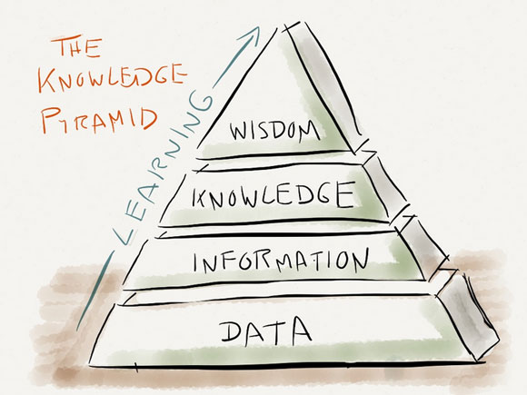
outline
GGBN and GBIF network
GBIF as a global scientific infrastructure
GBIF: focus on use and data quality
Early signals from the survey
Announcements

Slide 3
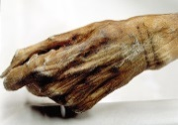
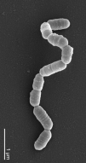
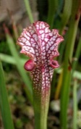
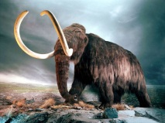
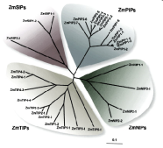
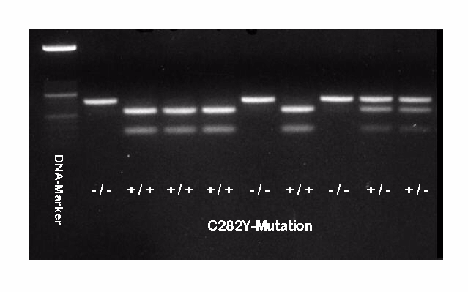
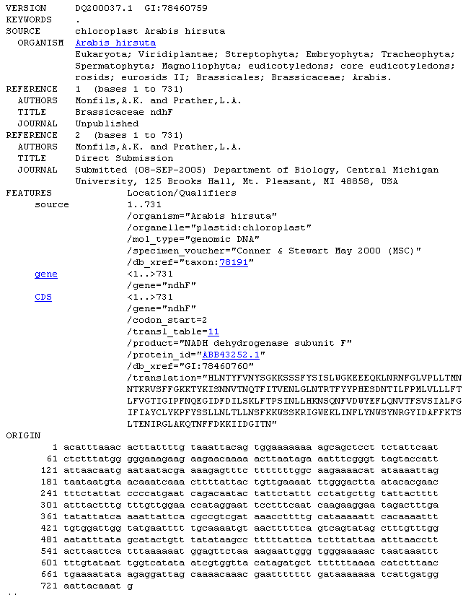
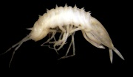
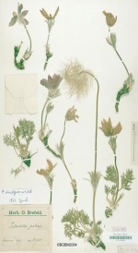
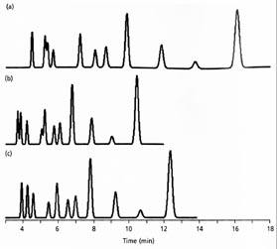
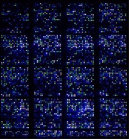
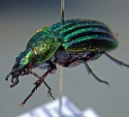
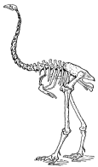
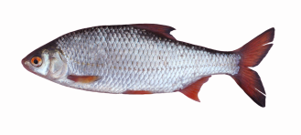
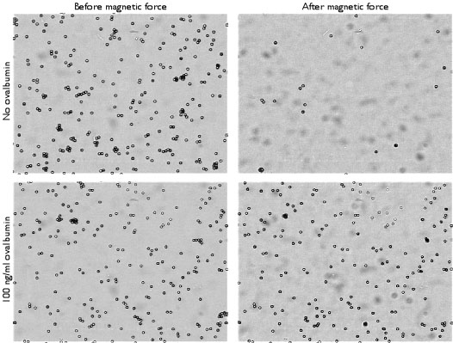
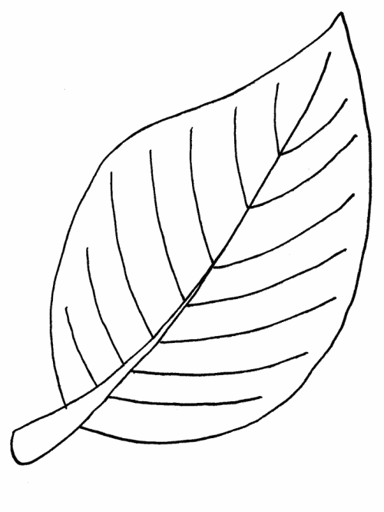
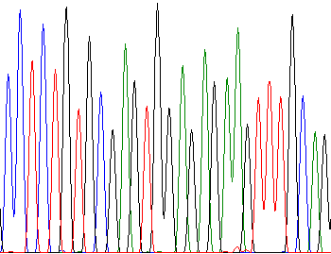
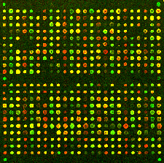
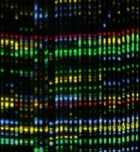
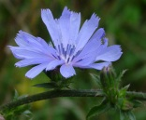
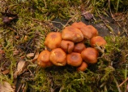
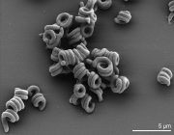
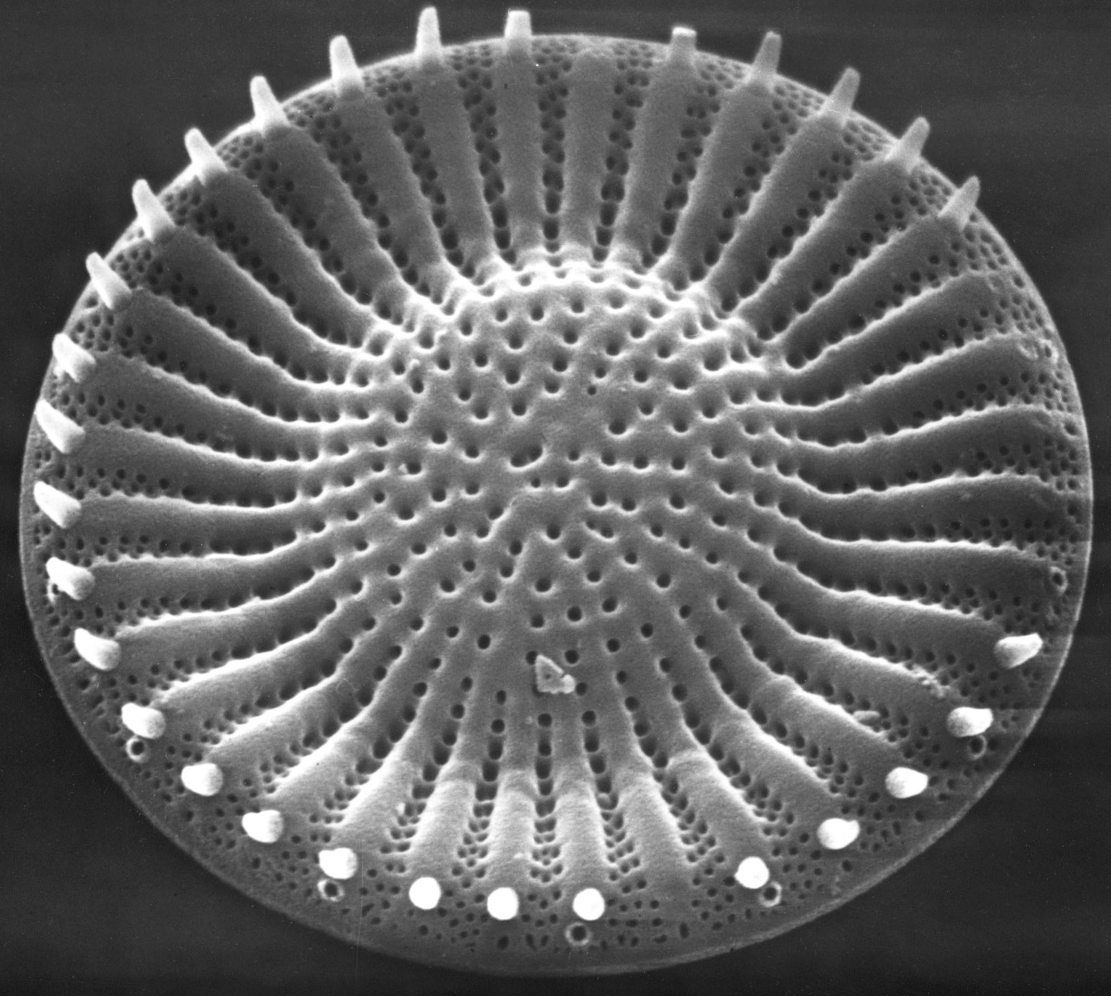
GGBN: BRIDGING THE NETWORKS
Source material / specimens
Molecular analysis data
DNA & Tissue

Slide 4
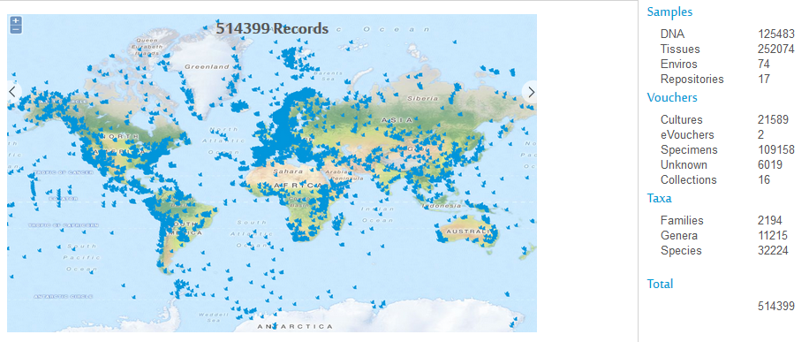
GGBN BY THE NUMBERS
GGBN is an international network of institutions (48 partners) on preservation of genomic samples representing the diversity of non-human life on Earth.
Collaborate to ensure consistent quality standards for DNA and tissue collections,
Improve best practices for the preservation and use of such collections and
Harmonize exchange and use of material in accordance with legislation and conventions.

Slide 5
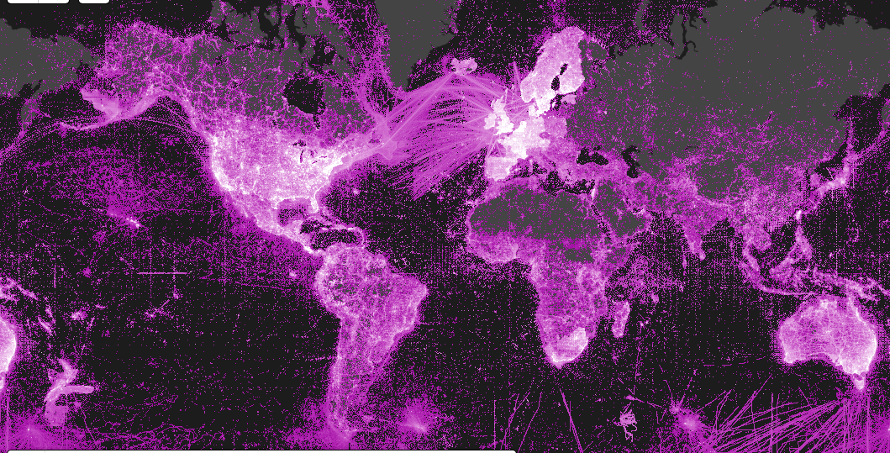
GBIF BY THE NUMBERS
649,054,525 species occurrence records
32,440 datasets
813 data-publishing institutions
http://www.gbif.org | 20 JUN 2016

Slide 6
GBIF KEY FACTS
Data infrastructure for research and policy
Free and open access to biodiversity data
Intergovernmental collaborative network
54 countries, 39 international organizations, 800+ institutions
National and thematic nodes
Standards and tools
GBIF.org and web services
PUBLISHERS
OCCURRENCE RECORDS

Slide 7
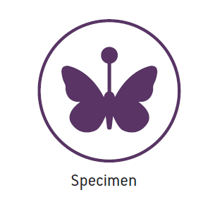
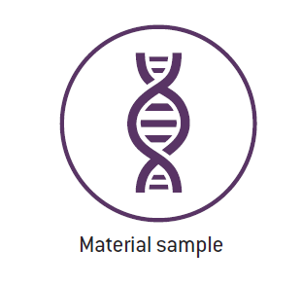
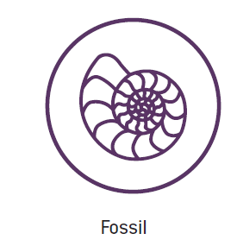
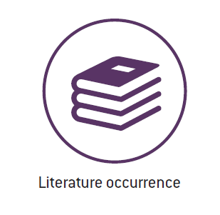
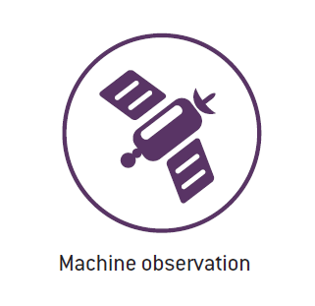
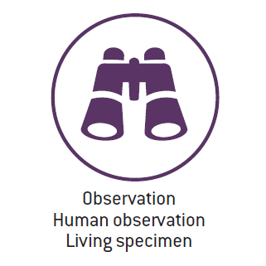
what
TYPES OF DATA SHARED THROUGH GBIF
GGBN
New uses and data quality dimensions
eDNA
Sample event data
http://www.gbif.org/occurrence
Notes:
Natural history collections
Research, monitoring projects
Citizen science observations
Records extracted from literature

Slide 8
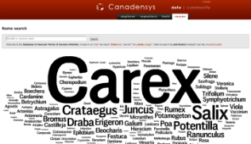
what
DATA SOURCES AND DATA USES
!?
Uses of biodiversity data
Taxonomy, conservation, biosecurity, land-use planning, climate change response, crop development, resource management, materials development, forensics …
!
!
Sources of biodiversity data
Collections, field observations, monitoring activities, genomics, citizen science, remote sensing, expert knowledge, historical literature, ...
www.gbif.org

Slide 9
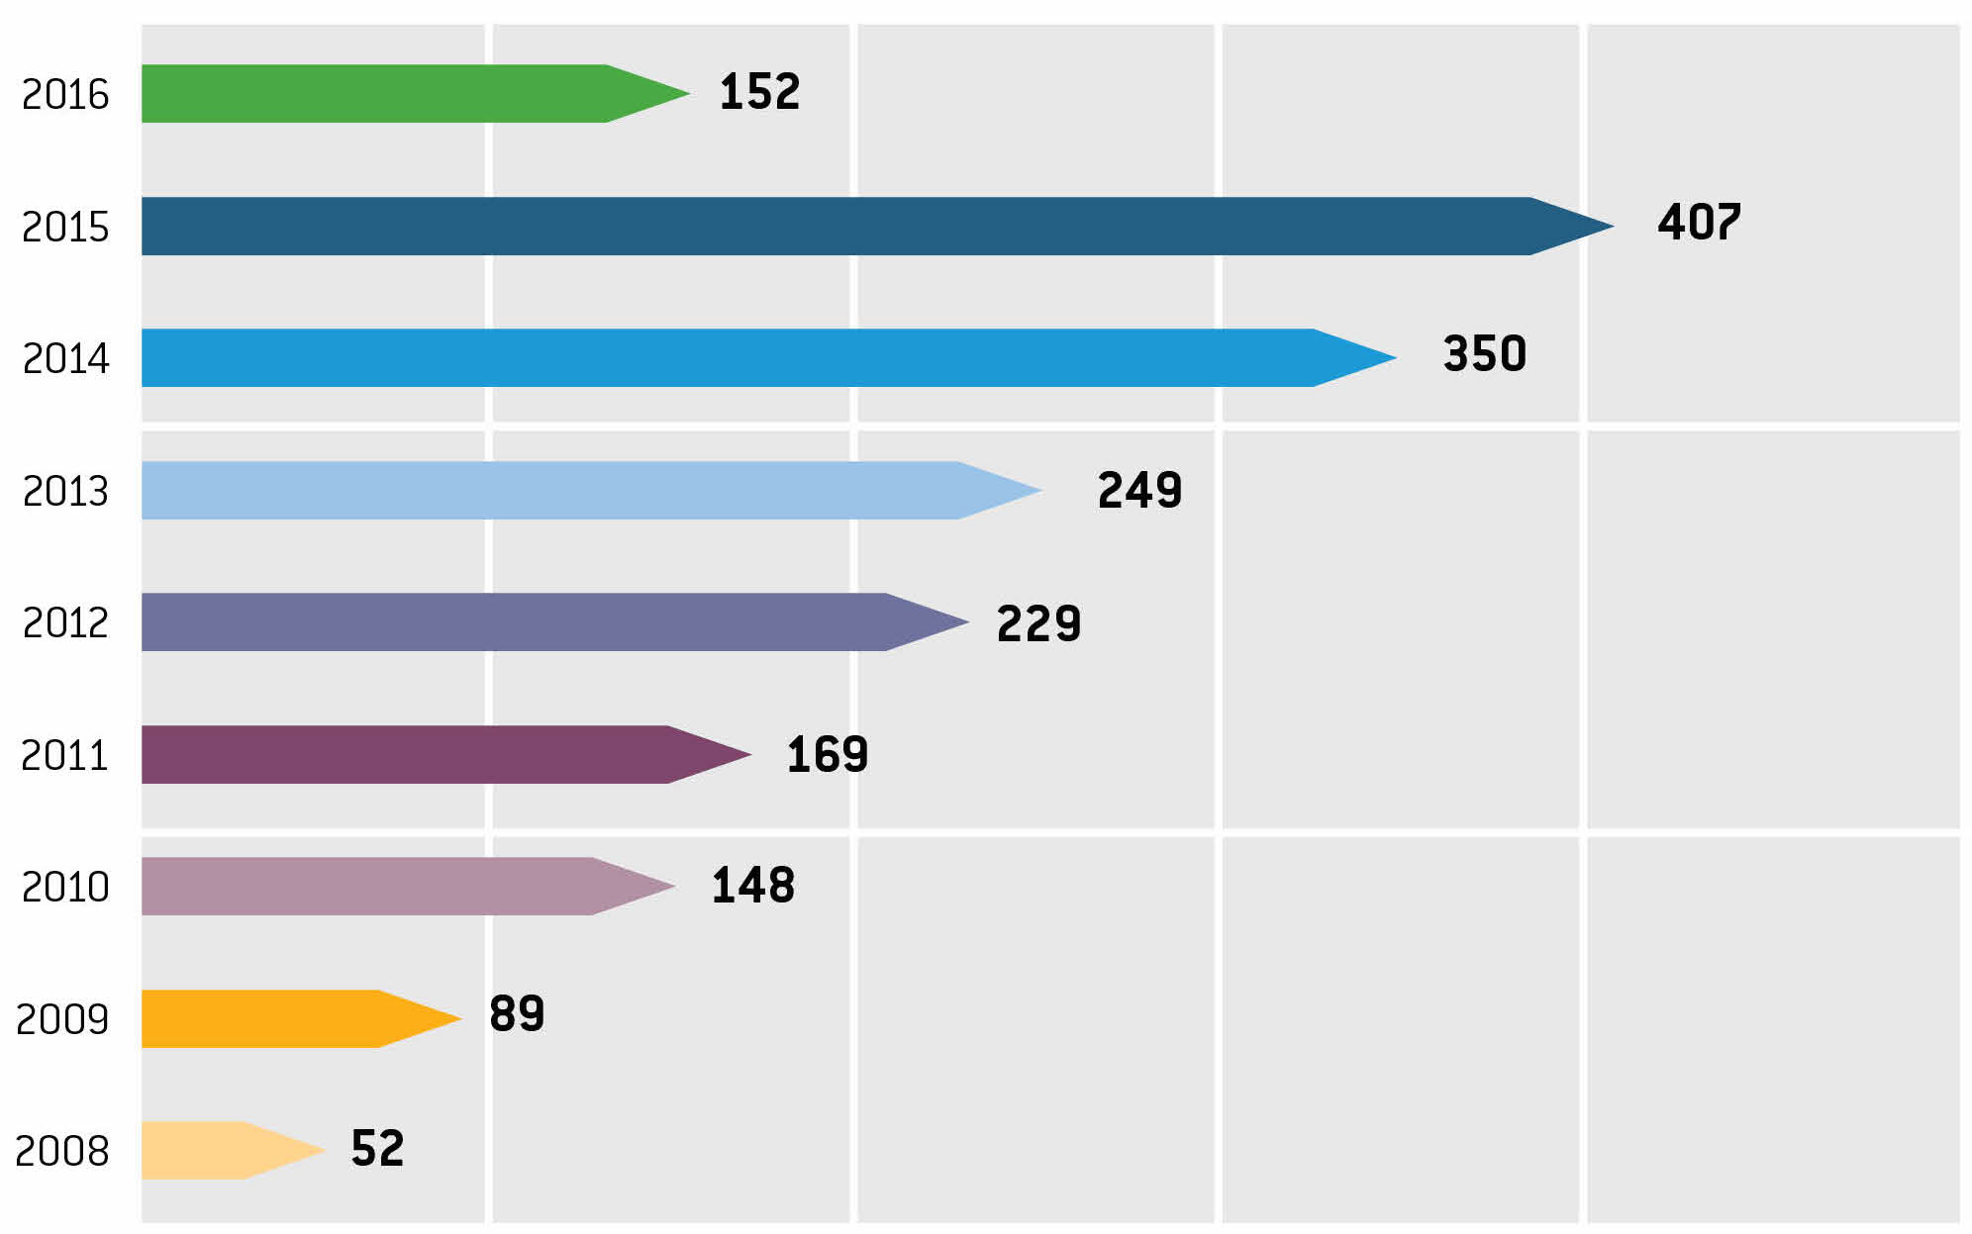
Citations in peer-reviewed research
data use
> 1 peer-reviewed publication a day
Annual number of peer-reviewed publications using GBIF-mediated data
9 JUN 2016 | GBIF Science Review available at http://www.gbif.org/resource/82191

Slide 10
Use citations, by country of authors
research use
May 2016
1. United States | 15 | 7. Australia | 4
2. Germany | 9 | 7. Brazil | 4
3. China | 5 | 9. Canada | 3
3. France | 5 | 9. Netherlands | 3
3. Spain | 5 | 9. South Africa | 3
3. United Kingdom | 5
Number of research publications in May 2016 citing use of GBIF-mediated data, ranked by country according to affiliation of author.
Top 11 countries shown.
Total 2016
1. United States | 49 | 5. Brazil | 14
2. Germany | 22 | 5. United Kingdom | 14
3. France | 18 | 8. Australia | 11
4. China | 17 | 8. Spain | 11
5. Mexico | 14 | 10. Canada | 10
Number of research publications in 2016 citing use of GBIF-mediated data, ranked by country according to affiliation of author. Top 10 countries shown.
10 JUN 2016

Slide 11
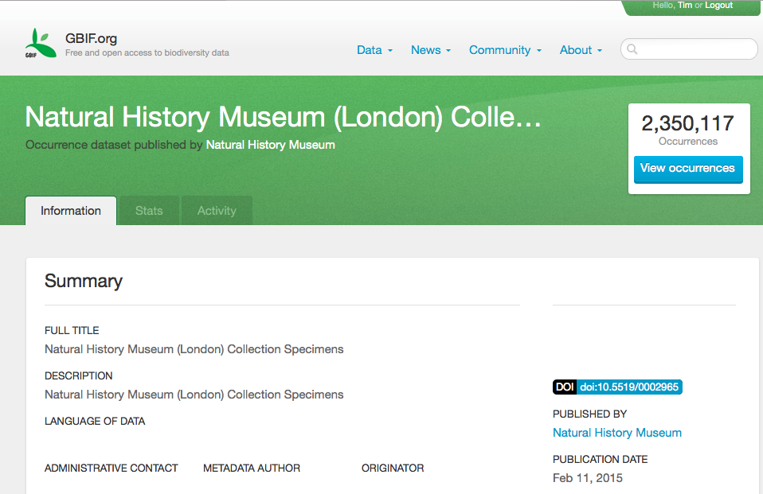
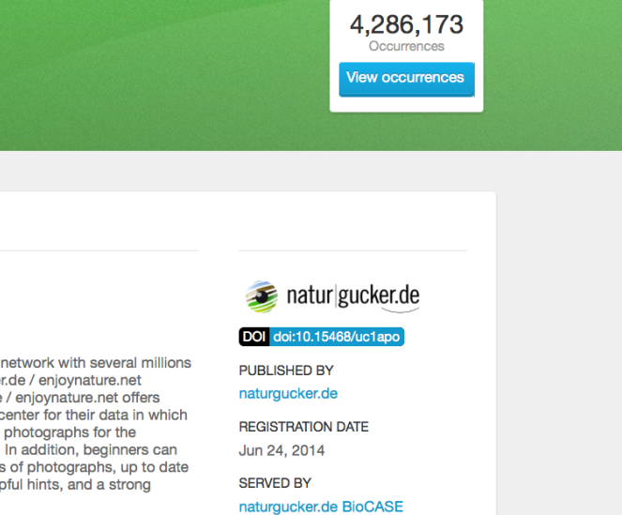
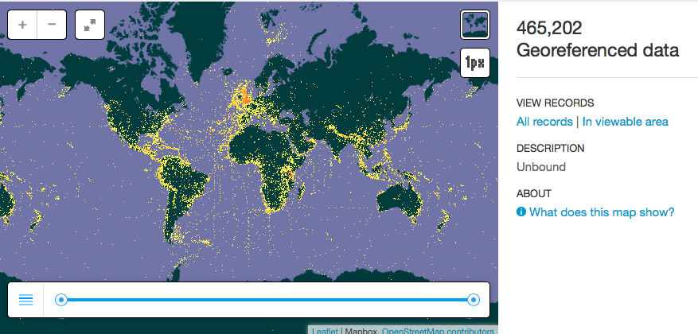
GBIF AND digital object identifiers
DOIs
http://www.gbif.org/newsroom/news/ipt-release-supports-doi-citation

Slide 12
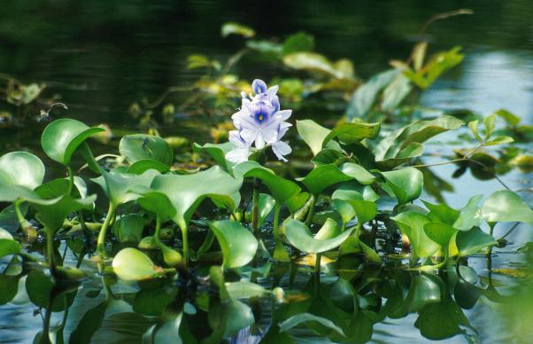
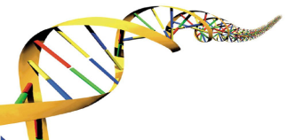
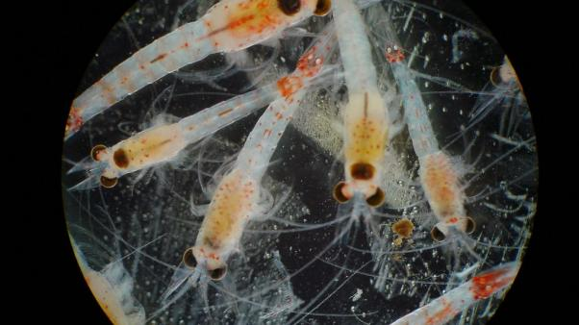
TASK GROUPS ON FITNESS FOR USE: invasive Alien Species and DNA evidence
2016 group on invasive alien species: Melodie McGeoch + 5 experts
meetings, teleconferences and survey
report in November 2016
* * *
Exploring data use and data publishing needs of molecular biodiversity research:
DNA survey, GGBN conference and TDWG
Improving availability of marine data to assess its fitness for academic use

Slide 13
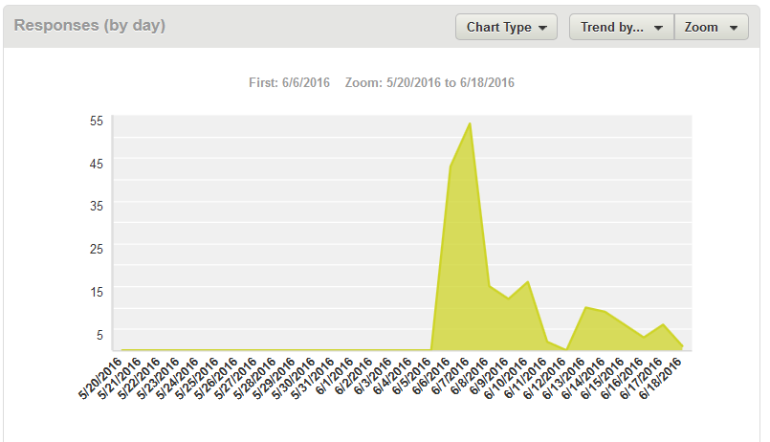
Molecular and morphological biodiversity: eaRLY SIGNALS GBIF and GGBN survey of data access, use and publishing
174 responses
31 May – 17 June 2016
Find the survey at GGBN.org and GBIF.org
fill the survey, forward the link

Slide 14
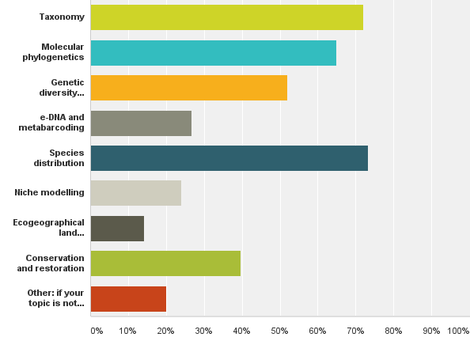
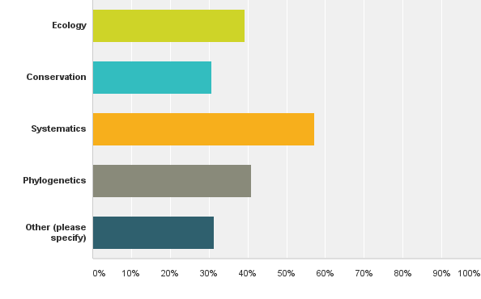
Q3: Research field & Q6 interest in accessing/using biodiversity Data?

Slide 15
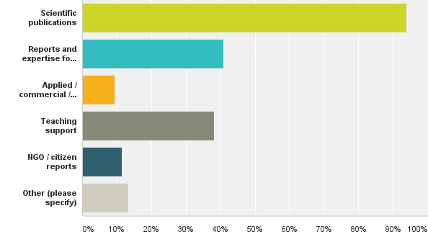
Q9: What kind of information product do you produce?

Slide 16
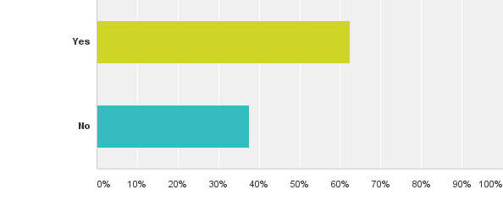
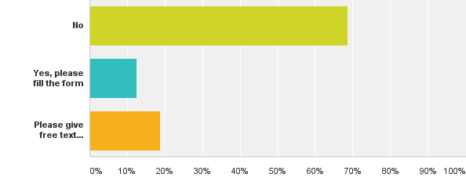
Q16: …published any molecular biodiversity data? & Q17: relevant datasets for GBIF & GGBN?

Slide 17
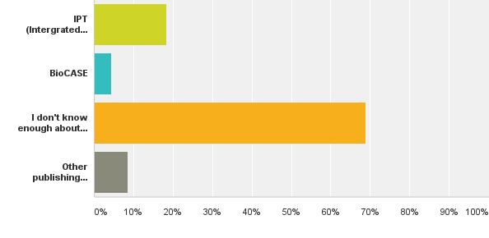
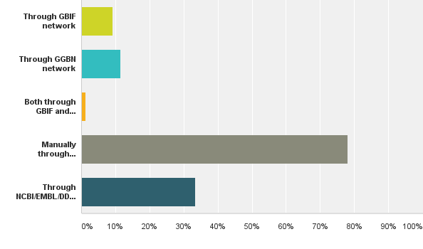
Q18: publishing molecular biodiversity data? & Q19: tool used to publish?

Slide 18
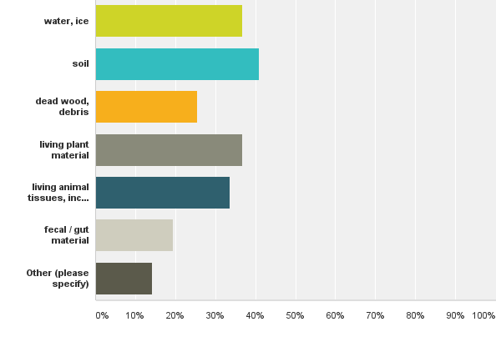
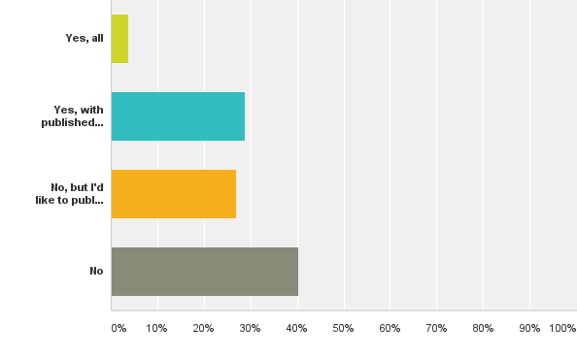
eDNA

Slide 19
MOLECULAR data in GBIF
287 dataset hits for “molecular”

Slide 20
GBIF and GGBN
WHO
WHERE
WHEN
WHO
WHERE
WHEN
COLLECTION
WHO
WHERE
WHEN
COLLECTION
MOLECULAR
WHO
WHERE
WHEN
COLLECTION
MARINE
WHO
WHERE
WHEN
COLLECTION
VERTEBRATE
WHO
WHERE
WHEN
COLLECTION
ARCTIC

Slide 21
GBIF network: partnerships and affiliations
http://www.gbif.org/whoweworkwith

Slide 22
Global Biodiversity Informatics Outlook
Models
Indicators
EBVs
GEO BON
Portals
Repositories
Curation
GBIF, GGBN,
ALA, EOL, CoL,
IUCN, WCMC,
GenBank, BOLD, ...
Digitisation
Field data
Remote-sensing
Museums
Universities
Govt. Agencies
Citizen Science
Standards
Best practices
Open data
RDA
TDWG
OGC
http://biodiversityinformatics.org/

Slide 23
strategic planning
GBIF Strategic Plan 2017-2021
http://www.gbif.org/newsroom/consultations#strategicplan

Slide 24
DATA QUALITY, ANALYSIS AND USE
Promoting data quality culture: talks, teaching, [publications]
TDWG / GBIF data quality interest group, chairs: Antonio Saraiva & Arthur Chapman
Join the work at the GBIF Community Site!
http://www.gbif.org/using-data

Slide 25
GAPS AND EBBE NIELSEN CHALLENGE 2016
Challenge opens on 29 July 2016
First prize €20,000, second prize €5,000
Winners announced on 26 October 2016
Dealing with gaps is the theme of the Ebbe Nielsen Challenge 2016
http://www.gbif.org/about/awards

Slide 26
DANKE schön

