Slide 1
Open biodiversity information: international perspectives
Dmitry Schigel Programme Officer for Content Analysis and Use GBIF Secretariat
Suomen Lajitietokeskus - seminaari eliölajitiedon merkityksestä, Helsinki, 22 MAY 2015

Slide 2
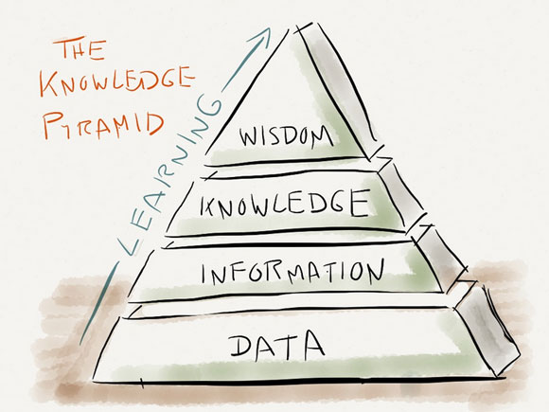
outline
Global biodiversity data
GBIF network
Finland and biodiversity data

Slide 3
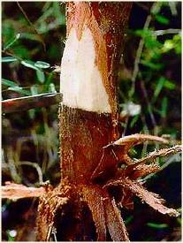
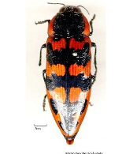
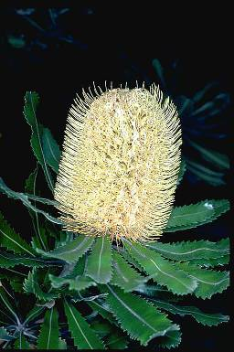
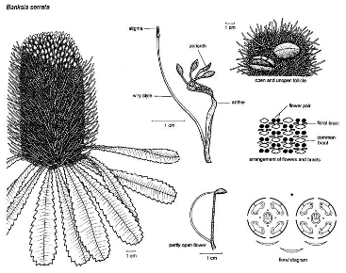
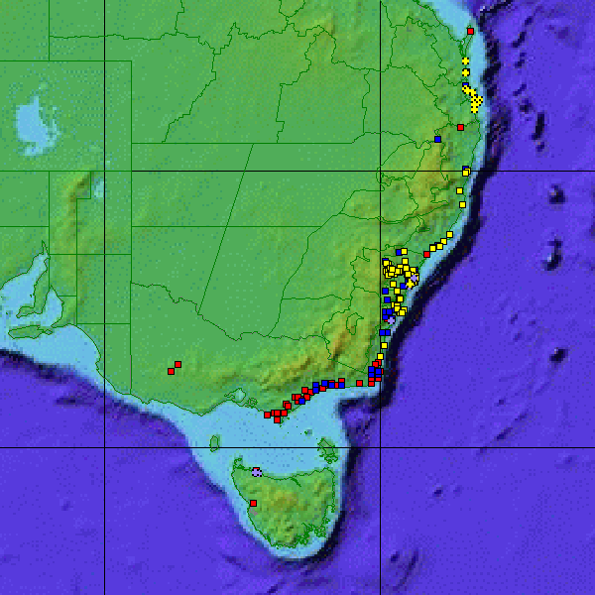
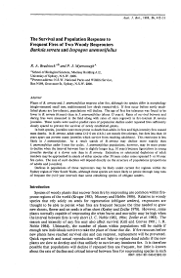
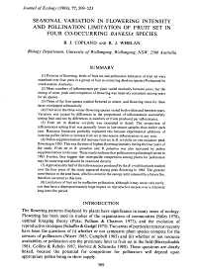
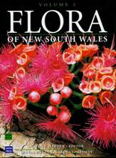
Biodiversity Data
Root rot
Phytophthora cinnamomi
Banksia jewel beetle
Cyrioides imperialis
Banksia serrata woodland
Acacia terminalis Allocasuarina monilifera
Banksia serrata
Dillwynia glaberrima
Epacris impressa
Leptospermum glaucescens
Leptospermum scoparium
Leucopogon collinus
Monotoca glauca
Philotheca virgata
Pimelea humilis
Community
member
Pathogen of
Larvae mine
stems
Banksia serrata L.f.
= Isostylis serrata (L.f.) Britten
Biology and ecology
= Sirmuellera serrata (L.f.) Kuntze
Named
Old Man Banksia
Saw Banksia
Kingdom: Plantae
Division: Magnoliophyta
Family: Proteaceae
Subfamily: Grevilleoideae
Tribe: Banksieae
Subtribe: Banksiinae
Genus: Banksia L.f.
Distribution
Literature
Molecular biology

Slide 4
Sources and uses
Uses of biodiversity data
Taxonomy, conservation, biosecurity, land-use planning, climate change response, crop development, resource management, materials development, forensics …
Sources of biodiversity data
Collections, field observations, monitoring activities, genomics, citizen science, remote sensing, expert knowledge, historical literature, ...

Slide 5
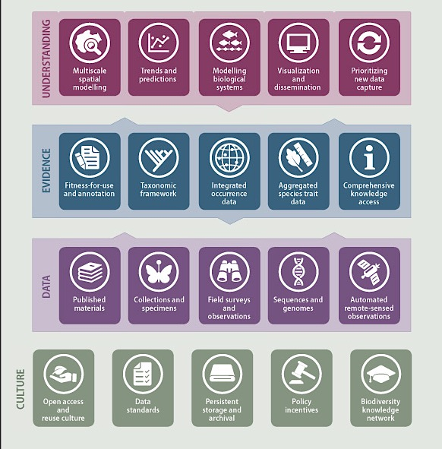
Digital Biodiversity Knowledge
http://biodiversityinformatics.org/
http://catalogueoflife.org/ http://biodiversitylibrary.org/ http://boldsystems.org/ http://eol.org/

Slide 6
BIODIVERSITY EVIDENCE and Policy
Implementation & monitoring
National Governments
POLICY
Strategic Plan for Biodiversity / Aichi Targets
Commitments
CBD
FAO
CMS
CITES
RAMSAR
Science-Policy
Interface
IPBES
Coordinated
analyses
IUCN
UNEP-WCMC
Future Earth
Expert
assessments
SCIENCE
Taxonomic
Research
Ecological
Research
Conservation
Research
Agricultural
Research
Human
Health
Climate
Change
Scientific
research
Data-Science
Interface
GEO BON
Map of Life
Modeled
variables
Catalogue
of Life
Data
catalogues
GBIF
TraitBank
INSDC
DATA
Natural
History
Collections
Field
Surveys
Laboratory
Data
Citizen
Science
Remote
Sensing
Source
data
Literature

Slide 7
GBIF network: partnerships and affiliations
http://www.gbif.org/whoweworkwith

Slide 8
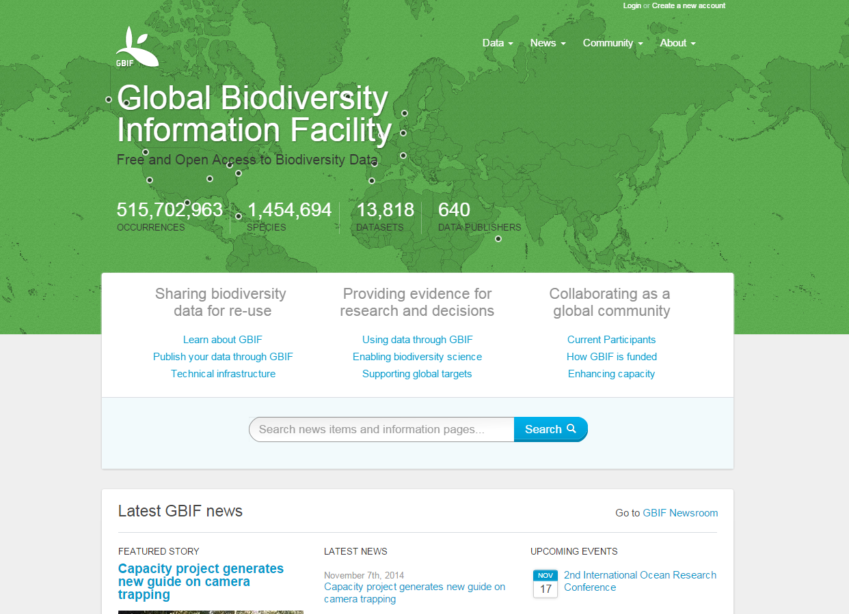
GBIF

Slide 9
Types of data shared through GBIF
Specimens from museum and herbarium collections
Observations from field surveys, inventories and citizen scientists
Records extracted from literature
NEW: Research projects, surveys, expeditions:
sample-based data

Slide 10
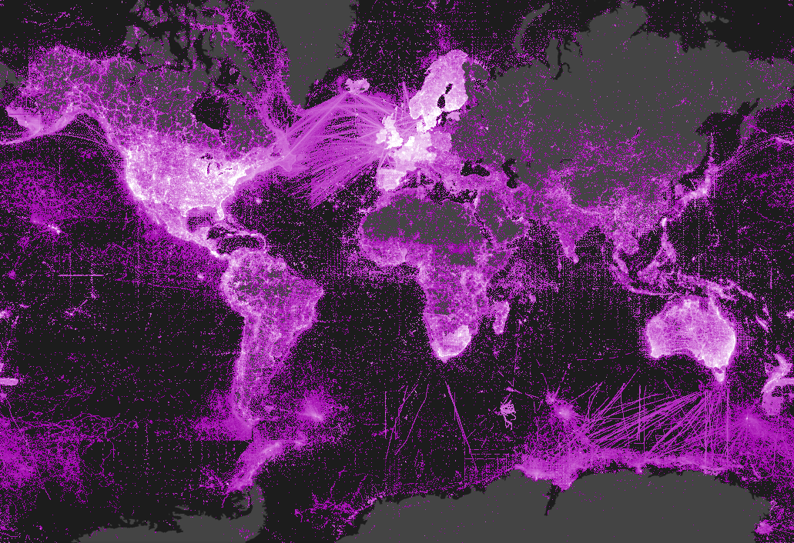
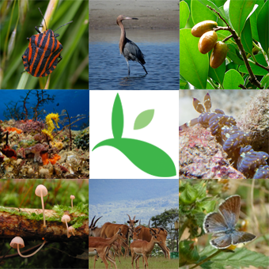
GBIF BY THE NUMBERS
533,667,297 species occurrence records
14,123 datasets
663 data-publishing institutions
http://www.gbif.org | 06 MAY 2015

Slide 11
Data published through GBIf.org
data publishing
Trend in primary biodiversity records (millions)
http://www.gbif.org | 6 MAY 2015

Slide 12
Data publishers
data publishing
Trend in number of institutions registered as GBIF data publishers
A sharp rise in the number of data publishers in September 2013 results from institutions choosing to register as separate entities rather than sharing datasets through a single publisher at their national node institution. http://www.gbif.org | 06 MAY 2015

Slide 13
Visits to GBIF.org by Country
use of gbif.org
Apr 2015
1. United States | 118,049 | 6. France | 5,715
2. China | 8,083 | 7. United Kingdom | 4,984
3. Spain | 6,388 | 8. Brazil | 4,823
4. India | 6,321 | 9. Mexico | 4,577
5. Germany | 6,075 | 10. Colombia | 3,620
Google Analytics report for GBIF.org; April statistics skewed by errors introduced in late April and resolved in early May. Access available upon request from comms@gbif.org | 04 MAY 2015

Slide 14
Data download requests, by country
use of gbif.org
1 Jan 2015 – 30 Apr 2015
Total of
33,144 requests
from 3886 users in
120 countries, islands and territories
1. Mexico | 5,838 | 6. Spain | 2,061
2. United States | 4,813 | 7. United Kingdom | 1,615
3. China | 3,359 | 8. Ecuador | 1,578
4. Denmark | 3,000 | 9. Colombia | 1,143
5. Brazil | 2,098 | 10. Germany | 895
Requests for download do not necessarily result in data actually being downloaded. Based on country indicated by user login | 06 MAY 2015

Slide 15
Citations in peer-reviewed research
research use
Annual number of peer-reviewed publications using GBIF-mediated data
04 MAY 2015

Slide 16
Research Examples
research use
Apr 2015
Brown, K.A., Parks, K.E., Bethell, C.A., et al. Predicting plant diversity patterns in Madagascar: understanding the effects of climate and land cover change in a biodiversity hotspot.
Khoury, C.K., Heider. B., Castañeda-Alvarez. N.P., et al. Distributions, ex situ conservation priorities, and genetic resource potential of crop wild relatives of sweet potato [Ipomoea batatas (L.) Lam., I. series Batatas]. Plant Science.
Leach, K., Kelly, R., Cameron, A., Montgomery, W.I. & Reid N. Expertly validated models and phylogenetically-controlled analysis suggests responses to climate change are related to species traits in the order Lagomorpha. PLoS ONE.
Shabani, F., Kumar, L., Nojoumian, A.H., et al. Projected future distribution of date palm and its potential use in alleviating micronutrient deficiency. J. Sci. Food Agric.
A complete archive of research citing used of GBIF can be accessed at http://www.mendeley.com/groups/1068301/gbif-public-library 06 MAY 2015

Slide 17
GBIF and Digital Object Identifiers
DOI – Digital Object Identifier
Persistent resolvable identifiers
Standard for published papers
Simplify citing references
Used in measuring impact

Slide 18
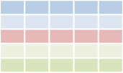
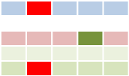
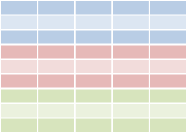
GBIF and Digital Object Identifiers
GBIF download
Cleaned data
Paper
Download DOI
Dataset DOI
Paper DOI
Data
Data
User publishes paper
Published paper can give resolvable links to GBIF download and/or to cleaned dataset
User cleans data
Researcher
Data attribution
Data attribution
User searches for data through GBIF.org
User deposits cleaned dataset in a repository and gets DOI for dataset
GBIF.org
Download history
Download 1
DataCite Denmark
. . .
GBIF assigns DOIs to
data downloads
GBIF.org creates a download data set

Slide 19
GBIF and Digital Object Identifiers
GBIF download
Cleaned data
Paper
Researcher
Reader
Download DOI
Dataset DOI
Paper DOI
Data
Data
Cite data sources
Linked results to data
Suggest data corrections
Retrieve source data
Reproduce results
Data attribution
Data attribution
Data Publisher
GBIF.org
GBIF
Download history
Download 1
. . .
Discover data usage
Receive suggested data corrections
Monitor data usage
Enhance fitness-for-use

Slide 20
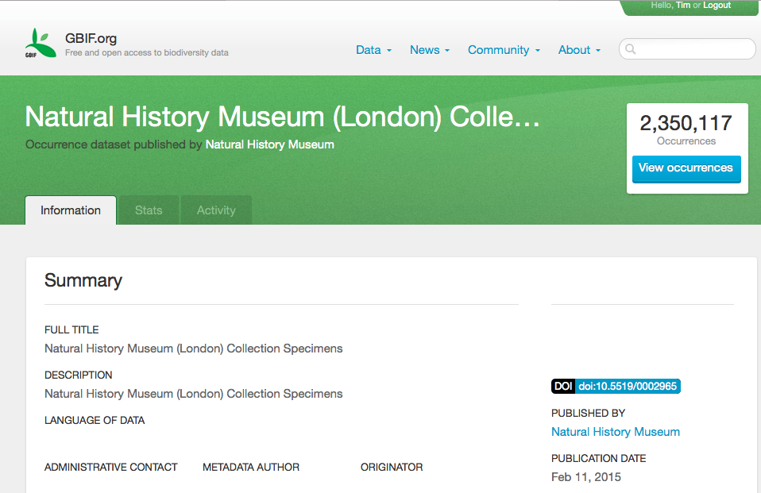
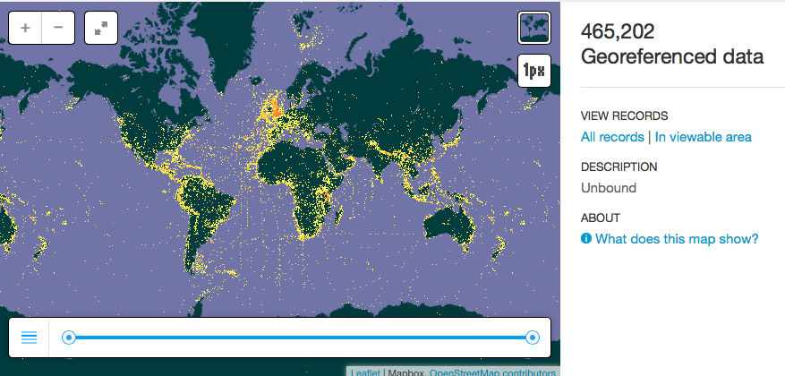
GBIF and digital object identifiers
http://www.gbif.org/dataset/7e380070-f762-11e1-a439-00145eb45e9a

Slide 21
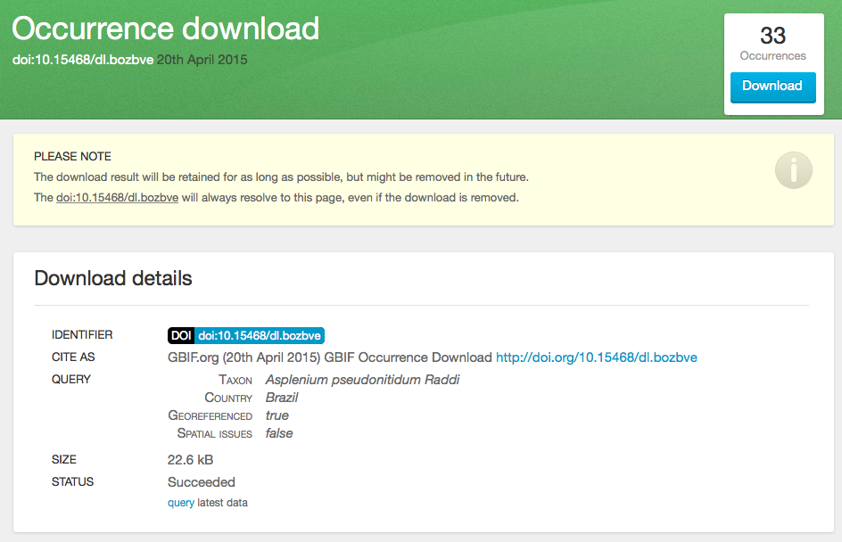
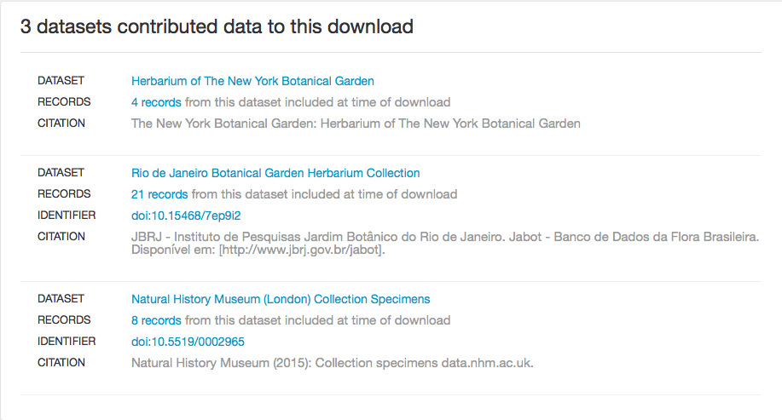
GBIF and digital object identifiers
http://www.gbif.org/dataset/7e380070-f762-11e1-a439-00145eb45e9a

Slide 22
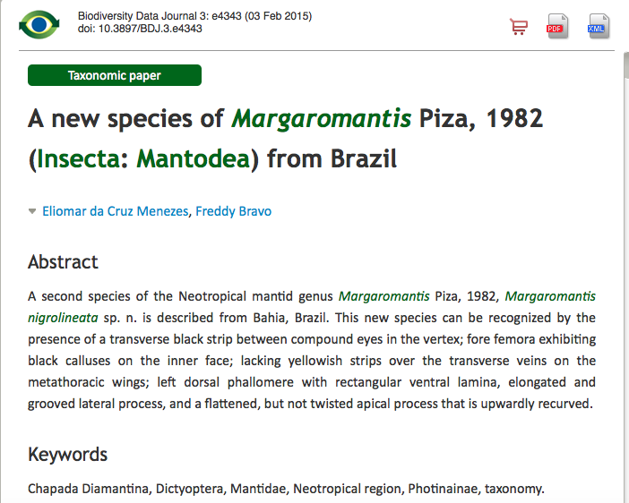
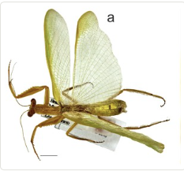
Publishing data from research

Slide 23
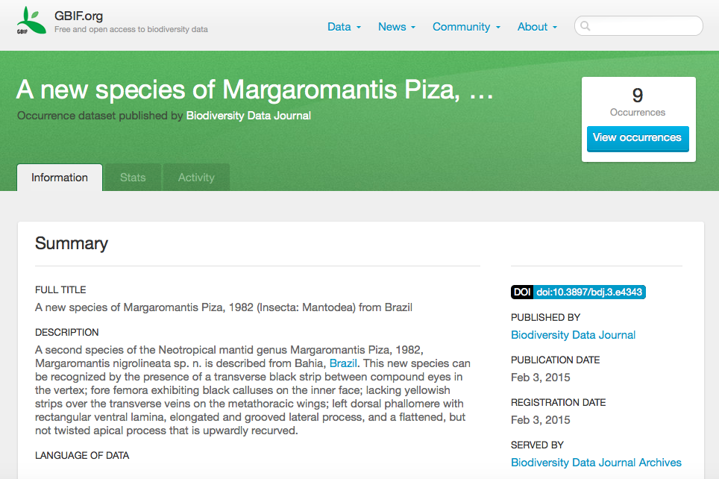
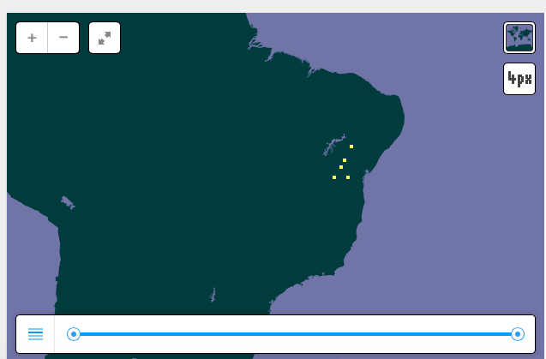
Publishing data from research
http://www.gbif.org/dataset/4bde5856-6d9f-41cd-880a-2d64eac05b0d

Slide 24
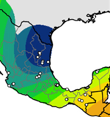
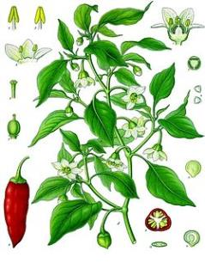
data quality
Enhancing data fitness for use
2015-16 objective: Enhance fitness of data accessed via GBIF.org for key research uses through engaging expert communities, and identify gaps
Agricultural biodiversity Chair: Elizabeth Arnaud, Bioversity International
Distribution modelling Chair: Jorge Soberon, University of Kansas
Next steps
Task group to consult with professional communities and prepare initial recommendations by GB22
Continue collaboration with University of São Paulo, Brazil, to develop user-based fitness-for-use ‘profiles’ for GBIF.org
Future task groups on marine & invasive species research
www.pnas.org/cgi/doi/10.1073/pnas.1308933111

Slide 25
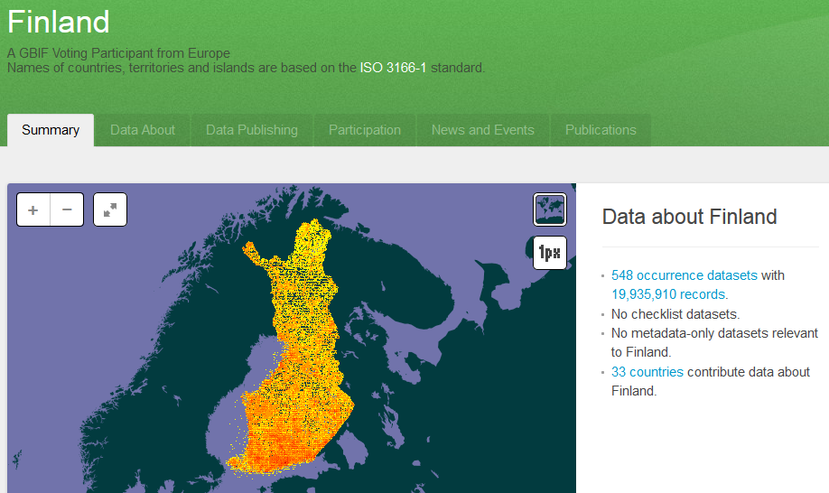
Finland And Global Biodiversity DATA

Slide 26
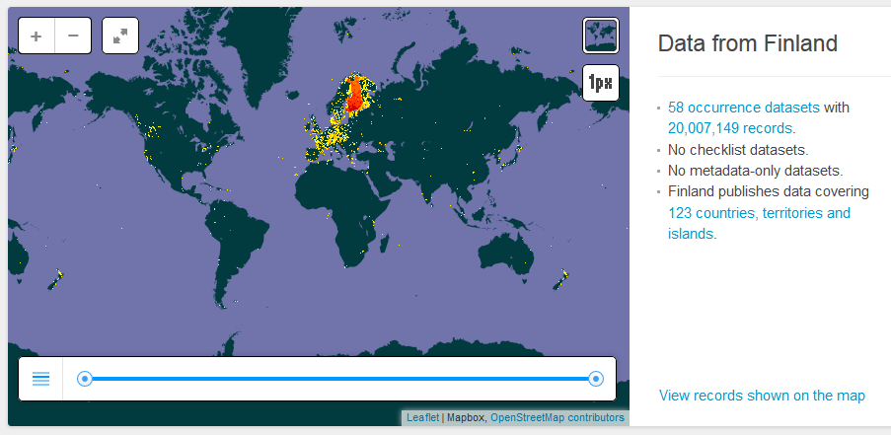
Finland And Global Biodiversity DATA

Slide 27
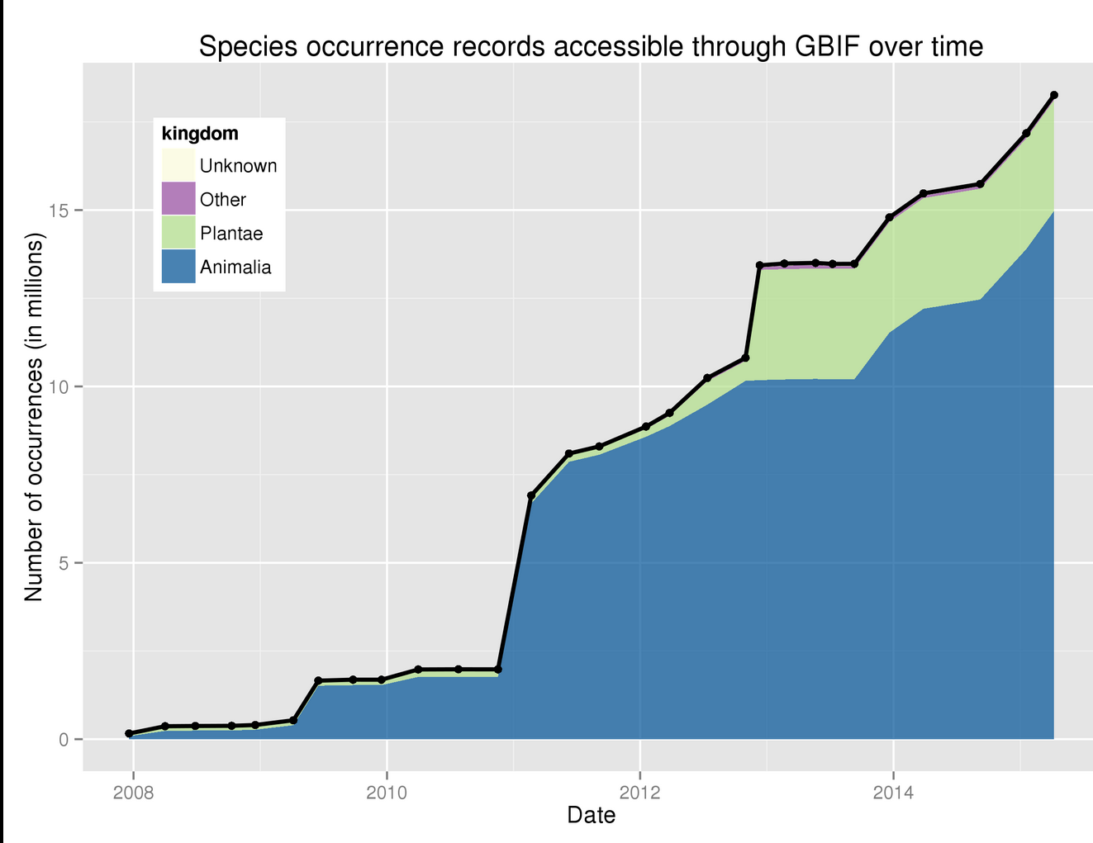
Finland And Global Biodiversity DATA

Slide 28
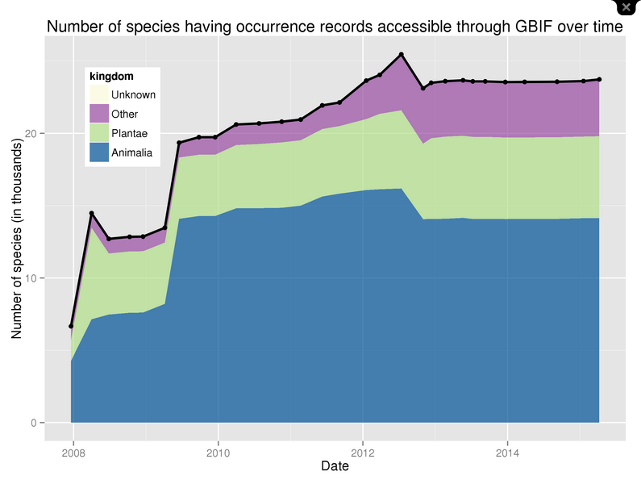
Finland And Global Biodiversity DATA

Slide 29
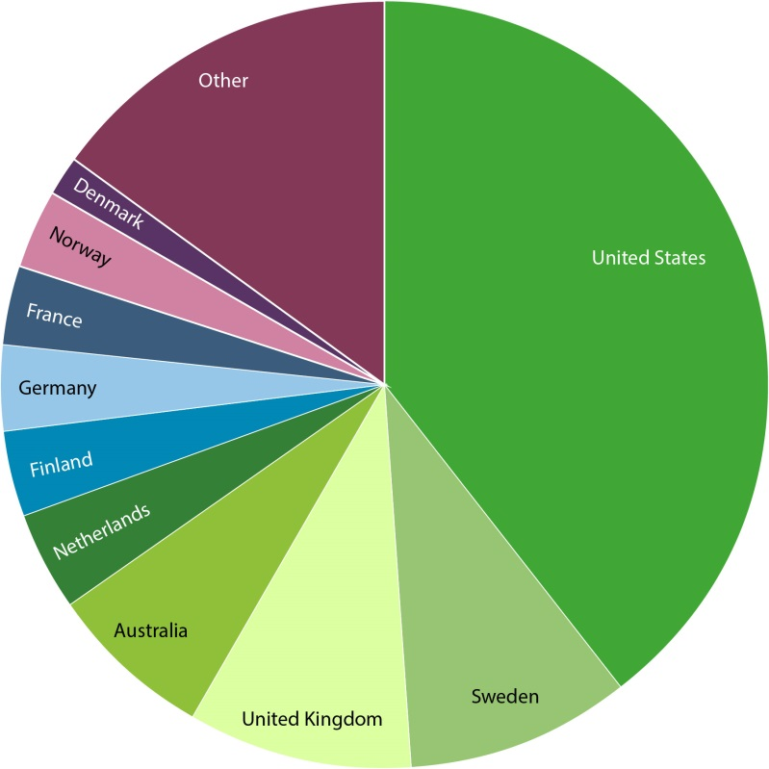
Data—by GBIF participant
data publishing
Number of new records published—Top 10 participant Countries (1 Jan to 30 Apr 2015)
Total number of records published—Top 10 Participant Countries (as of 30 Apr 2015)
1. United States | 2,433,348 | 6. Finland | 1,162,279
2. United Kingdom | 2,366,907 | 7. Belgium | 707,414
3. Australia | 2,260,641 | 8. Netherlands | 628,524
4. Sweden | 2,146,770 | 9. Norway | 252,036
5. Denmark | 1,187,322 | 10. Brazil | 110,487
1. United States | 209,481,914 | 6. Finland | 19,626,137
2. Sweden | 50,995,697 | 7. Germany | 18,792,652
3. United Kingdom | 49,538,295 | 8. France | 17,549,337
4. Australia | 36,989,101 | 9. Norway | 17,425,011
5. Netherlands | 21,577,009 | 10. Denmark | 10,238,708
NOTE: Datasets are assigned to countries according to the location of the publishing institution, including aggregated datasets with contributors from many other countries. http://www.gbif.org | 06 MAY 2015
Notes:
5.4 records per person in Sweden and 3.7 per capita in Finland, 3.4 records per capita in Norway while in USA it’s 0.65. If all 35 M Finnish records are considered, 6.4.

Slide 30
strategic planning
GBIF Strategic Plan 2017-2021
http://www.gbif.org/newsroom/consultations#strategicplan

Slide 31
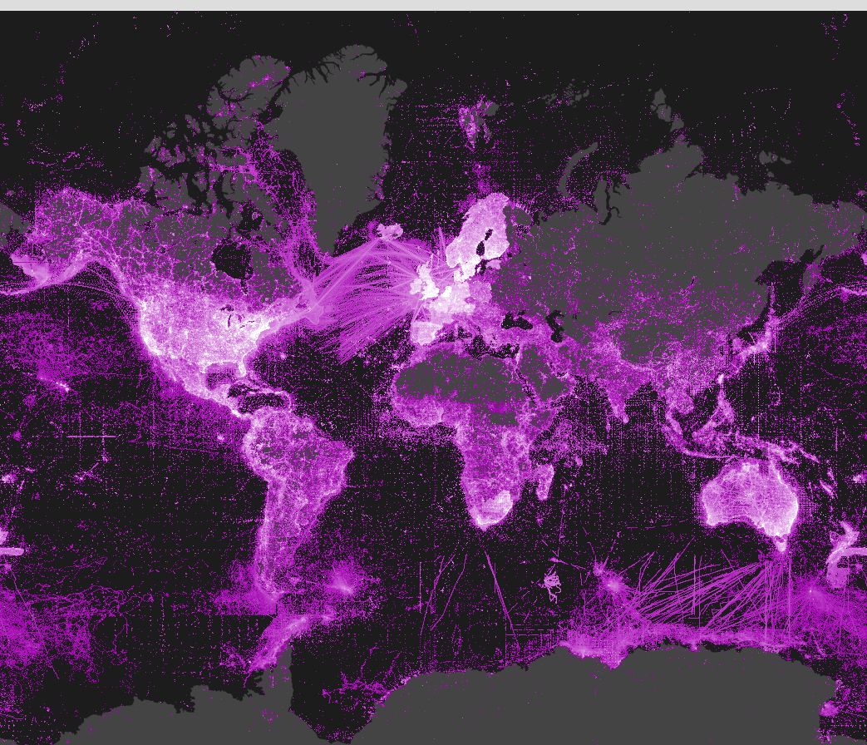
Kiitos Paljon

Slide 32
Concern – Prescence-only data
To monitor biodiversity trends, we need more than just presence data

Slide 33
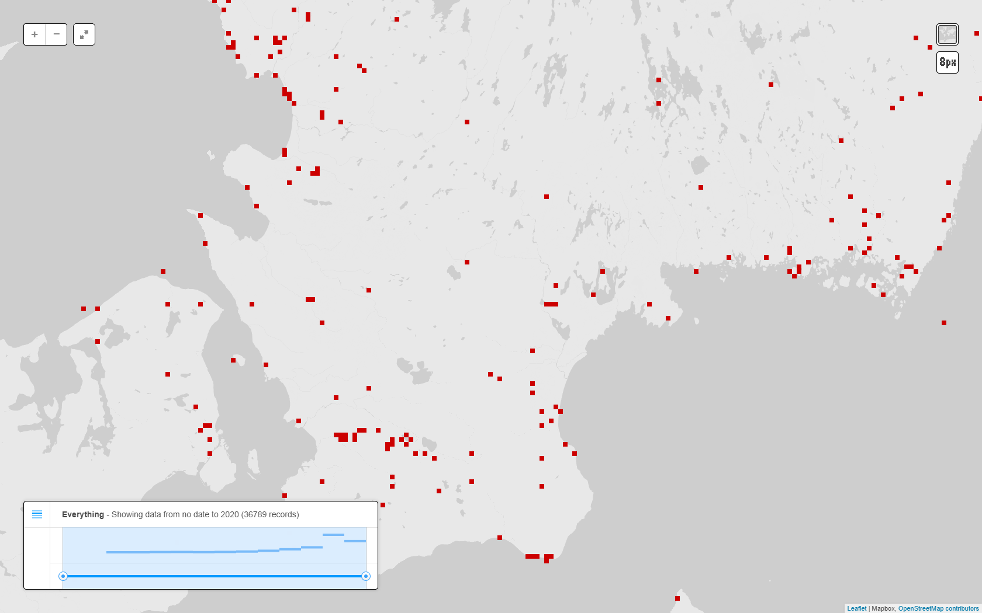
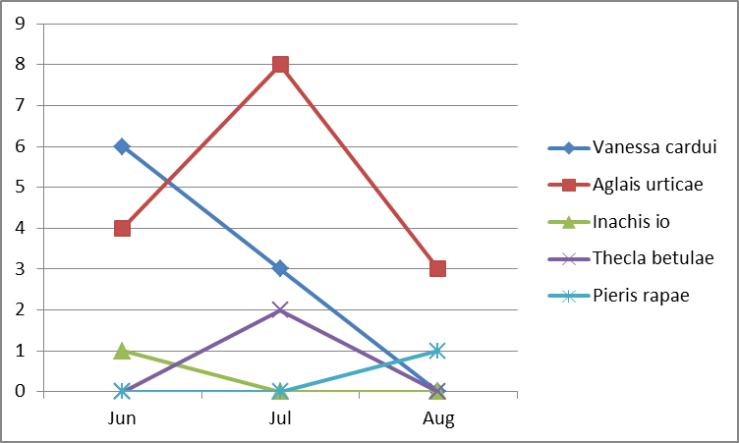
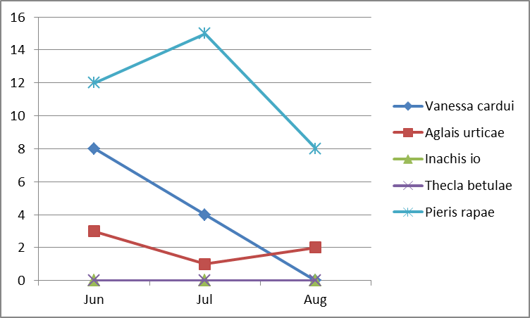
Extending GBIF for sample-based data
Species | Event | Quantity | Sample size | Protocol
Vanessa cardui | PlotA-2014-06 | 6 individuals | 1 km | Butterfly transect
Aglais urticae | PlotA-2014-06 | 4 individuals | 1 km | Butterfly transect
Inachis io | PlotA-2014-06 | 1 individual | 1 km | Butterfly transect
Species | Event | Quantity | Sample size | Protocol
Vanessa cardui | PlotA-2014-07 | 3 individuals | 1 km | Butterfly transect
Aglais urticae | PlotA-2014-07 | 8 individuals | 1 km | Butterfly transect
Thecla betulae | PlotA-2014-07 | 2 individuals | 1 km | Butterfly transect
Species | Event | Quantity | Sample size | Protocol
Pieris rapae | PlotA-2014-08 | 1 individuals | 1 km | Butterfly transect
Aglais urticae | PlotA-2014-08 | 3 individuals | 1 km | Butterfly transect
Comparable
Species | Event | Quantity | Sample size | Protocol
Pieris rapae | PlotB-2014-06 | 12 individuals | 1 km | Butterfly transect
Vanessa cardui | PlotB-2014-06 | 8 individuals | 1 km | Butterfly transect
Aglais urticae | PlotB-2014-06 | 3 individuals | 1 km | Butterfly transect
Species | Event | Quantity | Sample size | Protocol
Pieris rapae | PlotB-2014-07 | 15 individuals | 1 km | Butterfly transect
Vanessa cardui | PlotB-2014-07 | 4 individuals | 1 km | Butterfly transect
Aglais urticae | PlotB-2014-07 | 1 individuals | 1 km | Butterfly transect
Species | Event | Quantity | Sample size | Protocol
Pieris rapae | PlotB-2014-08 | 8 individuals | 1 km | Butterfly transect
Aglais urticae | PlotB-2014-08 | 2 individuals | 1 km | Butterfly transect
Not comparable
Species | Event | Quantity | Sample size | Protocol
Platichthys flesus | DiveX-20120301 | 3 individuals | 500 m2 | Fish dive survey
Sprattus sprattus | DiveX-20120301 | 71 individuals | 500 m2 | Fish dive survey

Slide 34
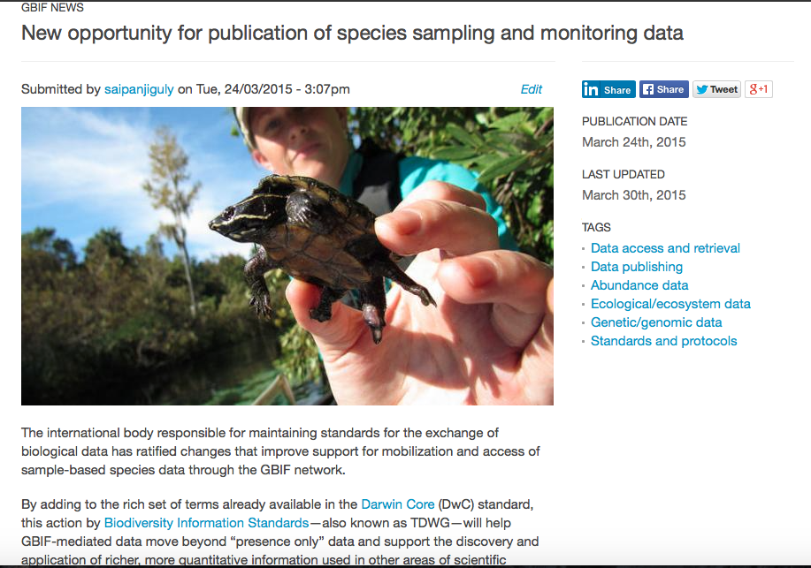
sample-based data
http://www.gbif.org/page/82105

Slide 35
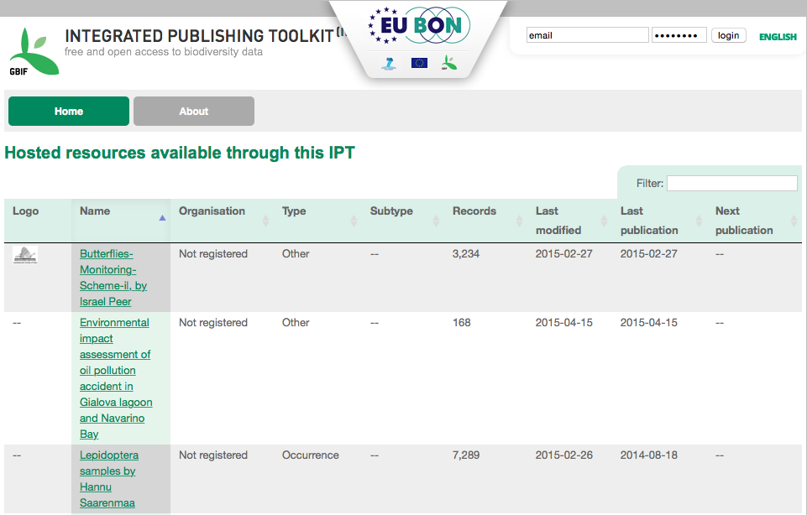
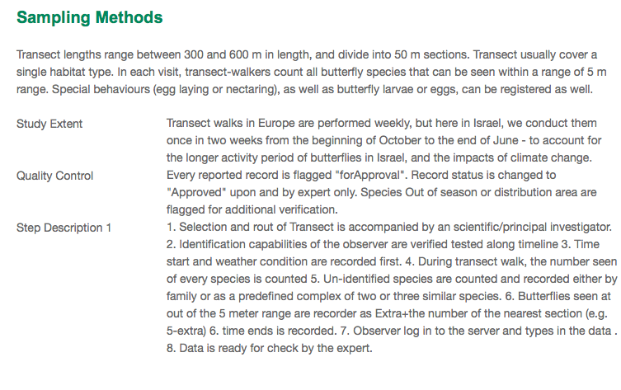
sample-based data
http://eubon-ipt.gbif.org/resource.do?r=butterflies-monitoring-scheme-il

Slide 36
GBIF and GLOBALLY CONNECTED DATA
Species Occurrence Catalogue
Taxon Name Catalogue
GBIF Data Index
Catalogue of Life
Institution Catalogue
Collection Catalogue
Taxon Concept Catalogue
Sequence Catalogue
Publication Catalogue
Comprehensive
service-centred catalogues
GBIF in future should use services from a shared catalogue to get the best concept (and to add it if not already included)
Published data sets
Catalogues with compatible services form an ecosystem to organise access to distributed biodiversity information
Catalogues are also best place of offer tools and services to support and organise annotations and corrections
Species
Occurrence
Taxon
Name
Institution
Collection
Taxon
Concept
Species occurrence record includes scientific name and no explicit species concept
Sequence
Publication
Conceptual biodiversity data model

