Slide 1
Data papers and DOIs
Dmitry Schigel Programme Officer for Content Analysis and Use GBIF Secretariat
EMODNET WP4 WORKSHOP, Crete, 8-9 June 2015

Slide 2
GBIF and Digital Object Identifiers
DOI – Digital Object Identifier
Persistent resolvable identifiers
Standard for published papers
Simplify citing references
Used in measuring impact

Slide 3
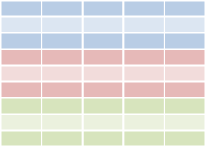
GBIF and Digital Object Identifiers
GBIF download
Cleaned data
Paper
Download DOI
Dataset DOI
Paper DOI
Data
Data
User publishes paper
Published paper can give resolvable links to GBIF download and/or to cleaned dataset
User cleans data
Researcher
Data attribution
Data attribution
User searches for data through GBIF.org
User deposits cleaned dataset in a repository and gets DOI for dataset
GBIF.org
Download history
Download 1
DataCite Denmark
. . .
GBIF assigns DOIs to
data downloads
GBIF.org creates a download data set

Slide 4
GBIF and Digital Object Identifiers
GBIF download
Cleaned data
Paper
Researcher
Reader
Download DOI
Dataset DOI
Paper DOI
Data
Data
Cite data sources
Linked results to data
Suggest data corrections
Retrieve source data
Reproduce results
Data attribution
Data attribution
Data Publisher
GBIF.org
GBIF
Download history
Download 1
. . .
Discover data usage
Receive suggested data corrections
Monitor data usage
Enhance fitness-for-use

Slide 5
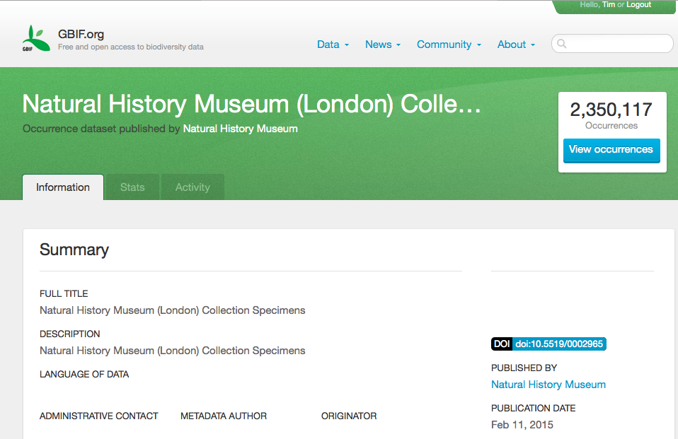
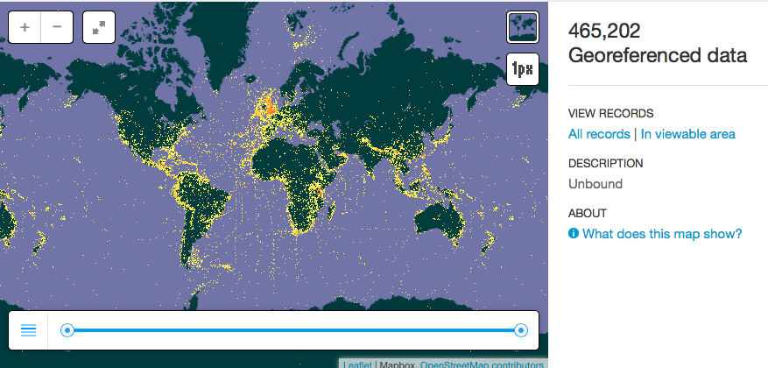
GBIF and digital object identifiers
http://www.gbif.org/dataset/7e380070-f762-11e1-a439-00145eb45e9a

Slide 6
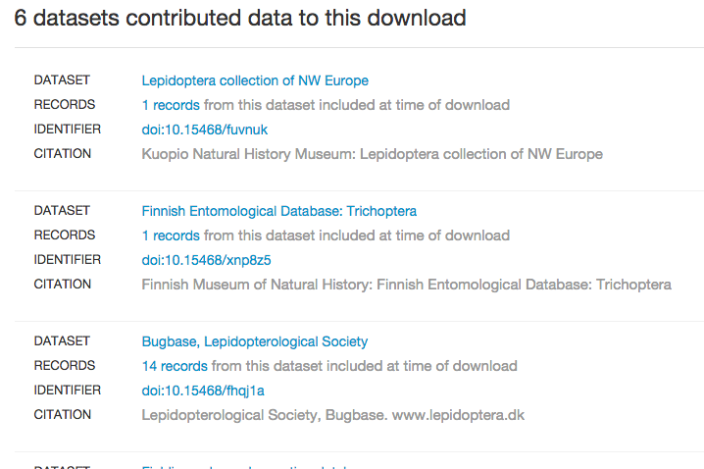
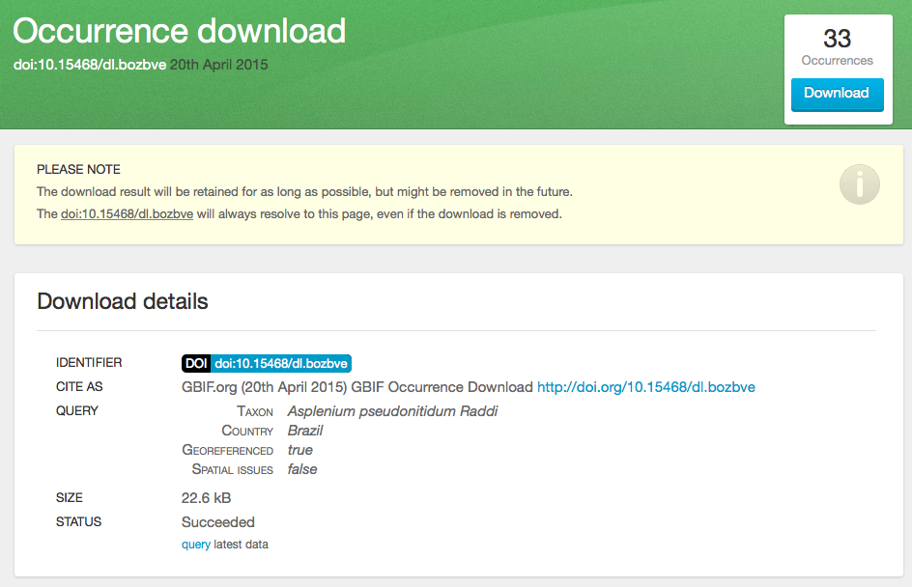
GBIF and digital object identifiers
http://www.gbif.org/dataset/7e380070-f762-11e1-a439-00145eb45e9a

Slide 7
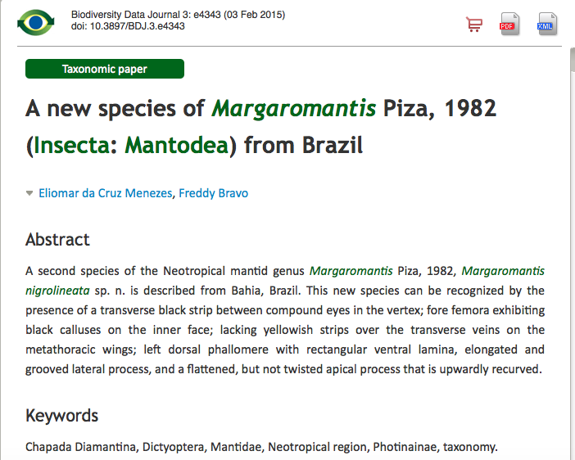
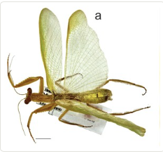
Publishing data from research

Slide 8
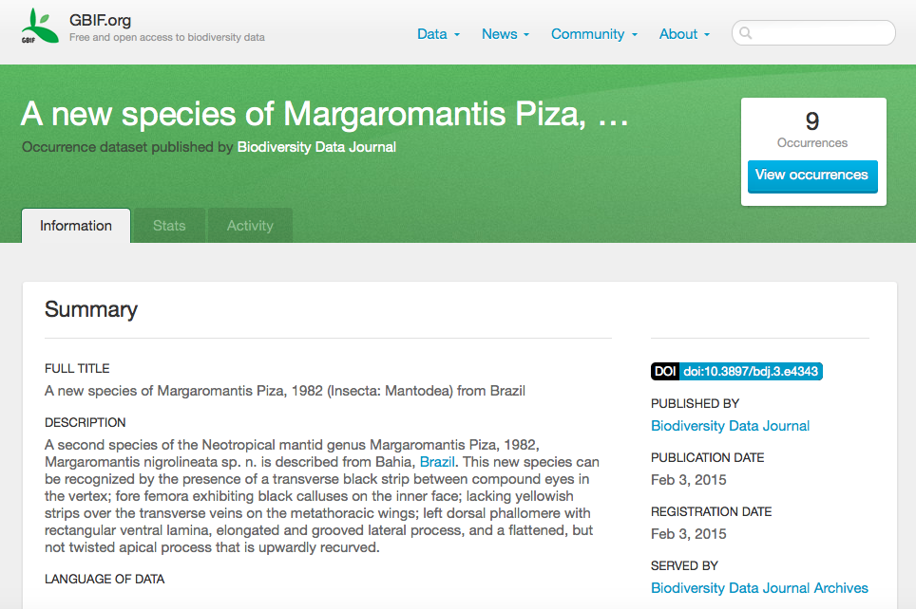
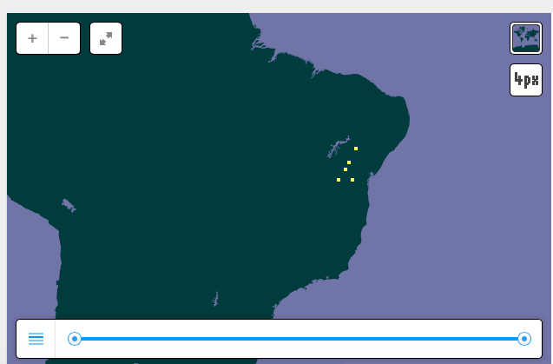
Publishing data from research
http://www.gbif.org/dataset/4bde5856-6d9f-41cd-880a-2d64eac05b0d

Slide 9
Content focus
Publishing avenue
Measure
count, downloads, research gate index.IF
Downloads,
Data citation index
Online stats:
activity, downloads
Aim
Communicating research results,
career, funding
Data availability
Data availability
Research paper
Data
Interpretation
Peer-reviewed journals
Data paper
BDJ, other journals
Dataset publication
GBIF

Slide 10
Categories of DOI | When issued | Issued by | Content | Why use | longevity
Mobilization | As close to publication event as possible | Publisher (e.g. using IPT 2.2) or GBIF.org | May change, versioning recommended | Institutional recognition through simple citation mechanism | Permanent (note: social responsibility)
Access | On any download using GBIF.org | GBIF | Immutable (will not change) | Simple citation, reproducibility, clarity of materials [& methods] | Description of data accession – permanent. Data – as long as possible (1 year?)
Use | Data archiving before manuscript submission | Repository where data is stored * | Immutable (will not change) | Clarity of results, enable reproducibility and discussion | Permanent
* GBIF aim to develop a repository backed by DataONE (scheduled for 2015)
…and there are, of course, bibliography DOIs
Notes:
The ultimate goal is to provide a service from GBIF.org to all data publishers, that lists the papers that have been published that make use of their data.
This helps provide the means to demonstrate to e.g. their funders, why they are investing in open data.

