Slide 1
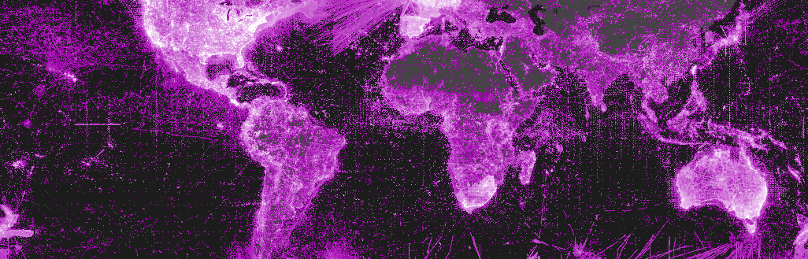
Biodiversity informatics and fungal data
Dmitry Schigel

Slide 2
Outline
Biodiversity informatics
e-Mycology
[Open] Data afterlife
What is GBIF and how does it work
Global and mycological examples

Slide 3
What is biodiversity informatics and why care?
Long words: definition from Wikipedia
“is the application of informatics techniques to biodiversity information for improved management, presentation, discovery, exploration and analysis”
Real life: time- and effort-saving tools
Biodiversity data are too many and too complex to handle
without the biodiversity informatics tools
Do you care about project, time, effort, scale and integration?

Slide 4
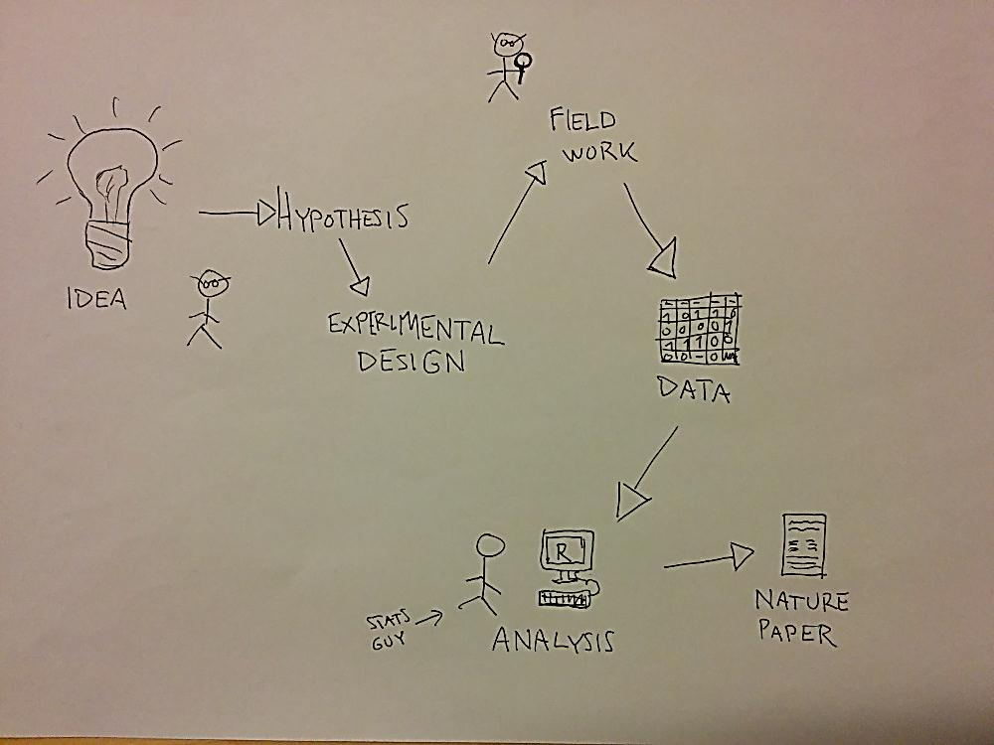
Image: Joona Lehtomäki (CC-BY 4.0)

Slide 5
Published?
Image: Joona Lehtomäki (CC-BY 4.0)

Slide 6
Image: Joona Lehtomäki (CC-BY 4.0)

Slide 7
Research activities
EXISTING
research planning
data collecting
data analysis
publishing
communication
OFTEN MISSING
data management
Data
... collection
... entry
... cleaning
... analysis
... archival

Slide 8
Data recycling
Publishing data exposes possible errors and allows better ”peer-review” quality control
Making your data compatible with global repositories is a data quality control method in itself
Good practice for reproduclible science, test wether the results actually say what is in the paper
Possibility to use different methods to same data
Data in repositories are mostly used in different scale than original context
by Hanna Kouvula

Slide 9
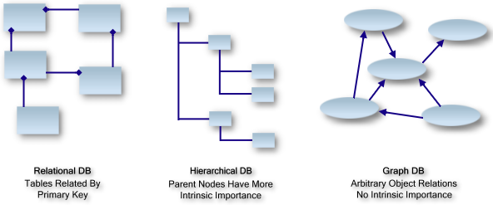
Tools – databases
keep massive and complex data with repeating entries neat
for anything from labels to sequences, measurements, images
Relational database is organised with relations that apply the principles of cardinality that define the data model.
An XML document typically contains nodes of information each with a parent node.
In a data graph, there is no concept of roots (or a hierarchy).

Slide 10
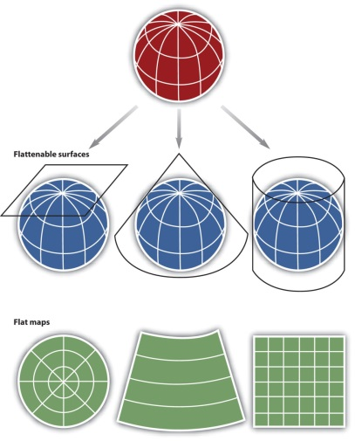
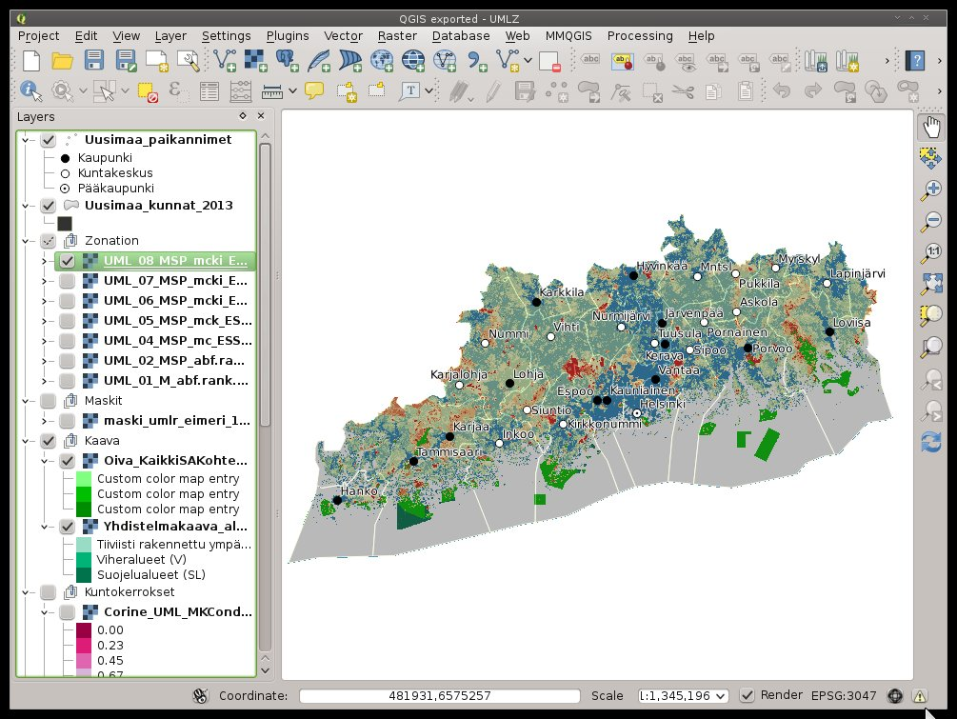
Tools – GIS
Geographic Information System
Unavoidable if doing anything serious with spatial data
Excellent for:
  Data entry
  Exploratory analyses
  Quality control
by Joona Lehtomäki

Slide 11


Tools – Programmatic tools
Many languages such as R and Python have extensive spatial capabilities
Maximal flexibility and power
Isolate repetitive tasks into functions/packages/libraries
A script is a complete documentation of what was done
by Joona Lehtomäki

Slide 12
Tools – Recommendations
It’s worth importing your spatial data to a GIS for quality control
Doing stats in R? Use programmatic tools for spatial data too!
For large datasets and performance, consider a database-approach
by Joona Lehtomäki

Slide 13
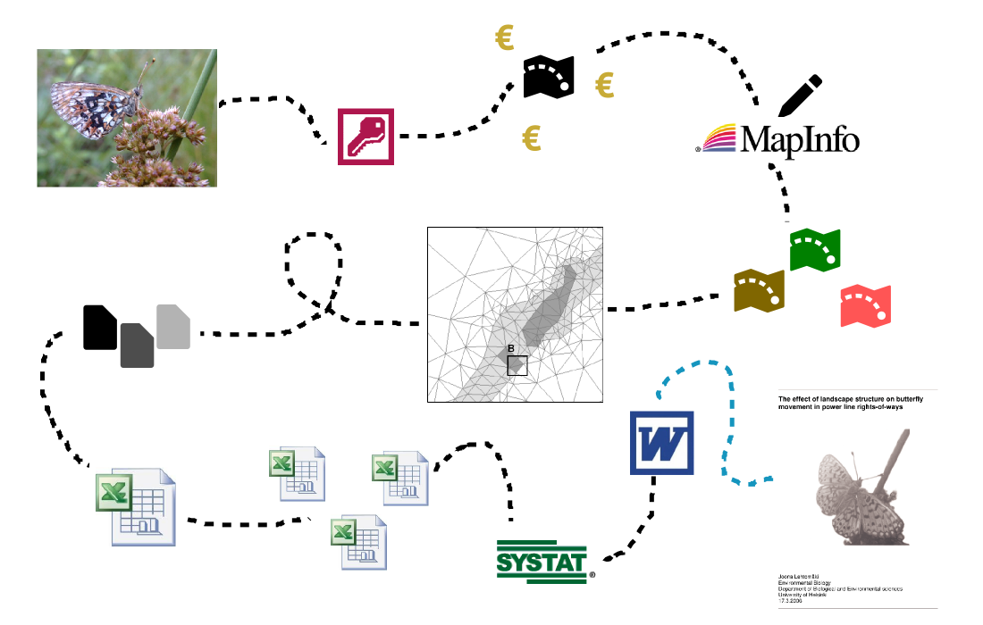
Image: Joona Lehtomäki (CC-BY 4.0)

Slide 14
e-Mycology
Index Fungorum & MycoBank
UNITE & PlutoF
Cybertruffle
Regional and national portals and databases
Thematic portals and databases
General biological portals with mycological content
e-publicaftions and data repositories

Slide 15
Next-generation sequencing: pipelines, codes, libraries
ITSx
QUIIME
SCATA
MRC / University of Helsinki pipeline
University if Copenhagen
… and many more.

Slide 16
[Open] Data afterlife

Slide 17
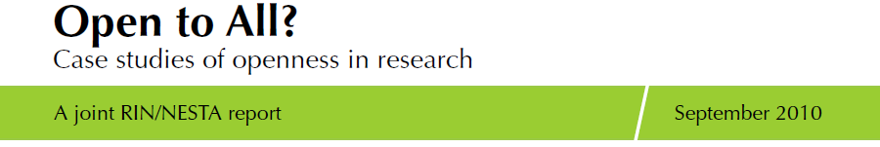
Benefits of openess
Increases the efficiency of research
Promotes scholarly rigour and enhancements to the quality of research
Enhances visibility and scope for engagement
by Joona Lehtomäki

Slide 18
Benefits of openess
Enables researchers to ask new research questions
Enhances collaboration and community-building
Increases the economic and social impact of research
by Joona Lehtomäki

Slide 19
Barriers and constraints to openess
Lack of evidence of benefits and rewards
Lack of skills, time and other resources
Cultures of independence and competition
Concerns about quality
Ethical, legal and other restrictions on accessibility
by Joona Lehtomäki

Slide 20
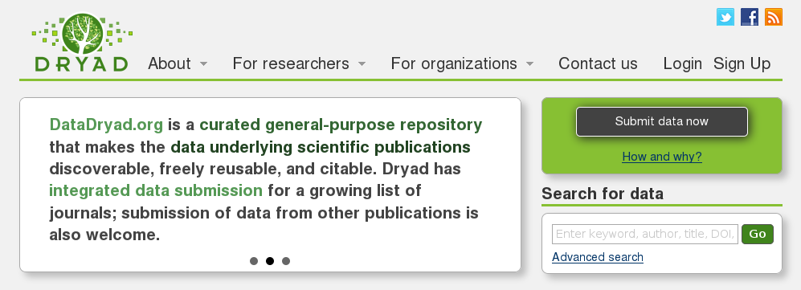
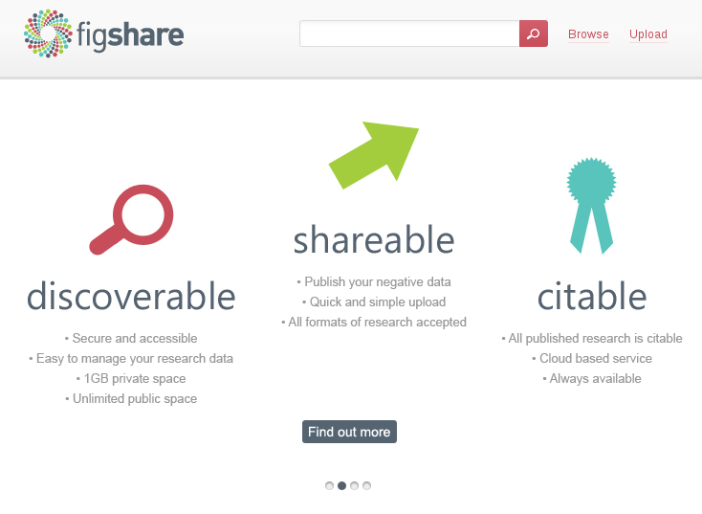
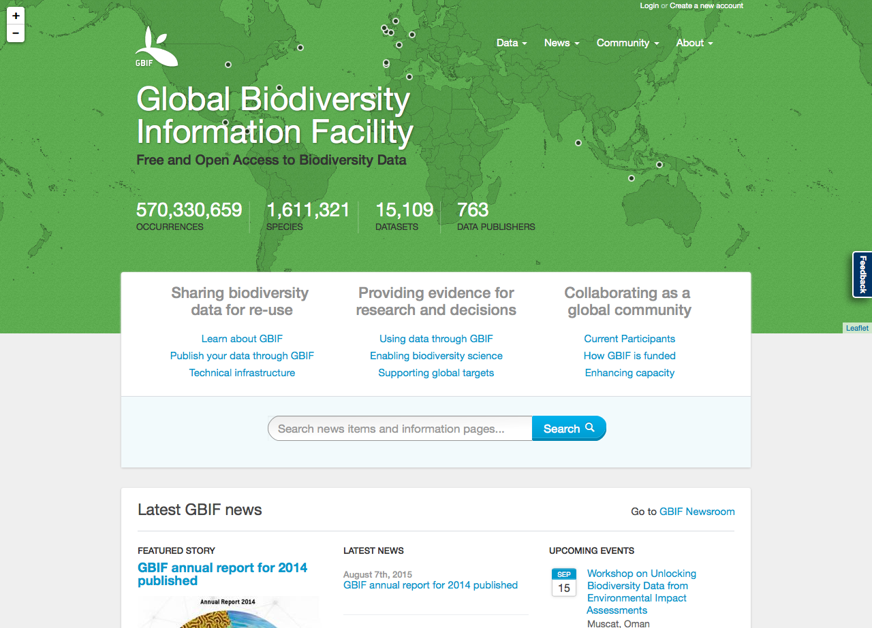
by Joona Lehtomäki

Slide 21
short term
long term
RESEARCH PHASE
DISSEMINATION PHASE
PRESERVATION
PHASE
file formats
ownership
metadata
storage
backups
share with whom?
embargo?
licensing
metadata
repository?
long-term manager?
by Joona Lehtomäki

Slide 22
by Hanna Koivula

Slide 23
What is GBIF and how does it work

Slide 24




















what
SOURCES AND USES
Uses of biodiversity data
Taxonomy, conservation, biosecurity, land-use planning, climate change response, crop development, resource management, materials development, forensics …
Sources of biodiversity data
Collections, field observations, monitoring activities, genomics, citizen science, remote sensing, expert knowledge, historical literature, ...
www.gbif.org

Slide 25
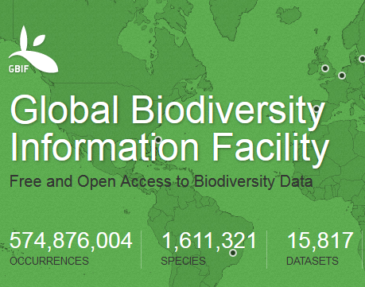
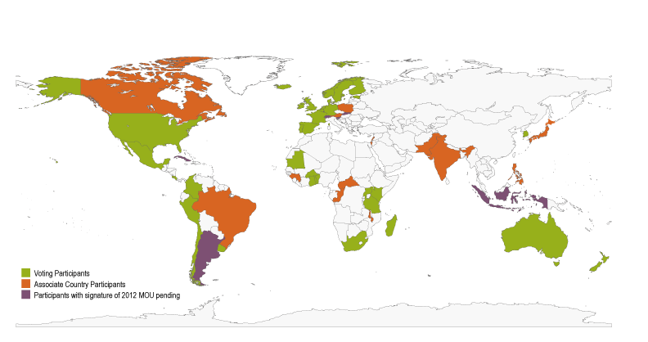
WHAT IS GBIF?
Free and open access to biodiversity information
International open data
research and policy
infrastructure
Funded by governments
92 members:
54 countries &
38 institutions
http://www.gbif.org/participation/summary

Slide 26
WHAT Does GBIF do?
Provides and maintains open access and web services to global species data through GBIF.org
Promotes common standards and free tools for biodiversity data management and exchange
Offers guidance on national mobilization of biodiversity information
Supports collaborative network at global and regional levels
www.gbif.org

Slide 27
Notes:
How does all this happen? It all comes togerther in GBIF.org, which is now a functional, near real-time infrastructure.

Slide 28
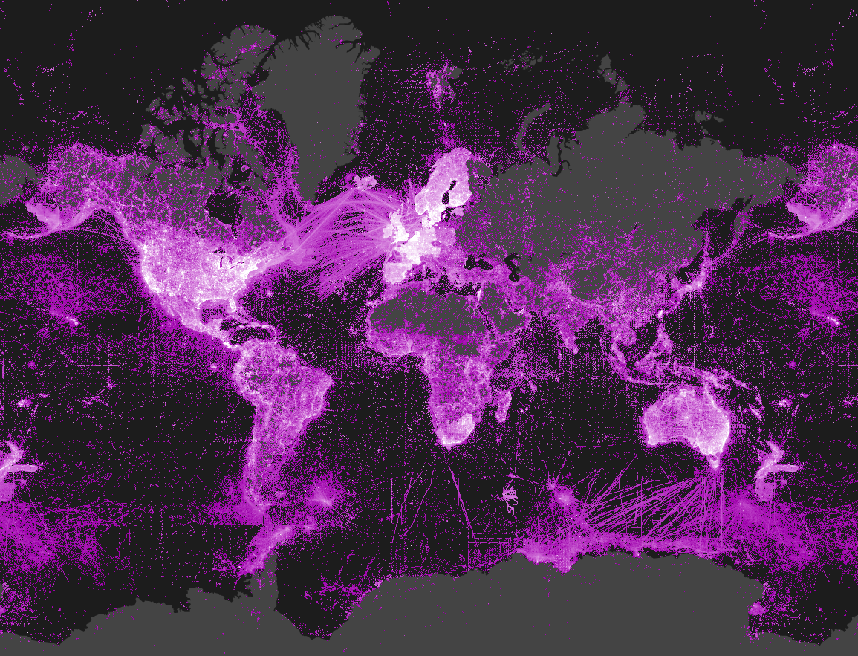

GBIF BY THE NUMBERS
570,330,659 species occurrence records
1,611,321
species
15,109
datasets
763
data-publishing institutions
http://www.gbif.org | 9 SEP 2015
Notes:
Snapshot of what we provide

Slide 29
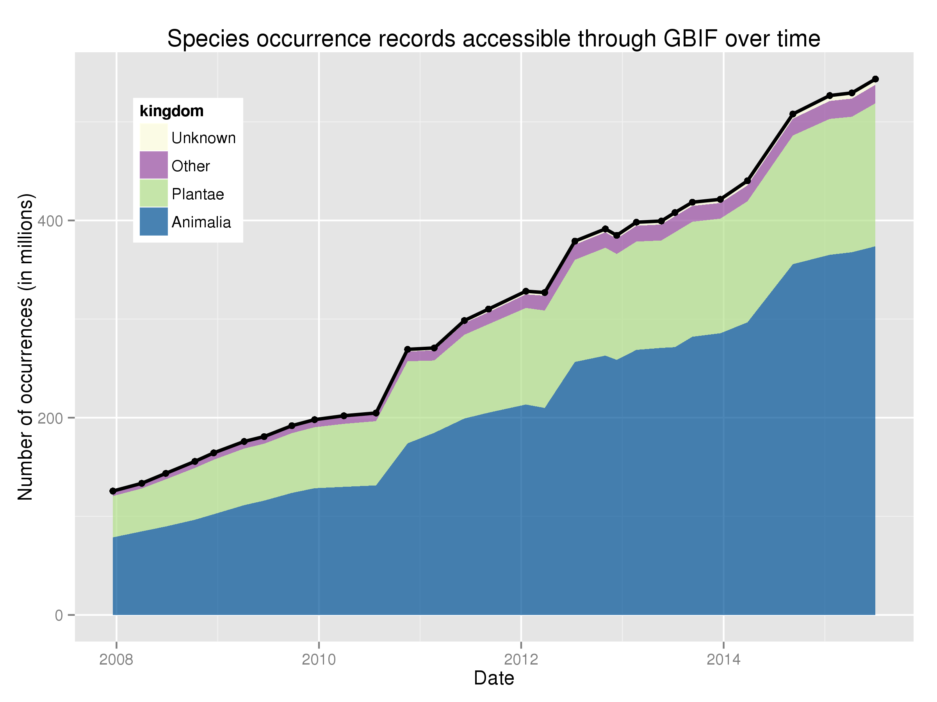
Reporting on data trends
global
http://www.gbif.org/analytics/global
Notes:
The infrastructure is maturing, and while we are still very much engaged in content mobilization, we are also coming to grips with questions data quality and data gaps. Global and national metrics on data trends are one way of doing that. Not simply numbers, but also geographic or taxonomic completeness and precision, for example.

Slide 30
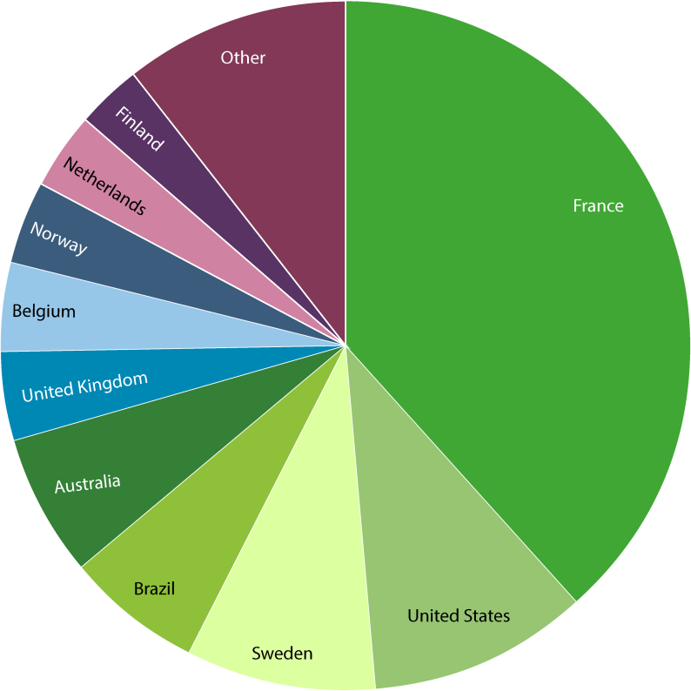
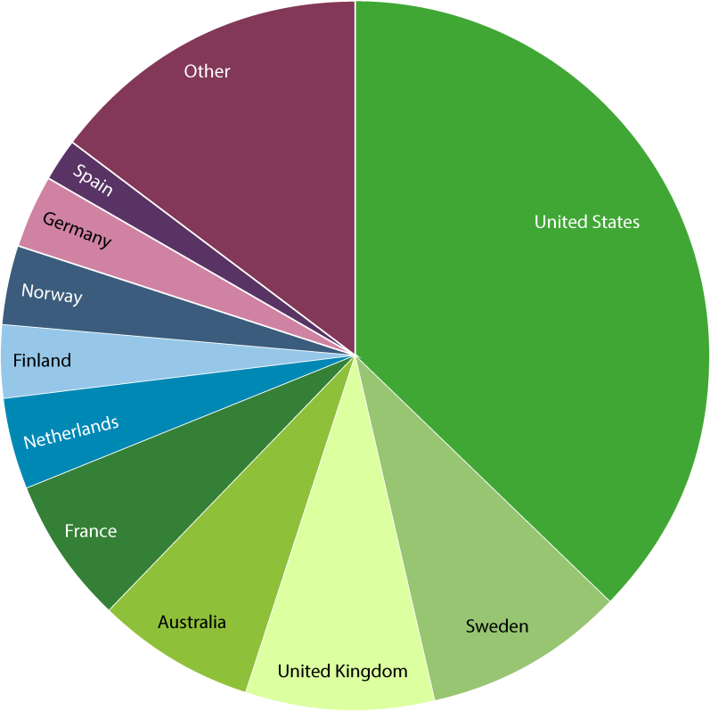
Data—by gbif participant
data publishing
Number of new records published—Top 10 participant Countries
(1 Jan to 31 August 2015)
Total number of records published—Top 10 Participant Countries
(as of 31 August 2015)
1. France | 21,582,586 | 6. United Kingdom | 2,440,150
2. United States | 5,920,877 | 7. Belgium | 2,297,574
3. Sweden | 4,907,131 | 8. Norway | 2,192,808
4. Brazil | 3,736,933 | 9. Netherlands | 2,088,214
5. Australia | 3,605,281 | 10. Finland | 1,736,075
1. United States | 212,516,656 | 6. Netherlands | 22,694,678
2. Sweden | 52,232,884 | 7. Finland | 20,157,042
3. United Kingdom | 49,611,538 | 8. Norway | 19,137,395
4. Australia | 40,300,025 | 9. Germany | 19,121,495
5. France | 38,974,640 | 10. Spain | 10,668,065
NOTE: Datasets are assigned to countries according to the location of the publishing institution,
including aggregated datasets with contributors from many other countries. http://www.gbif.org | 03 SEP 2015

Slide 31
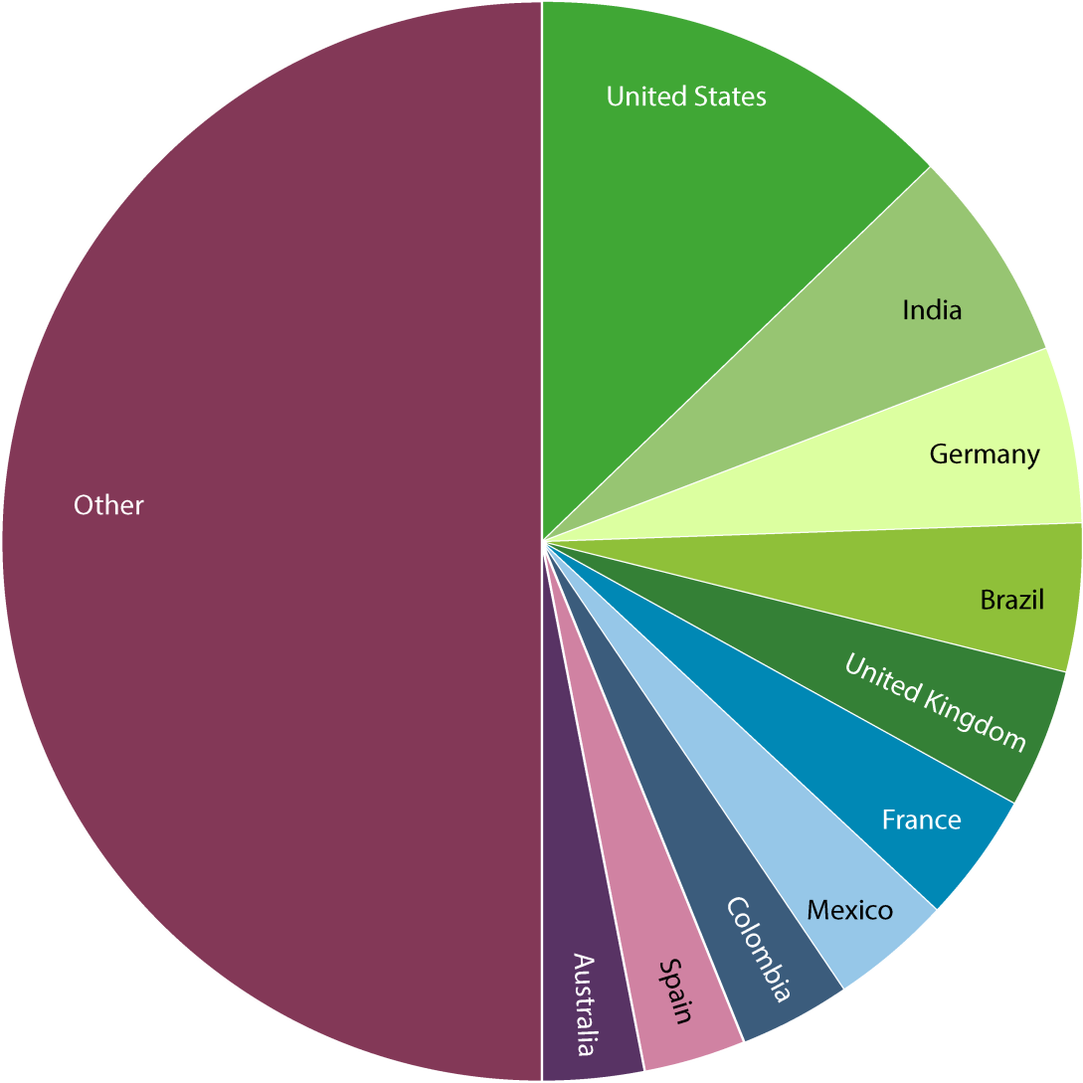
Visits to GBIF.org by Country
use of gbif.org
August 2015
1. United States | 12,152 | 6. France | 3,670
2. India | 6,150 | 7. Mexico | 3,338
3. Germany | 4,839 | 8. Colombia | 3,163
4. Brazil | 4,153 | 9. Spain | 2,909
5. United Kingdom | 3,890 | 10. Australia | 2,765
Access available upon request from comms@gbif.org | 02 SEP 2015

Slide 32
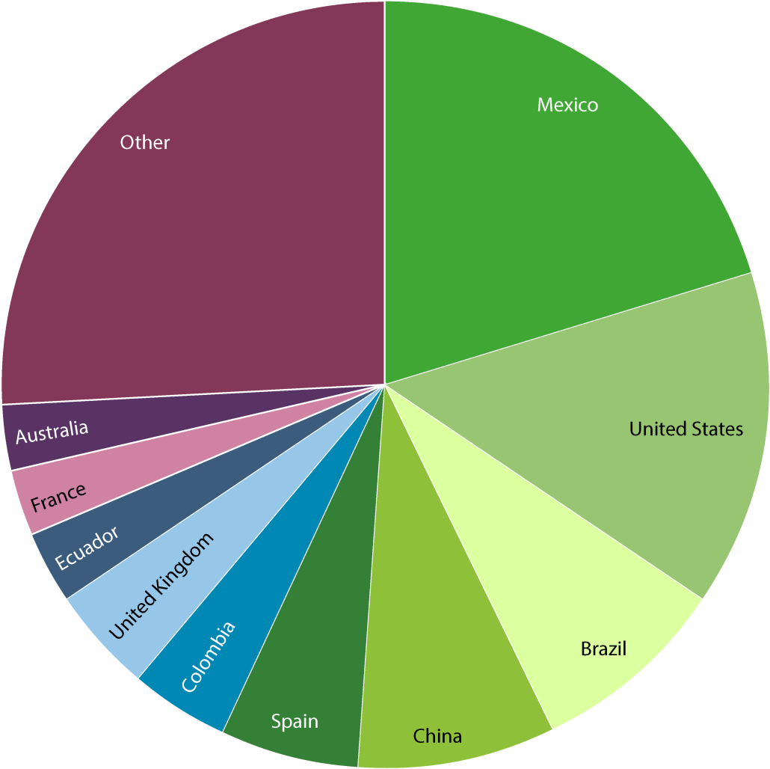
Data download requests, by country
use of gbif.org
1 Jan 2015 – 31 August 2015
Total of
58,538 requests
from 6,167 users in
137 countries, islands and territories
1. Mexico | 11,920 | 6. Colombia | 2,524
2. United States | 8,336 | 7. United Kingdom | 2,486
3. Brazil | 4,876 | 8. Ecuador | 1,814
4. China | 4,825 | 9. France | 1,618
5. Spain | 3,477 | 10. Australia | 1,616
Requests for download do not necessarily result in data actually being downloaded. Based on country indicated by user login | 4 SEP 2015

Slide 33
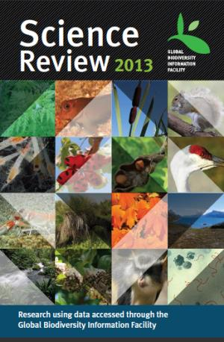
GBIF FOR SCIENCE
~ 1.5 peer-reviewed publications a day
annual number of peer-reviewed publications using GBIF-mediated data
http://www.gbif.org/resources/3427

Slide 34
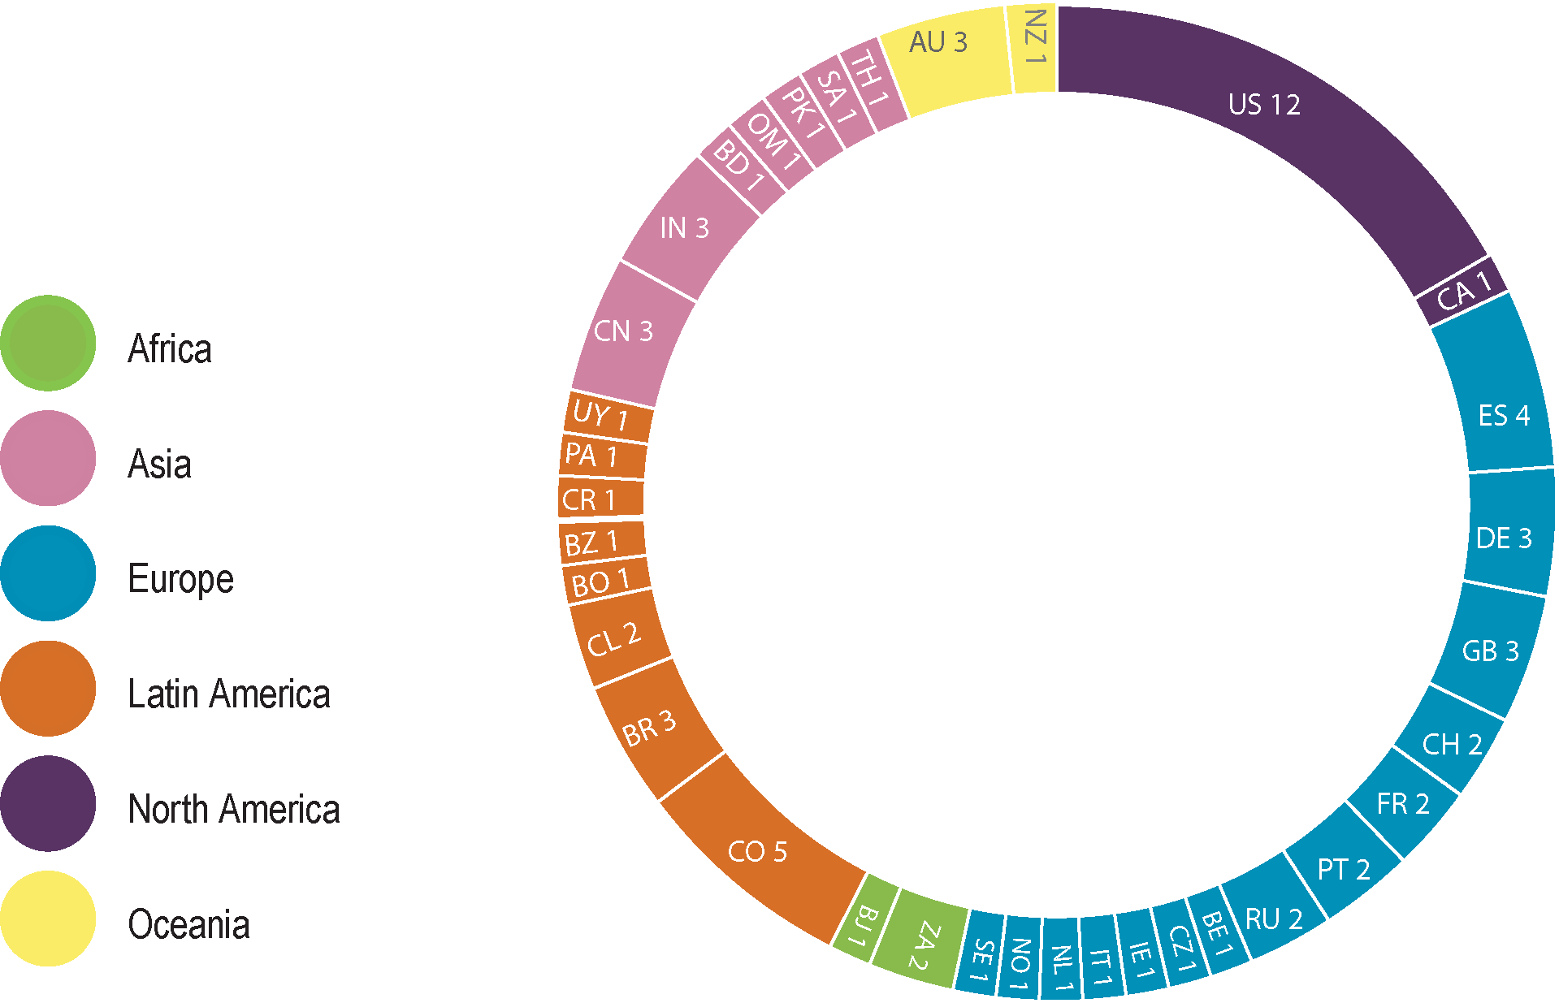
Use citations, by country of authors
research use
August 2015
August 2015
1. United States | 12 | 4. China | 3
2. Colombia | 5 | 4. Germany | 3
3. Spain | 4 | 4. India | 3
4. Australia | 3 | 4. United Kingdom | 3
4. Brazil | 3
Number of research publications in August 2015 citing use of
GBIF-mediated data, ranked by country according to affiliation of author.
Top nine countries shown.
Total 2015
1. United States | 109 | 6. Brazil | 22
2. United Kingdom | 50 | 6. China | 22
3. Germany | 28 | 8. Spain | 19
4. Mexico | 23 | 9. Colombia | 17
4. Australia | 23 | 10. Belgium | 16
Number of research publications from January to August 2015 citing use of GBIF-mediated data, ranked by country according to affiliation of author. Top ten countries shown.
2 SEP 2015

Slide 35
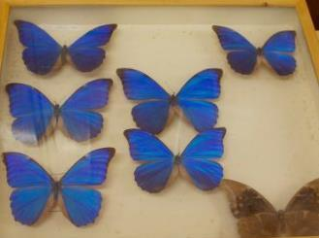
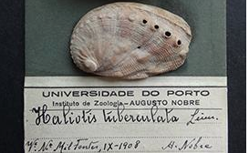
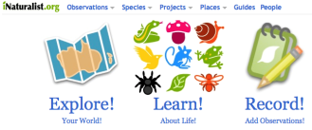
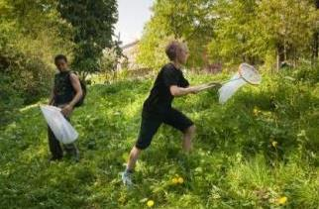
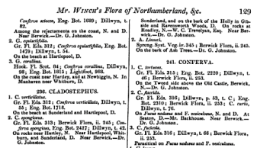
what
TYPES OF DATA SHARED THROUGH GBIF
Specimen data from museum collections
Citizen science observations
Records extracted from literature
NEW: Projects, surveys, expeditions: sample-based data
www.gbif.org

Slide 36
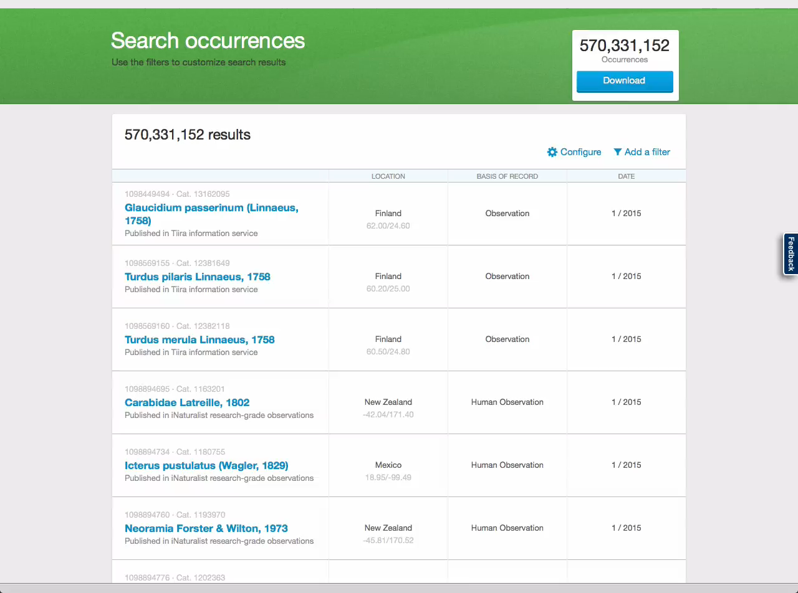
Notes:
Real time
Filters on Darwin Core terms
Live screen-capture to show the system’s performance
Passenger pigeon: once the most abundant bird in North America. Find earliest human observation.

Slide 37
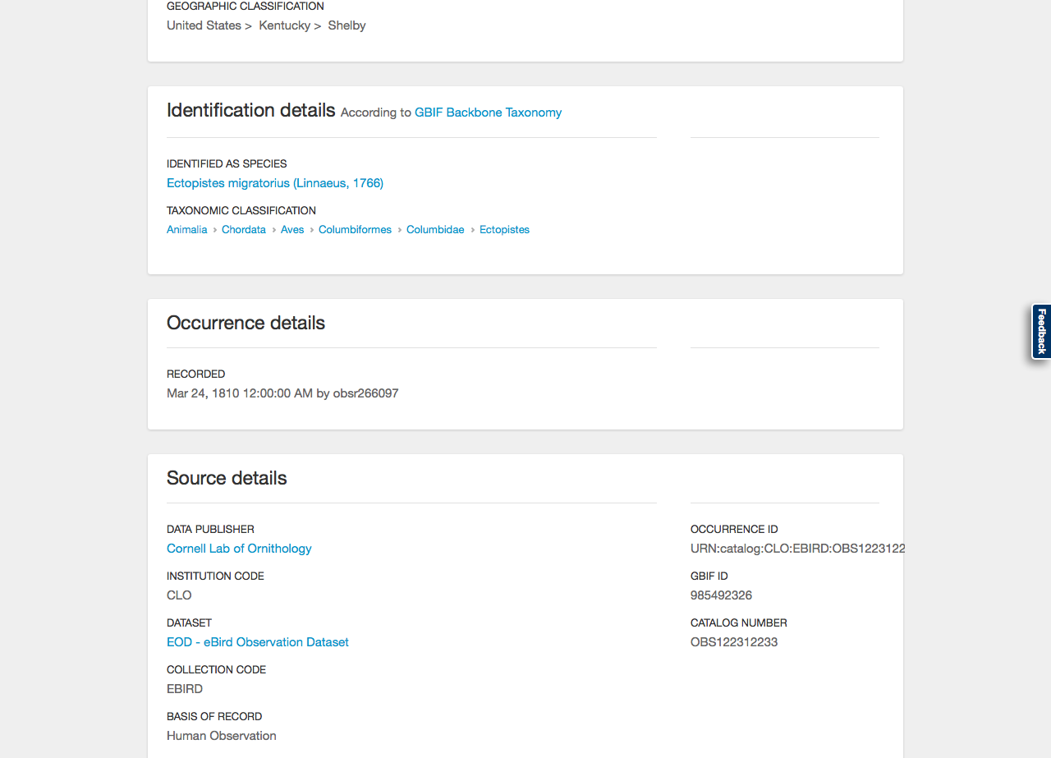

Slide 38
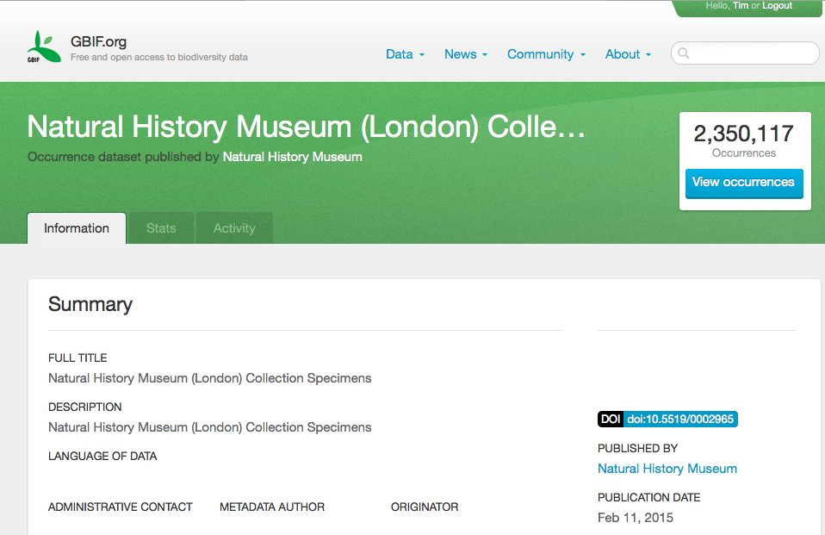
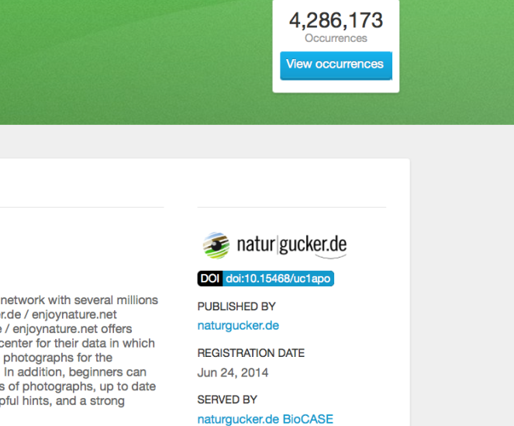
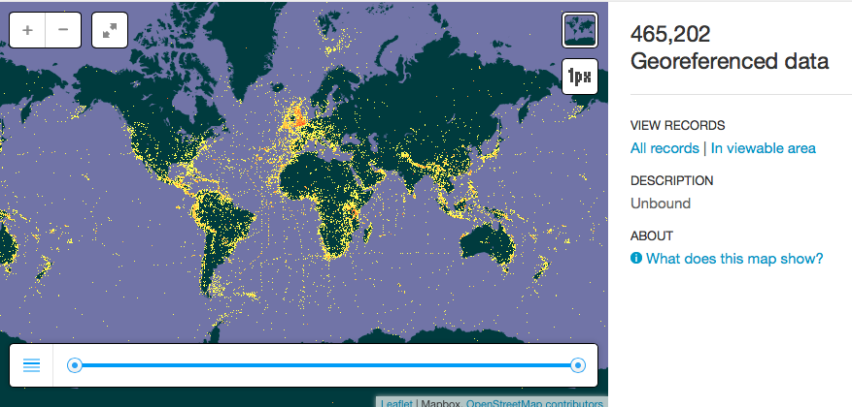
GBIF and digital object identifiers
DOIs
http://www.gbif.org/newsroom/news/ipt-release-supports-doi-citation

Slide 39
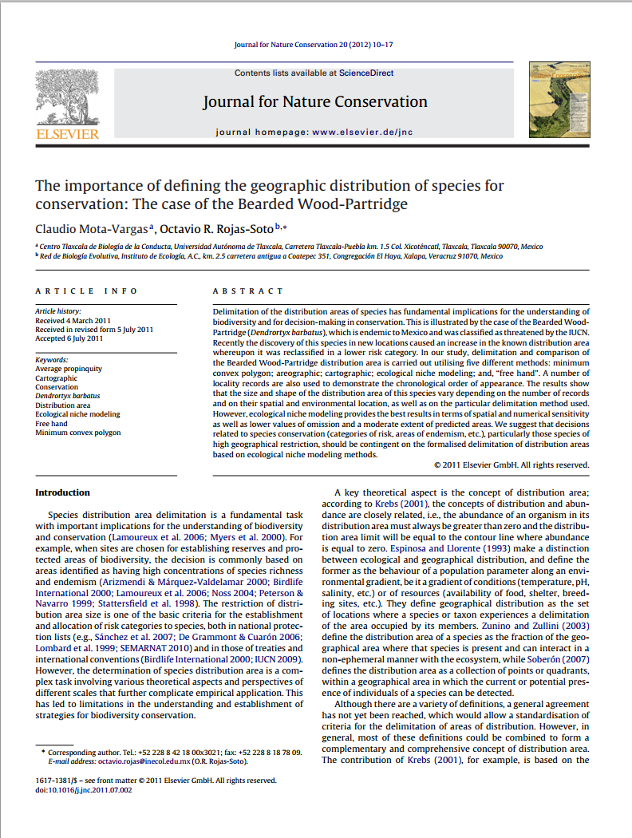

DOIs
GBIF and Digital Object Identifiers
DOI – Digital Object Identifier
Persistent resolvable identifiers
Standard for published papers
Simplify citing references
Used in measuring impact

Slide 40
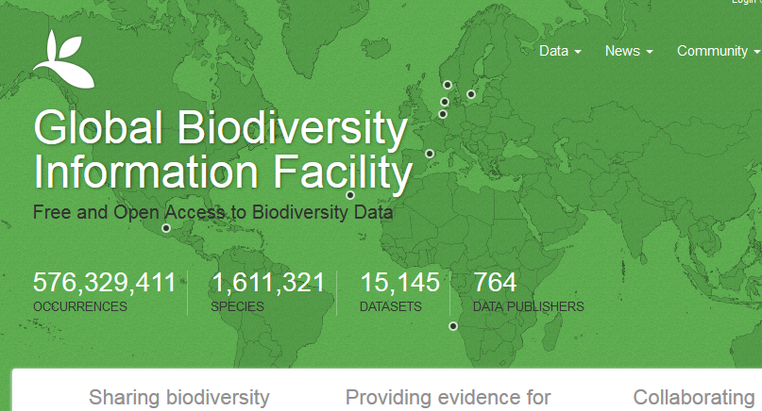
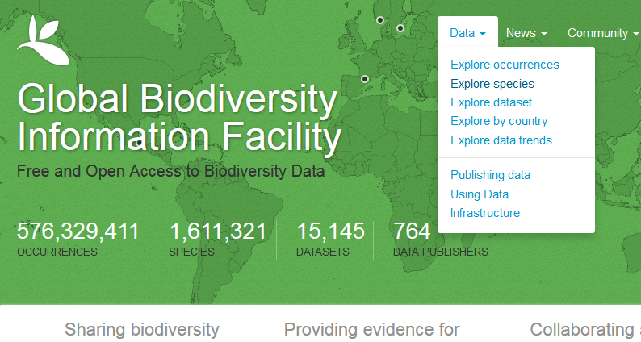
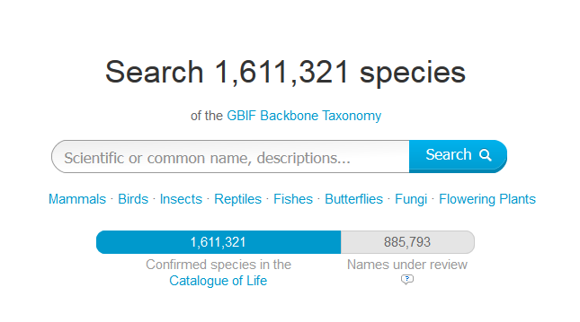
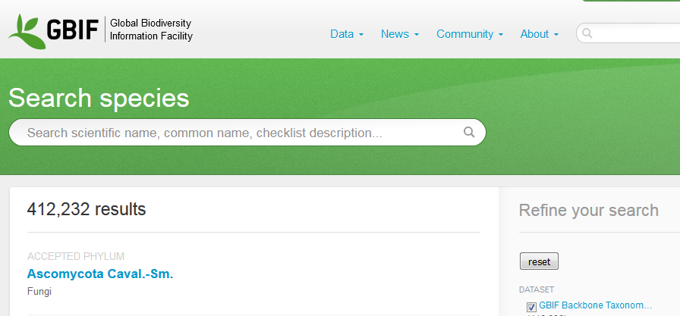
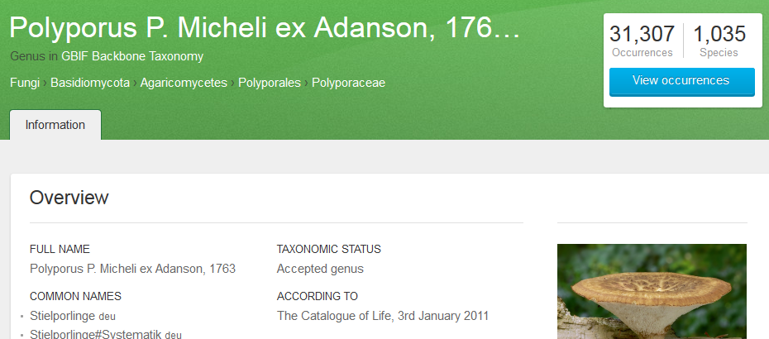
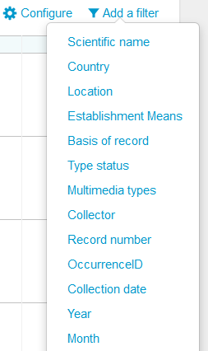
How to find things

Slide 41
Examples of data afterlife

Slide 42
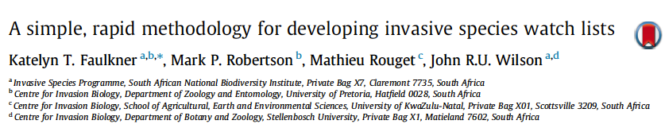

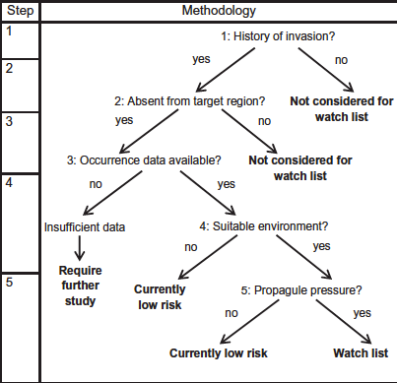

invasive alien species
INVASIVE SPECIES WATCH LISTS
20 million records for 884 species
GBIF & Global Invasive Species Database
Models of invasion success for SA:
env suitability & propagule pressure
Watch list of 400 potential invaders
Methodology applicable to any region
http://dx.doi.org/10.1016/j.biocon.2014.08.014

Slide 43
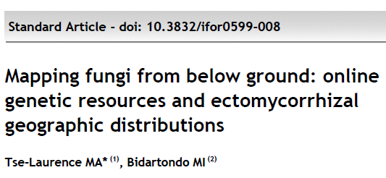

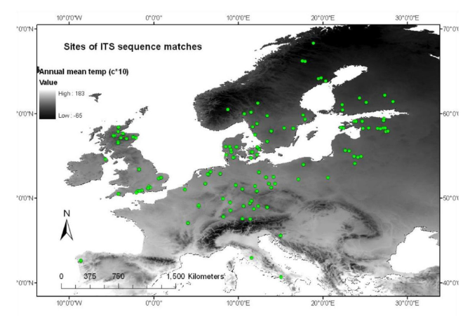
from below ground: genes & distributions
fungi
DNA sequences of 20 ectomycorrhizal fungal species
public DNA databases
species presence on maps
environmental layers and GIS
fungal samples from GBIF
uniform methodology for viable species distribution models for
ectomycorrhizas.
doi: 10.3832/ifor0599-008

Slide 44
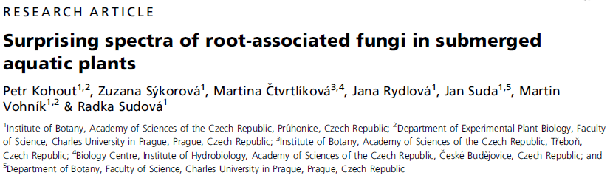

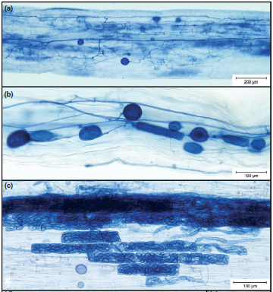
Surprises from root fungi in aquatic plants
fungi
Wide spectra of root-associated fungi
Little is known about fungal diversity in submerged roots
four oligotrophic freshwater lakes in Norway. Levels
41 fungal OTUs
Mucoromycotina, Chytridiomycota,
Glomeromycota, Ascomycota and Basidiomycota
new views on fungal diversity in aquatic environment
DOI: 10.1111/j.1574-6941.2011.01291.x

Slide 45
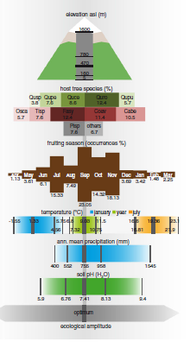
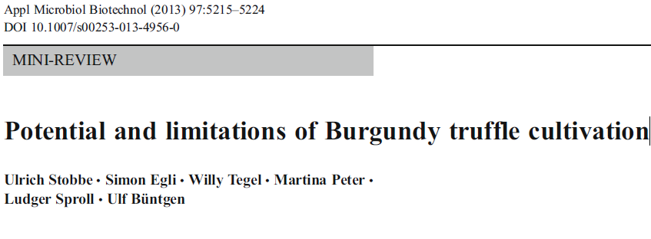
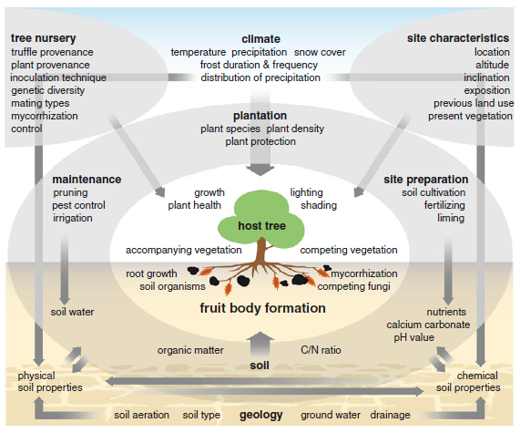
Burgundy truffle cultivation
fungi
Burgundy truffles highly prized
Artificial mycorrhization and outplanting of oaks and hazel
review ecological requirements, environmental factors, and molecular techniques
historical background and
current knowledge
socioeconomic relevance
DOI 10.1007/s00253-013-4956-0

Slide 46













partnerships
EXTERNAL ENGAGEMENT AND GLOBAL RELEVANCE
needs in globally aggregated data
Convention on Biological Diversity
data as indicator for Aichi Targets
Global Biodiversity Outlook
regional and national-level products
Intergovernmental platform on biodiversity & ecosystem services
GBIF as resource, observer and technical advisor
International Union
for Conservation of Nature
partnership to integrate data and knowledge products
www.gbif.org

Slide 47
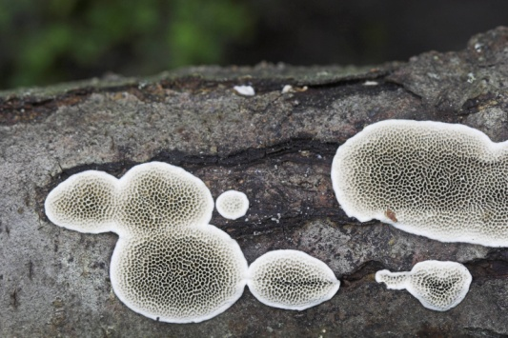
Thank you
and GBIF Secretariat: Kyle Copas & all
University of Helsinki:
Joona Lehtomäki, Hanna Koivula, Tapani Lahti
iDigBio: Deborah Paul
Open Science Training Initiative: Sophie Kay
Open Knowledge Finland & Open Science working group: Antti Poikola

